Slide 1
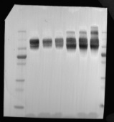
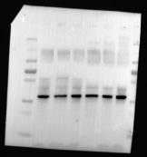
Full unedited gel for Figure 2D
185kd
185kd
UMOD
115kd
115kd
80kd
80kd
65kd
65kd
50kd
50kd
30kd
GAPDH
30kd
25kd
25kd
15kd
15kd

Slide 2
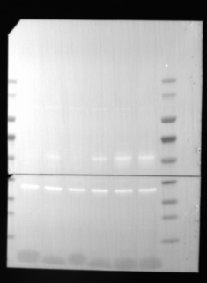
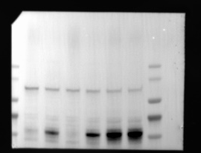
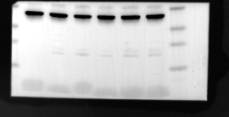
Full unedited gel for Figure 4A
140kd
115kd
80kd
p50ATF6α
65kd
50kd
40kd
30kd
GAPDH
25kd
15kd

Slide 3
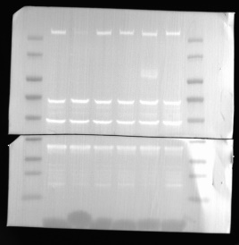
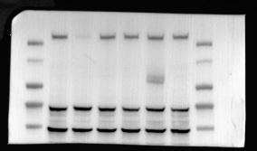
Full unedited gel for Figure 4A
140kd
115kd
80kd
65kd
ATF4
50kd
40kd
GAPDH
30kd
25kd
15kd

Slide 4
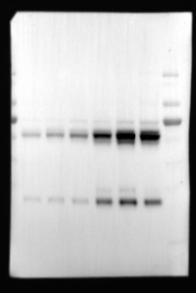
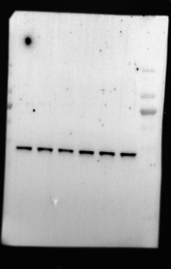
Full unedited gel for Figure 4A
140kd
140kd
115kd
115kd
80kd
80kd
65kd
65kd
XBP1s
50kd
50kd
40kd
GAPDH
40kd
30kd
30kd
25kd
25kd
15kd
15kd

Slide 5
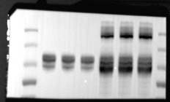
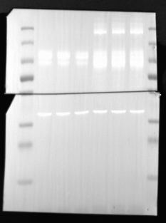
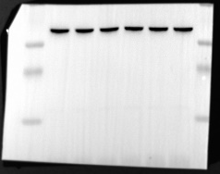
Full unedited gel for Figure 4I
185kd
UMOD
115kd
80kd
65kd
50kd
GAPDH
30kd
25kd
15kd

Slide 6
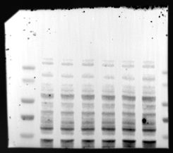
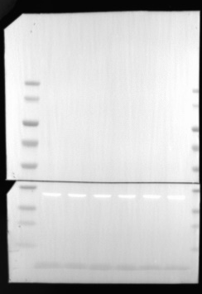
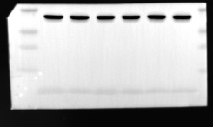
Full unedited gel for Figure 4K
140kd
115kd
80kd
65kd
p50ATF6α
50kd
GAPDH
40kd
30kd
25kd
15kd

Slide 7
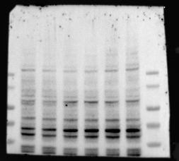
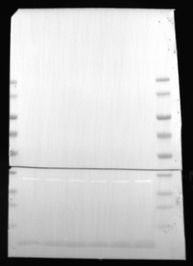
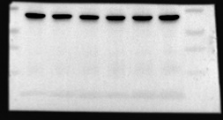
Full unedited gel for Figure 4K
140kd
115kd
80kd
XBP1s
65kd
50kd
40kd
GAPDH
30kd
25kd
15kd

Slide 8
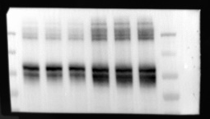
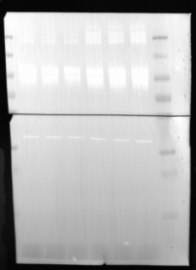
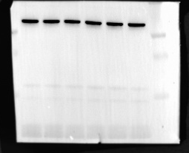
Full unedited gel for Figure 4N
185kd
115kd
UMOD
80kd
65kd
50kd
GAPDH
30kd
25kd
15kd

Slide 9
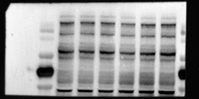
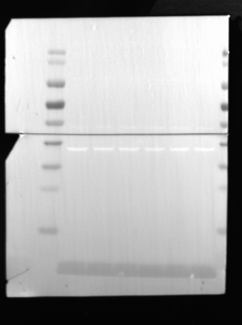
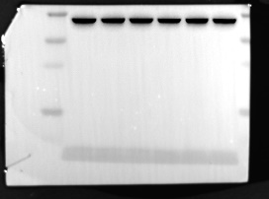
Full unedited gel for Figure 4P
140kd
115kd
80kd
65kd
p50ATF6α
50kd
GAPDH
40kd
30kd
25kd
15kd

Slide 10
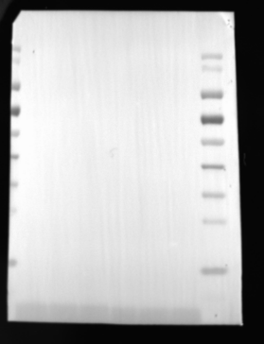
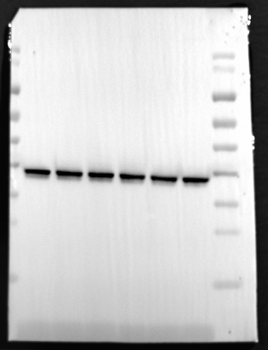
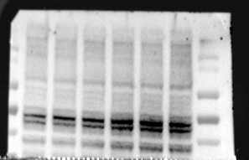
Full unedited gel for Figure 4P
140kd
115kd
80kd
65kd
140kd
50kd
115kd
80kd
GAPDH
40kd
XBP1s
65kd
30kd
50kd
25kd
15kd

Slide 11
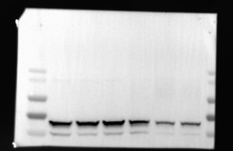
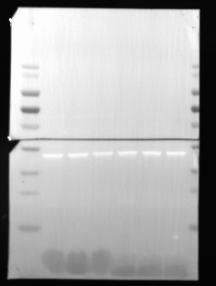
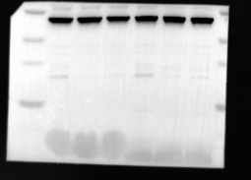
Full unedited gel for Figure 5B
140kd
115kd
80kd
SLC7A11
65kd
50kd
GAPDH
40kd
30kd
25kd
15kd

Slide 12
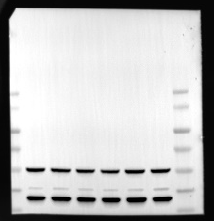
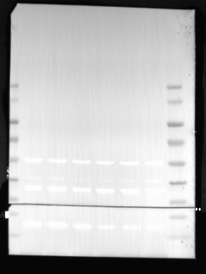
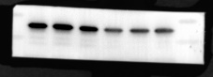
Full unedited gel for Figure 5B
140kd
115kd
80kd
65kd
50kd
40kd
GAPDH
30kd
FTH
25kd
15kd

Slide 13
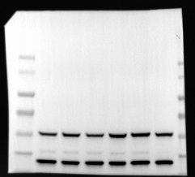
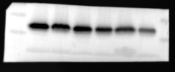
Full unedited gel for Figure 5B
140kd
115kd
80kd
65kd
50kd
GAPDH
40kd
30kd
GPX4
25kd
15kd

Slide 14
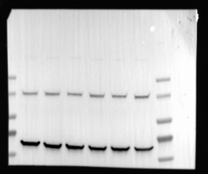
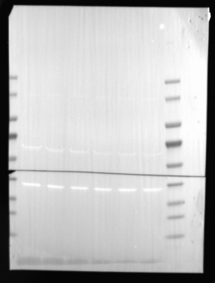
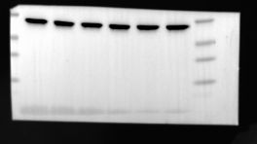
Full unedited gel for Figure 5K
140kd
115kd
80kd
SLC7A11
65kd
50kd
GAPDH
40kd
30kd
25kd
15kd

Slide 15
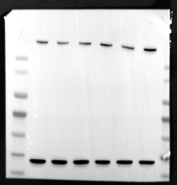
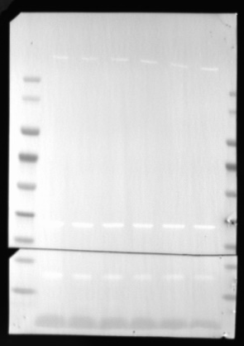
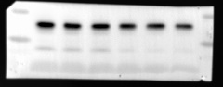
Full unedited gel for Figure 5K
140kd
115kd
80kd
65kd
50kd
GAPDH
40kd
30kd
FTH
25kd
15kd

Slide 16
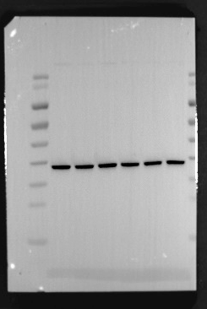
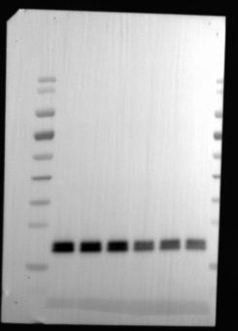
Full unedited gel for Figure 5K
140kd
115kd
80kd
65kd
50kd
GAPDH
GPX4
40kd
30kd
25kd
15kd

Slide 17
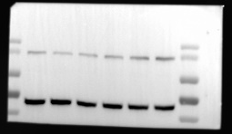
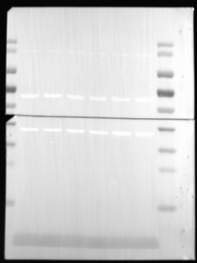
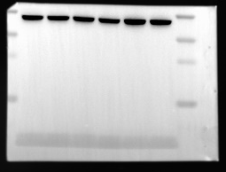
Full unedited gel for Figure 5O
140kd
115kd
80kd
SLC7A11
65kd
50kd
40kd
GAPDH
30kd
25kd
15kd

Slide 18
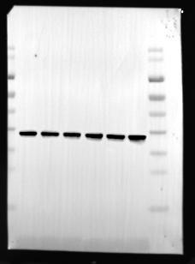
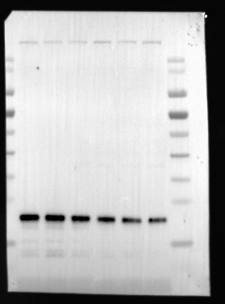
Full unedited gel for Figure 5O
140kd
140kd
115kd
115kd
80kd
80kd
65kd
65kd
50kd
50kd
GAPDH
40kd
40kd
30kd
30kd
25kd
25kd
FTH
15kd
15kd

Slide 19
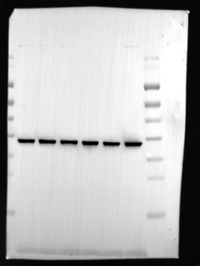
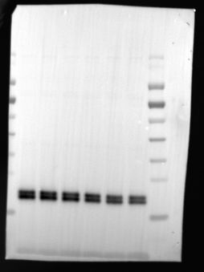
Full unedited gel for Figure 5O
140kd
140kd
115kd
115kd
80kd
80kd
65kd
65kd
50kd
50kd
GAPDH
40kd
40kd
30kd
30kd
25kd
25kd
GPX4
15kd
15kd

Slide 20



Full unedited gel for Figure 6C
140kd
115kd
HSPA1A
80kd
65kd
50kd
40kd
GAPDH
30kd
25kd
15kd

Slide 21



Full unedited gel for Figure 6F
140kd
115kd
80kd
HSPA1A
65kd
50kd
GAPDH
40kd
30kd
25kd
15kd

Slide 22



Full unedited gel for Figure 6F
185kd
115kd
UMOD
80kd
65kd
50kd
GAPDH
30kd
25kd
15kd

Slide 23



Full unedited gel for Figure 6F
140kd
115kd
80kd
65kd
p50ATF6α
50kd
GAPDH
40kd
30kd
25kd
15kd

Slide 24



Full unedited gel for Figure 6F
140kd
115kd
80kd
XBP1s
65kd
50kd
GAPDH
40kd
30kd
25kd
15kd

Slide 25



Full unedited gel for Figure 6K
140kd
115kd
HSPA1A
80kd
65kd
50kd
GAPDH
40kd
30kd
25kd
15kd

Slide 26



Full unedited gel for Figure 6K
185kd
115kd
UMOD
80kd
65kd
50kd
GAPDH
30kd
25kd
15kd

Slide 27



Full unedited gel for Figure 6K
140kd
115kd
80kd
65kd
p50ATF6α
50kd
GAPDH
40kd
30kd
25kd
15kd

Slide 28



Full unedited gel for Figure 6K
140kd
115kd
80kd
XBP1s
65kd
50kd
40kd
GAPDH
30kd
25kd
15kd

Slide 29



Full unedited gel for Figure 7B
140kd
115kd
HSPA1A
80kd
65kd
50kd
40kd
GAPDH
30kd
25kd
15kd

Slide 30



Full unedited gel for Figure 7B
185kd
115kd
UMOD
80kd
65kd
50kd
GAPDH
30kd
25kd
15kd

Slide 31



Full unedited gel for Figure 7B
140kd
115kd
80kd
65kd
p50ATF6α
50kd
40kd
GAPDH
30kd
25kd
15kd

Slide 32



Full unedited gel for Figure 7B
140kd
115kd
80kd
XBP1s
65kd
50kd
GAPDH
40kd
30kd
25kd
15kd

Slide 33



Full unedited gel for Figure 7G
140kd
115kd
HSPA1A
80kd
65kd
50kd
GAPDH
40kd
30kd
25kd
15kd

Slide 34



Full unedited gel for Figure 7G
185kd
115kd
UMOD
80kd
65kd
50kd
GAPDH
30kd
25kd
15kd

Slide 35



Full unedited gel for Figure 7G
140kd
115kd
80kd
65kd
p50ATF6α
50kd
GAPDH
40kd
30kd
25kd
15kd

Slide 36



Full unedited gel for Figure 7G
140kd
115kd
XBP1s
80kd
65kd
50kd
40kd
30kd
GAPDH
25kd
15kd

Slide 37



Full unedited gel for Figure 8B
140kd
115kd
80kd
HSPA1A
65kd
50kd
GAPDH
40kd
30kd
25kd
15kd

Slide 38
Full unedited gel for Figure 8B
185kd
115kd
UMOD
80kd
65kd
50kd
GAPDH
30kd
25kd
15kd

Slide 39



Full unedited gel for Figure 8B
140kd
115kd
80kd
65kd
p50ATF6α
50kd
GAPDH
40kd
30kd
25kd
15kd

Slide 40


Full unedited gel for Figure 8B
140kd
140kd
115kd
115kd
80kd
65kd
80kd
XBP1s
50kd
65kd
40kd
50kd
30kd
GAPDH
40kd
25kd
30kd
25kd
15kd
15kd

Slide 41



Full unedited gel for Figure 9A
140kd
115kd
80kd
SLC7A11
65kd
50kd
GAPDH
40kd
30kd
25kd
15kd

Slide 42



Full unedited gel for Figure 9A
GAPDH
140kd
115kd
80kd
65kd
50kd
40kd
30kd
25kd
FTH
15kd

Slide 43



Full unedited gel for Figure 9A
140kd
115kd
80kd
65kd
50kd
GAPDH
40kd
30kd
25kd
GPX4
15kd

Slide 44


Full unedited gel for Figure 9E
140kd
115kd
80kd
SLC7A11
65kd
50kd
GAPDH
40kd
30kd
25kd
15kd

Slide 45


Full unedited gel for Figure 9E
140kd
115kd
140kd
80kd
115kd
65kd
80kd
65kd
50kd
50kd
40kd
40kd
30kd
GAPDH
25kd
30kd
25kd
FTH
15kd
15kd

Slide 46



Full unedited gel for Figure 9E
140kd
115kd
80kd
65kd
50kd
GAPDH
40kd
30kd
GPX4
25kd
15kd

Slide 47



Full unedited gel for Figure 9M
140kd
115kd
80kd
SLC7A11
65kd
50kd
40kd
GAPDH
30kd
25kd
15kd

Slide 48



Full unedited gel for Figure 9M
140kd
115kd
80kd
65kd
50kd
GAPDH
40kd
30kd
25kd
FTH
15kd

Slide 49



Full unedited gel for Figure 9M
140kd
115kd
80kd
65kd
50kd
GAPDH
40kd
30kd
25kd
GPX4
15kd

Slide 50

Full unedited gel for Supplemental Figure 4B
140kd
115kd
80kd
65kd
SLC7A11
50kd
40kd
GAPDH
30kd
25kd
15kd

Slide 51


Full unedited gel for Supplemental Figure 4B
140kd
140kd
115kd
115kd
80kd
80kd
65kd
65kd
50kd
50kd
40kd
40kd
GAPDH
30kd
30kd
25kd
25kd
FTH
15kd
15kd

Slide 52


Full unedited gel for Supplemental Figure 4B
140kd
140kd
115kd
115kd
80kd
80kd
65kd
65kd
50kd
50kd
40kd
40kd
GAPDH
30kd
30kd
25kd
25kd
GPX4
15kd
15kd

