Slide 1
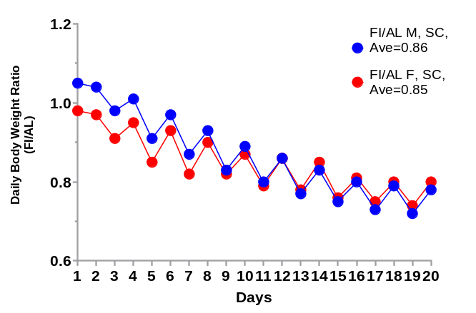
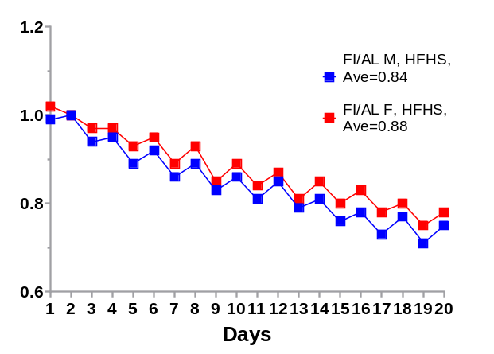
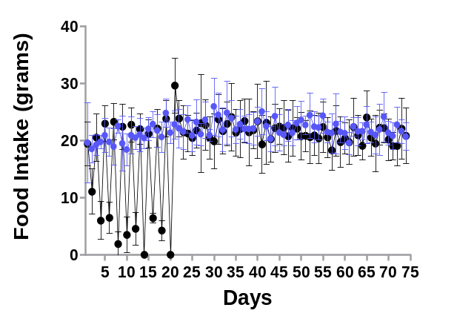
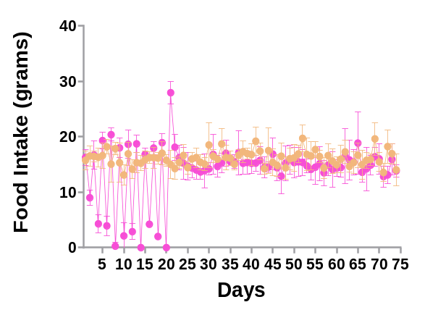
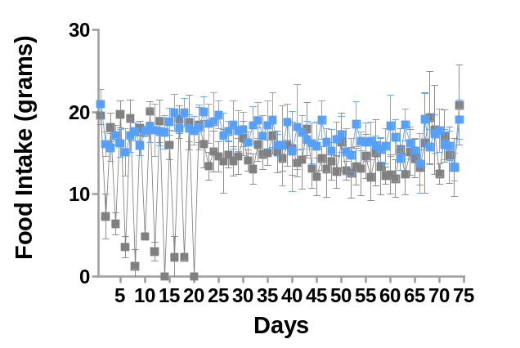
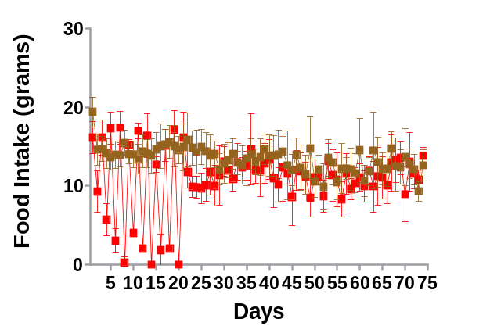
Supplemental Figure 1
A
B
Daily Body Weight Ratio
(FI/AL)
Daily Body Weight Ratio
(FI/AL)
0.74
0.75
0.72
0.71
Days
Days
C
D
AL F, SC
P (adj.) ≤0.05, after FI period
Day 21
AL M, SC
P (adj.) ≤0.05, after FI period
Day 21
FI F, SC
FI M, SC
Food Intake (grams)
Days
E
F
P (adj.) ≤0.05, after FI period
Day 23, 25,31,32
AL M, HFHS
P (adj.) ≤0.05, after FI period
Day 25, 28
AL F, HFHS
FI M, HFHS
FI F, HFHS
Food Intake (grams)
Food Intake (grams)
Days
Days

Slide 2
Supplemental Figure 1. Changes in body weight and food intake
during protocols 1 and 2. (A) Body weight changes in male (M)
and female (F) rats during the FI intervention period in protocol 1
(standard chow (SC) diet-feeding). (B) Body weight changes in male
(M) and female (F) rats during the FI intervention period in protocol
2 (high fat/high sucrose (HF/HS) diet-feeding). In both plots,
numbers shown at day 19 represent the ratio of body weights of rats
on the FI protocol relative to those fed AL. (C) Food
intake in grams in male rats during protocol 1 (SC diet); (D) Food intake in
grams in female rats in protocol 1 (SC diet). (E) Food intake in
grams in male rats in protocol 2 (HF/HS diet); (F) Food intake in
grams in female rats in protocol 2 (HF/HS diet). For panels C
through F, data are the mean ± standard error of the mean (SEM)
for 6 animals in each group, with statistical analysis performed
using mixed models for repeated measures as described in
Methods. Time points at which there were significant differences
in the AL group compared to the FI group, with adjusted p<0.05, are
indicated by text in each figure panel.

Slide 3
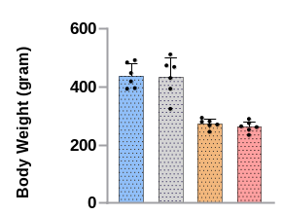
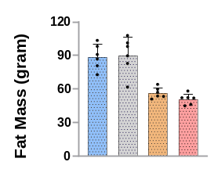
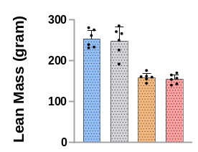
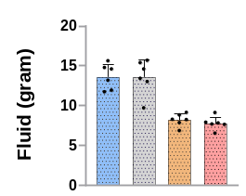
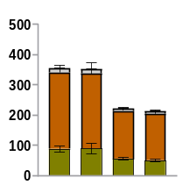
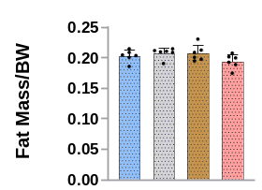
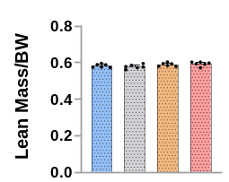
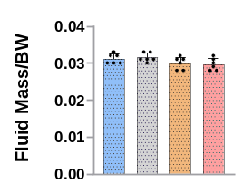
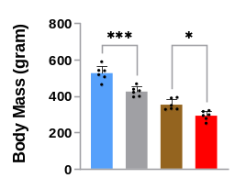
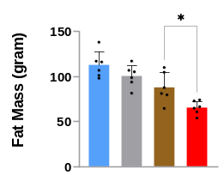
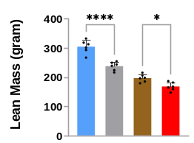
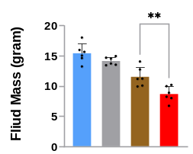
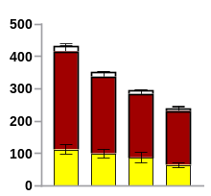
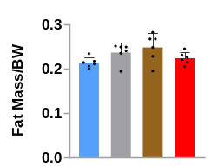
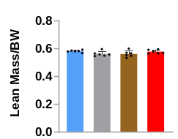
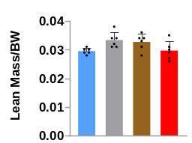
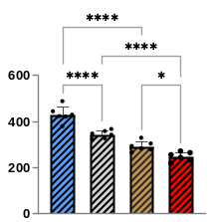
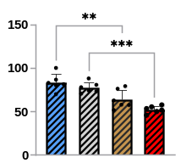
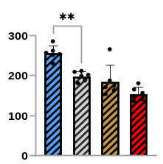
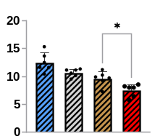
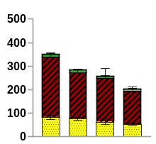
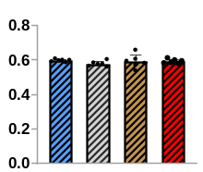
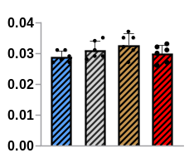
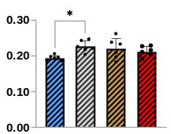
Supplemental Figure 2
A
B
C
D
Body Mass (grams)
Fat Mass (grams)
Lean Mass (grams)
Fluid Mass (grams)
AL
AL
FI
AL
FI
AL
FI
AL
FI
AL
FI
FI
AL
AL
FI
Termination, SC
M
F
FI
M
F
M
F
E
F
M
F
G
H
Fluid
Lean
Body Composition
(grams)
Fat
Fat Mass/ Body Mass
Lean Mass/ Body Mass
Fluid Mass/ Body Mass
AL
AL
FI
FI
AL
AL
FI
AL
FI
AL
FI
AL
FI
AL
FI
M
F
FI
M
F
M
F
M
F
I
J
K
L
Body Mass (grams)
Fat Mass (grams)
Lean Mass (grams)
Fluid Mass (grams)
AL
AL
FI
AL
FI
AL
FI
AL
FI
AL
FI
AL
FI
AL
FI
Termination, HFHS
FI
M
F
M
F
M
F
M
F
M
Fluid
N
P=0.052
O
P
Lean
Body Composition
(grams)
Fat
Lean Mass/ Body Mass
Fluid Mass/ Body Mass
Fat Mass/ Body Mass
AL
AL
FI
AL
FI
AL
FI
FI
AL
AL
FI
FI
AL
AL
FI
M
F
M
F
M
F
FI
M
F
Q
R
S
T
Body Mass (grams)
Fat Mass (grams)
Lean Mass (grams)
Fluid Mass (grams)
Day 50, HFHS
AL
AL
FI
AL
FI
AL
FI
FI
AL
AL
FI
AL
FI
AL
FI
M
F
FI
M
F
M
F
U
V
M
F
W
X
Fluid
Lean
Body Composition
(grams)
Fat
Fat Mass/ Body Mass
Lean Mass/ Body Mass
Fluid Mass/ Body Mass
AL
AL
FI
FI
AL
AL
FI
FI
AL
AL
FI
AL
FI
AL
FI
M
F
FI
M
F
M
F
M
F

Slide 4
Supplemental Figure 2. Effects of FI on body composition in
male and female rats. Rats from protocol 1, SC diet-feeding,
at sacrifice/termination (panels A-H). Rats from protocol 2,
HF/HS diet feeding, at sacrifice/termination (panels I-P). Rats from
Protocol 2, HF/HS diet feeding, at day 50 of the protocol (panels
Q-X) were analyzed for body composition by TD-NMR. Data are
mean values ± SEM for 6 animals in each experimental group.
Statistical analyses performed using one-way ANOVA followed
by Tukey test. Asterisks indicate differences between groups with
*Adjusted p<0.05, ** Adjusted p<0.01, *** Adjusted p <0.001,
and **** Adjusted p<0.0001.

Slide 5
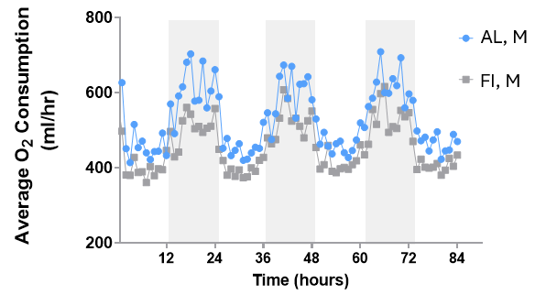
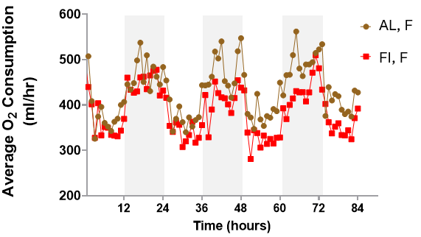
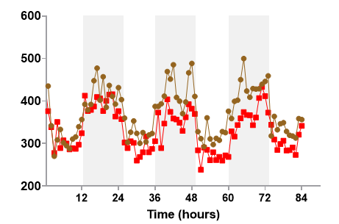
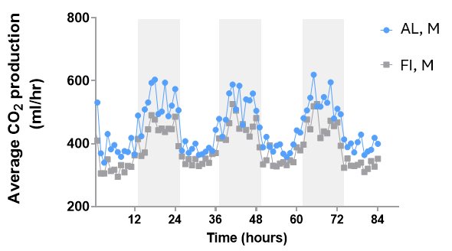
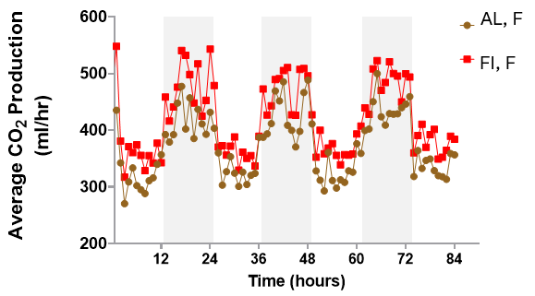
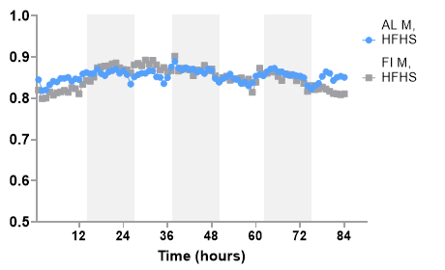
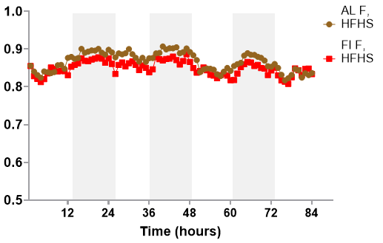
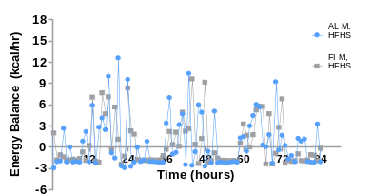
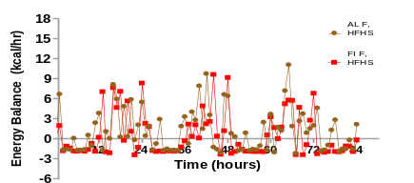
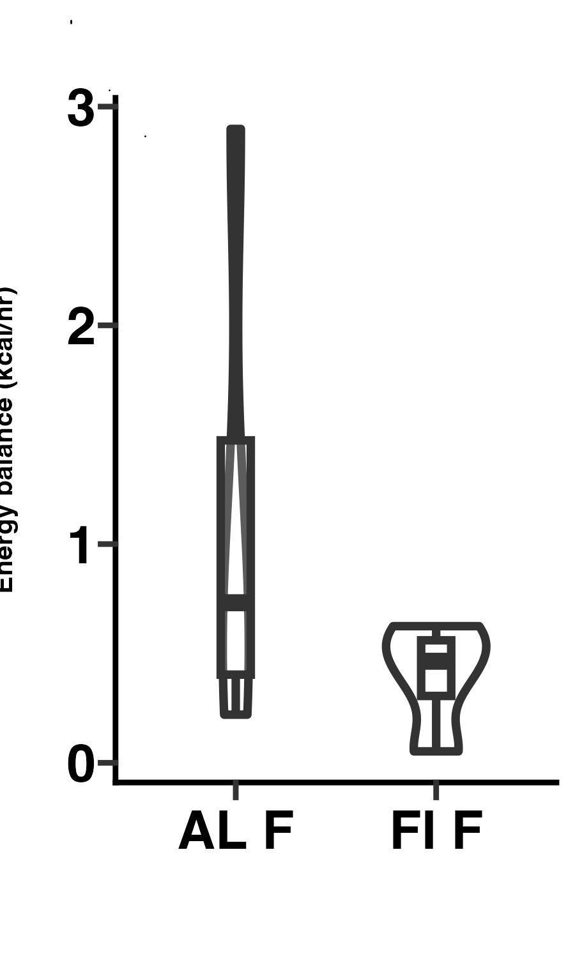
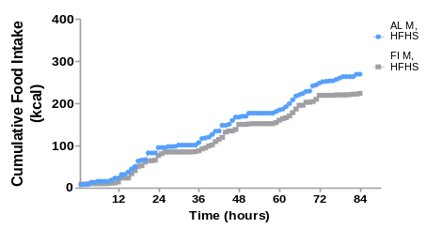
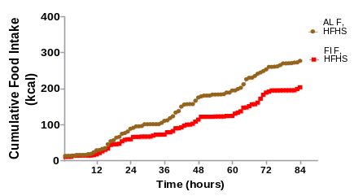
Supplemental Figure 3
A
B
0.037
C
D
0.11
O₂ Consumption
(ml/hr)
O₂ Consumption
(ml/hr, average)
O₂ Consumption
(ml/hr)
O₂ Consumption
(ml/hr, average)
E
F
0.043
G
H
0.038
CO₂ Production
(ml/hr)
CO₂ Production
(ml/hr, average)
CO₂ Production
(ml/hr)
CO₂ Production
(ml/hr, average)
I
J
0.72
K
L
0.89
AL, M
AL, F
FI, M
RER
(average)
FI, F
RER
RER
RER
(average)
M
N
0.40
O
P
AL, M
0.31
Energy Balance
(kcal/hr)
FI, M
AL, M
FI, M
Energy Balance
(kcal/hr, average)
Energy Balance
(kcal/hr)
Energy Balance
(kcal/hr, average)
Q
R
0.18
S
T
0.19
AL, M
AL, F
Cumulative food
Intake (kcal)
FI, M
Cumulative food
Intake (kcal)
FI, F
Cumulative food intake
(kcal, average)
Cumulative food intake
(kcal, average)

Slide 6
Supplemental Figure 3. Effects of FI intervention on oxygen
consumption, CO₂ production, respiratory exchange
ratio (RER), energy balance, and food intake. Rats from protocol 2
(HF/HS diet-fed) were placed in Promethion (Sable) metabolic cages for
noninvasive analysis of respiration and physical activity. (A) Oxygen
consumption in dark (dark-shaded) and light (unshaded) measurement
periods in FI compared to AL male rats; (B) Average oxygen consumption
across full days in FI compared to AL male rats; (C) Oxygen consumption
in dark (dark-shaded) and light (unshaded) measurement periods
in FI compared to AL female rats; (D) Average oxygen consumption
across full days in FI compared to AL female rats; (E) CO₂
production in dark (dark-shaded) and light (unshaded)
measurement periods in FI compared to AL male rats; (F) Average
CO₂ production across full days in FI compared to AL male rats;
G) CO₂ production in dark (dark-shaded) and light (unshaded)
measurement periods in FI compared to AL female rats; (H) Average
CO₂ production across full days in FI compared to AL female rats;
(I) RER in dark (dark-shaded) and light (unshaded) measurement
periods in FI compared to AL male rats; (J) Average RER across full
days in FI compared to AL male rats; (K) RER in dark (dark-shaded)
and light (unshaded) measurement periods in FI compared to AL
female rats; (L) Average RER across full days in FI compared to
female rats. (M) Energy balance in dark (dark-shaded) and light
(unshaded) measurement periods in FI compared to AL male
rats; (N) Average Energy balance across full days in FI compared to
male rats. (O) Energy balance in dark (dark-shaded) and light
(unshaded) measurement periods in FI compared to AL female
rats; (P) Average energy balance across full days in FI compared to
female rats. RER and energy balance were calculated using CalR. (Q)
Cumulative food intake across 4-day measurement period in dark (dark-
shaded) and light (unshaded) measurement periods in male FI and AL rats;
(R) Average cumulative food intake for 4 day period, male rats. (S)
Cumulative food intake across 4-day measurement for female FI and AL
rats; (T) Average cumulative food intake for 4 day period, female rats.
Levels of significance indicated for average measurements were
determined using unpaired t-tests.

Slide 7
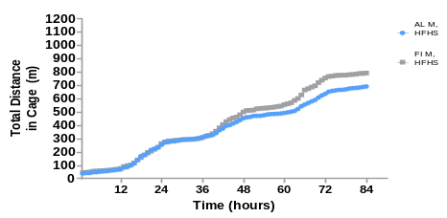
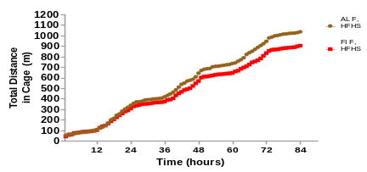
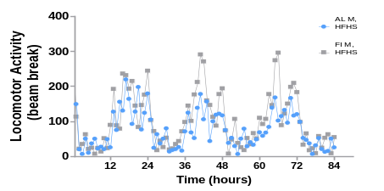
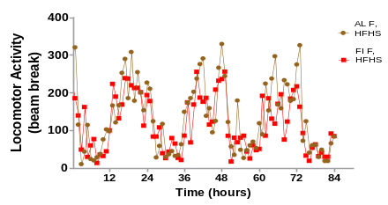
Supplemental Figure 4
A
B
C
D
AL, M
0.72
AL, F
0.62
Total Distance
in Cage (m)
FI, M
Total Distance
in Cage (m)
FI, F
Total Distance in Cage
(m, average)
Total Distance in Cage
(m, average)
E
F
G
H
0.43
0.59
AL, M
AL, F
FI, M
Locomotor Activity
(beam break)
FI, F
Locomotor Activity
(beam break)
Locomotor Activity
(beam break, average)
Locomotor Activity
(beam break, average)

Slide 8
Supplemental Figure 4. Effects of FI intervention on physical
activity. Rats from protocol 2 (HF/HS diet-feeding) were placed in
Promethion (Sable) metabolic cages for noninvasive analysis of
physical activity. (A) Physical activity expressed as cumulative
distance traveled in dark (dark-shaded) and light (unshaded)
measurement periods in male FI and AL rats; (B) Average distance
traveled/full day in FI compared to AL male rats. (C) Physical activity
expressed as cumulative distance traveled in dark (dark-shaded)
and light (unshaded) measurement periods in female FI and AL rats;
(D) Average distance traveled/full day in FI compared to AL female
rats. (E) Physical activity measured by average beam breaks in
dark (dark-shaded) and light (unshaded) measurement periods
in male FI and AL rats; (F) Average beam breaks/full day in FI
compared to AL male rats. (G) Physical activity measured by
average beam breaks in dark (dark-shaded) and light (unshaded)
measurement periods in female FI and AL rats; (H) Average beam
breaks/full day in FI compared to AL female rats. Data were analyzed
with CalR software (9) with 4 rats per experimental group. For
panels B, D, F, and H, statistical analyses were performed
using unpaired t-tests.

Slide 9
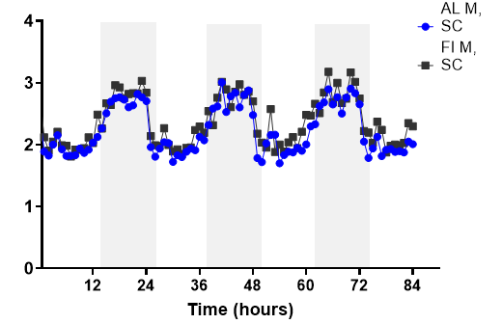
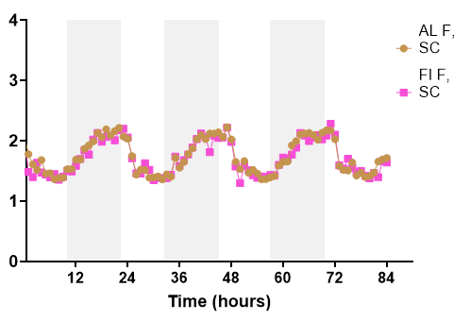
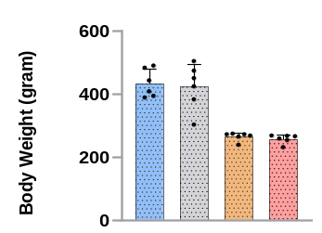
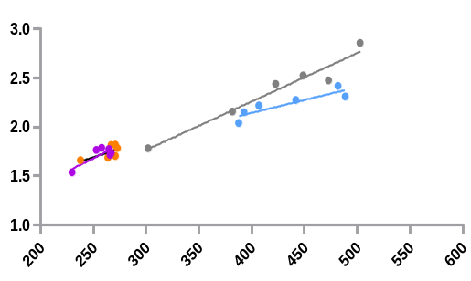






Supplemental Figure 5
A
B
C
D
0.42
0.61
Energy Expenditure
(kcal/hr)
Energy Expenditure
(kcal/hr, average)
Energy Expenditure
(kcal/hr)
Energy Expenditure
(kcal/hr, average)
E
F
_{Total Energy Expenditure}
_{(kcal)}
AL M, R²=0.7989
Total Energy Expenditure
(kcal/hr)
FI M, R²=0.9497
Body Weight (grams)
AL F, R²=0.4258
FI F, R²=0.6769
AL
AL
FI
FI
M
F
Weight (Time of Day: Total)
Mass (Time of Day: Total)
G
H
I
J
0.39
0.36
Cumulative Food Intake
(kcal)
Cumulative Food Intake
(kcal, average)
Cumulative Food Intake
(kcal)
Cumulative Food Intake
(kcal, average)
K
L
M
N
0.41
0.28
Total Distance in Cage
(m)
Total Distance in Cage
(m, average)
Total Distance in Cage
(m)
Total Distance in Cage
(m, average)
O
P
Q
R
0.68
0.16
Locomotor Activity
(beam break)
Locomotor Activity
(beam break, average)
Locomotor Activity
(beam break, average)
Locomotor Activity
(beam break)
200
100
AL F
FI F

Slide 10
Supplemental Figure 5. Effects of FI intervention on physiologic
outcomes in Protocol 1 rats (SC diet-fed). Rats from protocol 1
(SC diet-feeding) were placed in Promethion metabolic cages for
noninvasive analysis of respiration and physical activity. (A) Energy
expenditure in dark (dark-shaded) and light (unshaded)
measurement periods in FI compared to AL male rats; (B) Average
energy expenditure across full days in FI compared to AL male rats.
(C) Energy expenditure in dark (dark-shaded) and light (unshaded)
measurement periods in FI compared to AL female rats; (D) Average
energy expenditure across full days in FI compared to AL female
rats; (E) Average body weights of male (M) and female (F) rats
at the end of the 7-day cage period. (F) Energy expenditure
normalized to body weights in male and female FI and AL rats. (G)
Cumulative food intake across 4-day measurement period in dark
(dark-shaded) and light (unshaded) measurement periods in male FI
and AL rats; (H) Average cumulative food intake for 4 day period,
male rats. (I) Cumulative food intake across 4-day measurement
period in dark (dark-shaded) and light (unshaded) measurement
periods for female FI and AL rats; (J) Average cumulative food intake
for 4 day period, female rats. (K) Physical activity expressed as
distance traveled in dark (dark-shaded) and light (unshaded)
measurement periods in male FI and AL rats; (L) Average distance
traveled/full day in FI compared to AL male rats. (M) Physical
activity expressed as distance traveled in dark (dark-shaded) and
light (unshaded) measurement periods in female FI and AL rats;
(N) Average distance traveled/full day in FI compared to AL female
rats. (O) Physical activity measured by average beam breaks in dark
(dark-shaded) and light (unshaded) measurement periods in male FI
and AL rats; (P) Average beam breaks/full day in FI compared to AL
male rats. (Q) Physical activity measured by average beam breaks
in dark (dark-shaded) and light (unshaded) measurement periods in
female FI and AL rats; (R) Average beam breaks/full day in FI
compared to AL female rats. Levels of significance indicated for
average measurements were determined using unpaired t-tests.
ANOVA and ANCOVA tests were used for panels E and F,
respectively, with no significant differences found between groups.

Slide 11





Supplemental Figure 6
A
*
*
*
*
*
*
*
*
*
*
AL, Male
FI, Male
AL, Female
FI, Female
Prior to FI
End of FI
1 Wk after FI
3 Wk after FI
5 Wk after FI
Termination
B
C
D
*
*
*
AL, Male
AL, Male
AL, Male
FI, Male
FI, Male
FI, Male
AL, Female
AL, Female
AL, Female
FI, Female
FI, Female
FI, Female
Prior to FI
End of FI
End of FI
Termination
Prior to FI
1 Wk after FI
3 Wk after FI
5 Wk after FI
End of FI
5 Wk after FI
Termination
Termination
3 Wk after FI
Prior to FI
3 Wk after FI
1 Wk after FI
1 Wk after FI
5 Wk after FI

Slide 12
Supplemental Figure 6. Effects of FI intervention on plasma
metabolites in rats across the timespan of protocol 2.
Plasma samples were obtained before and immediately after
the 20-day FI intervention period, at indicated intervals thereafter,
and at sacrifice from rats in protocol 2 (HF/HS diet-fed).
(A) Amino acids measured by flow injection tandem
mass spectrometry (MS/MS); (B) Branched-chain ketoacids
measured by liquid chromatography-mass spectrometry (LC-MS);
(C) 3-hydroxyisobutryate (3-HIB) and 2-hydroxybutyrate (2-HB)
measured by LC-MS; (D) C2 (acetyl) acylcarnitine measured by
flow injection MS/MS. Heatmaps of metabolites from 6 animals per
experimental group were generated using Morpheus software
(https://software.broadinstitute.org/morpheus). Statistical
analyses were performed as described in Methods. Pink asterisks
indicate differences in the AL group compared to the FI group for
both males and females, with adjusted p<0.05. The blue asterisk
indicates a difference in the AL group compared to the FI group for
females only, with adjusted p<0.05.

Slide 13










Supplemental Figure 7
A
AL, Male
FI, Male
AL, Female
FI, Female
+
+
+
+
+
+
+
+
+
+
+
+
+
+
+
+
+
B
AL, Male
FI, Male
AL, Female
FI, Female
+
+
+
+
+
+
+
+
+
+
+
*
+
*
+
+
+
+
+
+
+
+
C
D
E
AL, Male
AL, Male
AL, Male
FI, Male
FI, Male
FI, Male
AL, Female
AL, Female
AL, Female
FI, Female
FI, Female
FI, Female
3-HIB
2-HB
KIV
3-HB
KIC
KMV
+
*
+
+
+
+
*

Slide 14
Supplemental Figure 7. Effects of FI intervention on liver
metabolites in rats from protocols 1 and 2. Liver samples were
obtained at sacrifice from rats in protocol 1 (SC diet-fed) or protocol
2 (HF/HS diet-fed) and subjected to metabolomics analyses. (A)
Acyl carnitines measured in livers of rats from protocol 1 (SC diet-
fed); (B) Biogenic amines measured by liquid chromatography-
mass spectrometry (LC-MS) in livers of rats from protocol 2 (HF/HS diet-
fed); (C) Branched-chain ketoacids measured by LC-MS in rats from
protocol 2 (HF/HS diet-fed); (D) 3-hydroxyisobutryate (3-HIB),
2-hydroxybutyrate (2-HB) and 3-hydroxybutyrate (3-HB) measured by
LC-MS in rats from protocol 2 (HF/HS diet-fed); (E) Organic acids
measured by LC-MS in rats from protocol 2 (HF/HS diet-fed). Heatmaps
of metabolites from 6 animals per experimental group were generated
using Morpheus software (https://software.broadinstitute.org/morpheus).
Statistical analyses were performed as described in Methods. Green
pluses indicate differences between all male compared to all female
rats with adjusted p<0.05. Blue asterisks indicate differences in the AL
group compared to the FI group for females, with adjusted p<0.05. Green
asterisks indicate differences in the AL group compared to the FI group
for males, with adjusted p<0.05.

