Slide 1
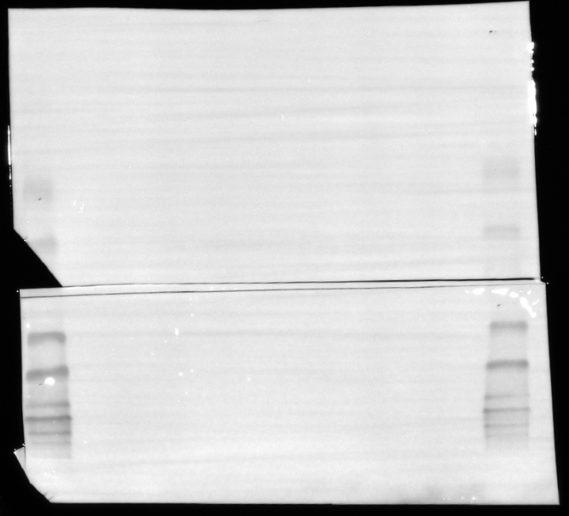
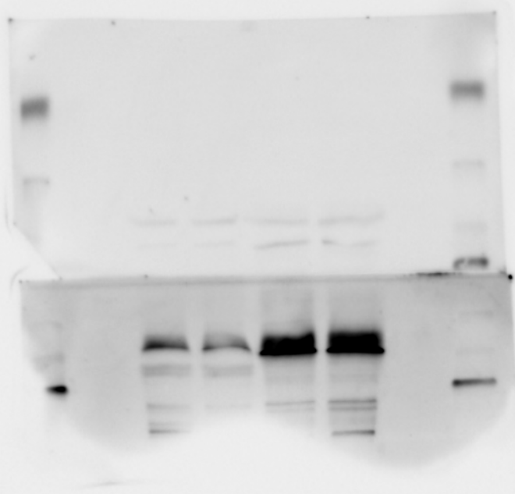
Full unedited gel for Figure 3C
(and Supp. Fig. 6)
Anti SKP2
1 2 3 4
----15
----20
----25
----37
SKP2 (48kDa)
----50
----75
----100
----150
----250
Line 1: Soft_control_3-1 – Lane used in figure
Line 2: Soft_Erastin_3 – Lane used in figure
Line 3: Stiff_control_3-1 – Lane used in figure
Line 4: Stiff_Erastin_3 – Lane used in figure

Slide 2
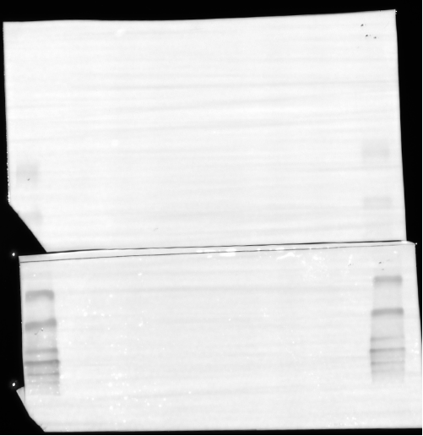
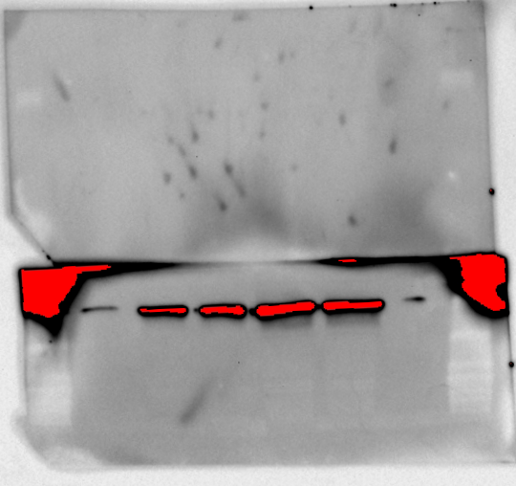
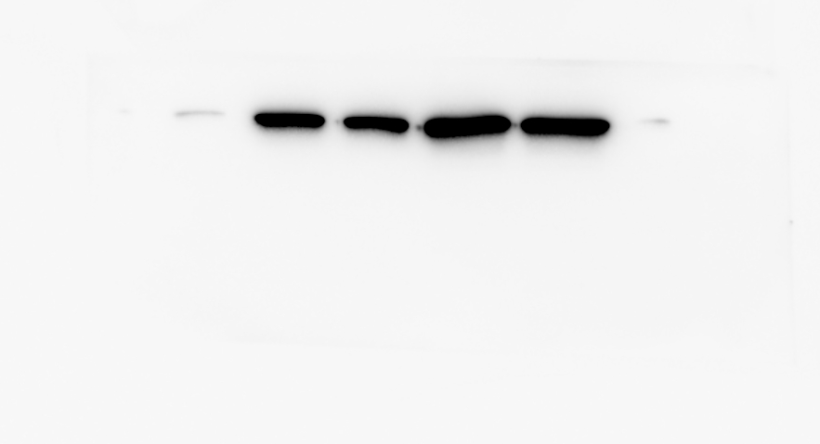
Full unedited gel for Figure 3C
(and Supp. Fig. 6)
----15
----20
----25
----37
----50
GAPDH (37KDa)
----75
----100
----150
----250
1 2 3 4
Image used for analysis and in figure
Line 1: Soft_control_3 – Lane used in figure
Line 2: Soft_Erastin_3 – Lane used in figure
Line 3: Stiff_control_3 – Lane used in figure
Line 4: Stiff_Erastin_3 – Lane used in figure

Slide 3
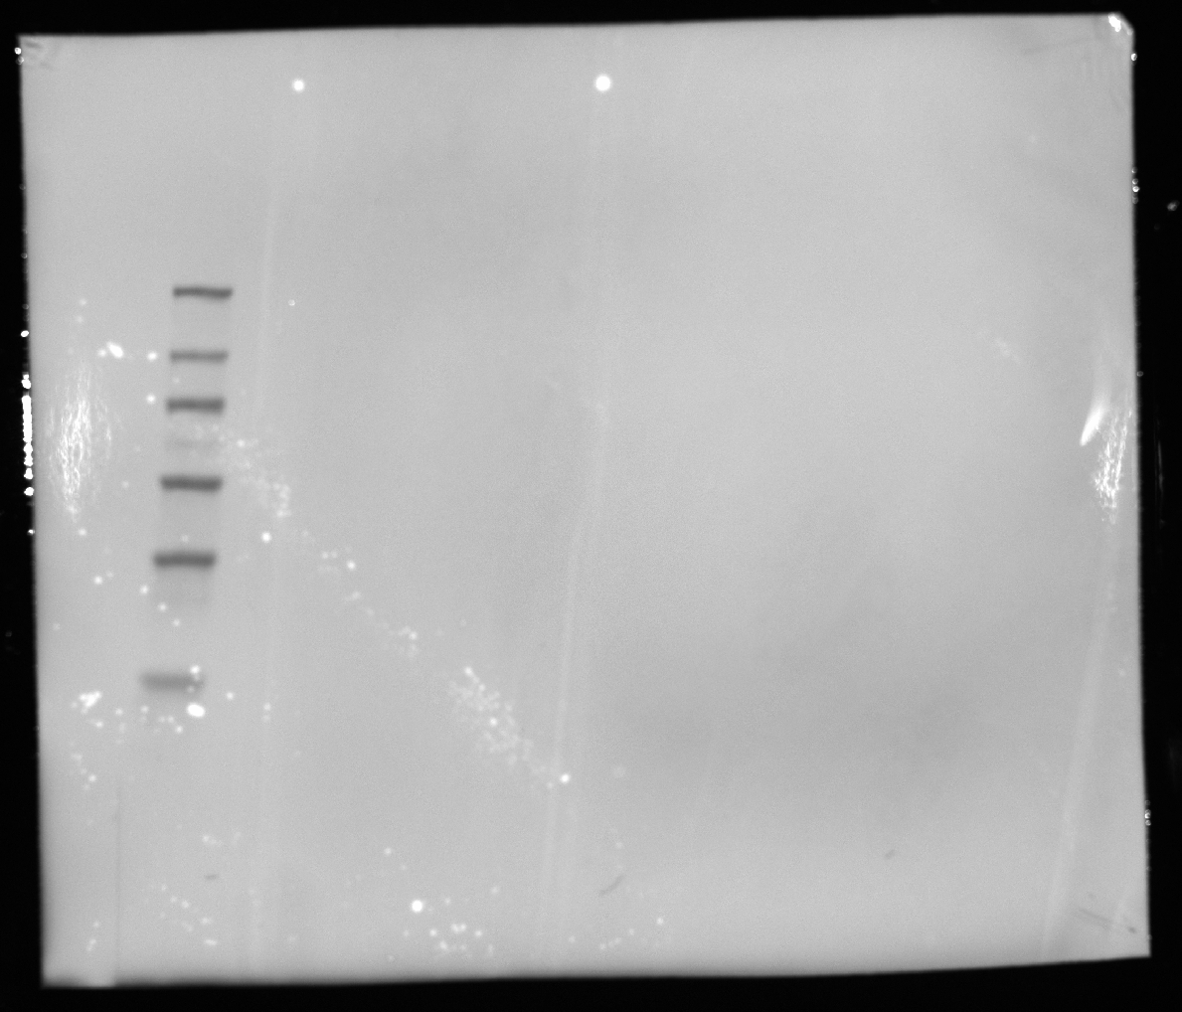
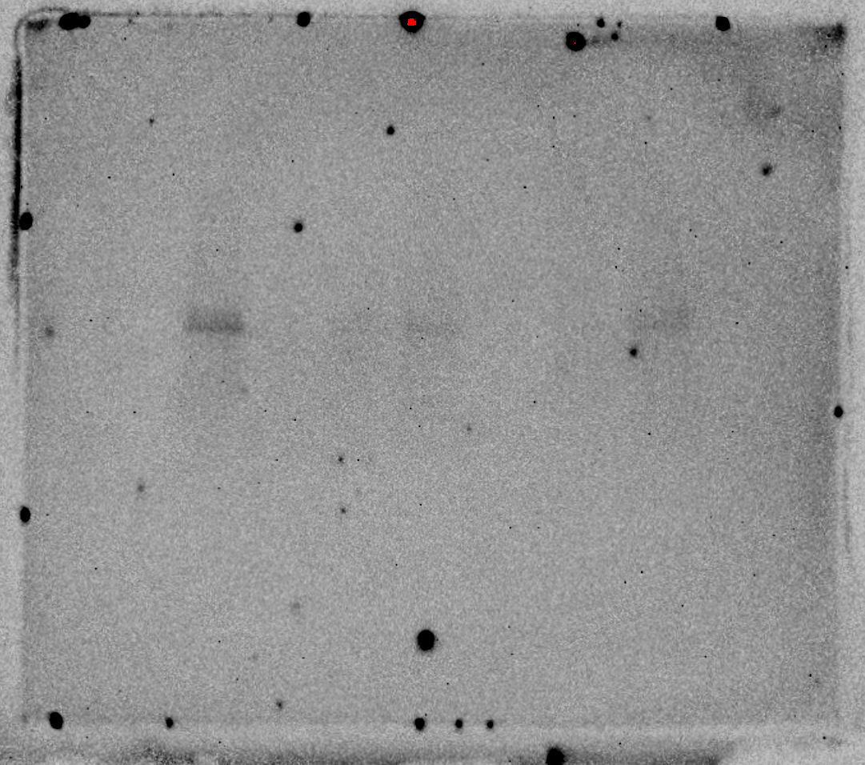
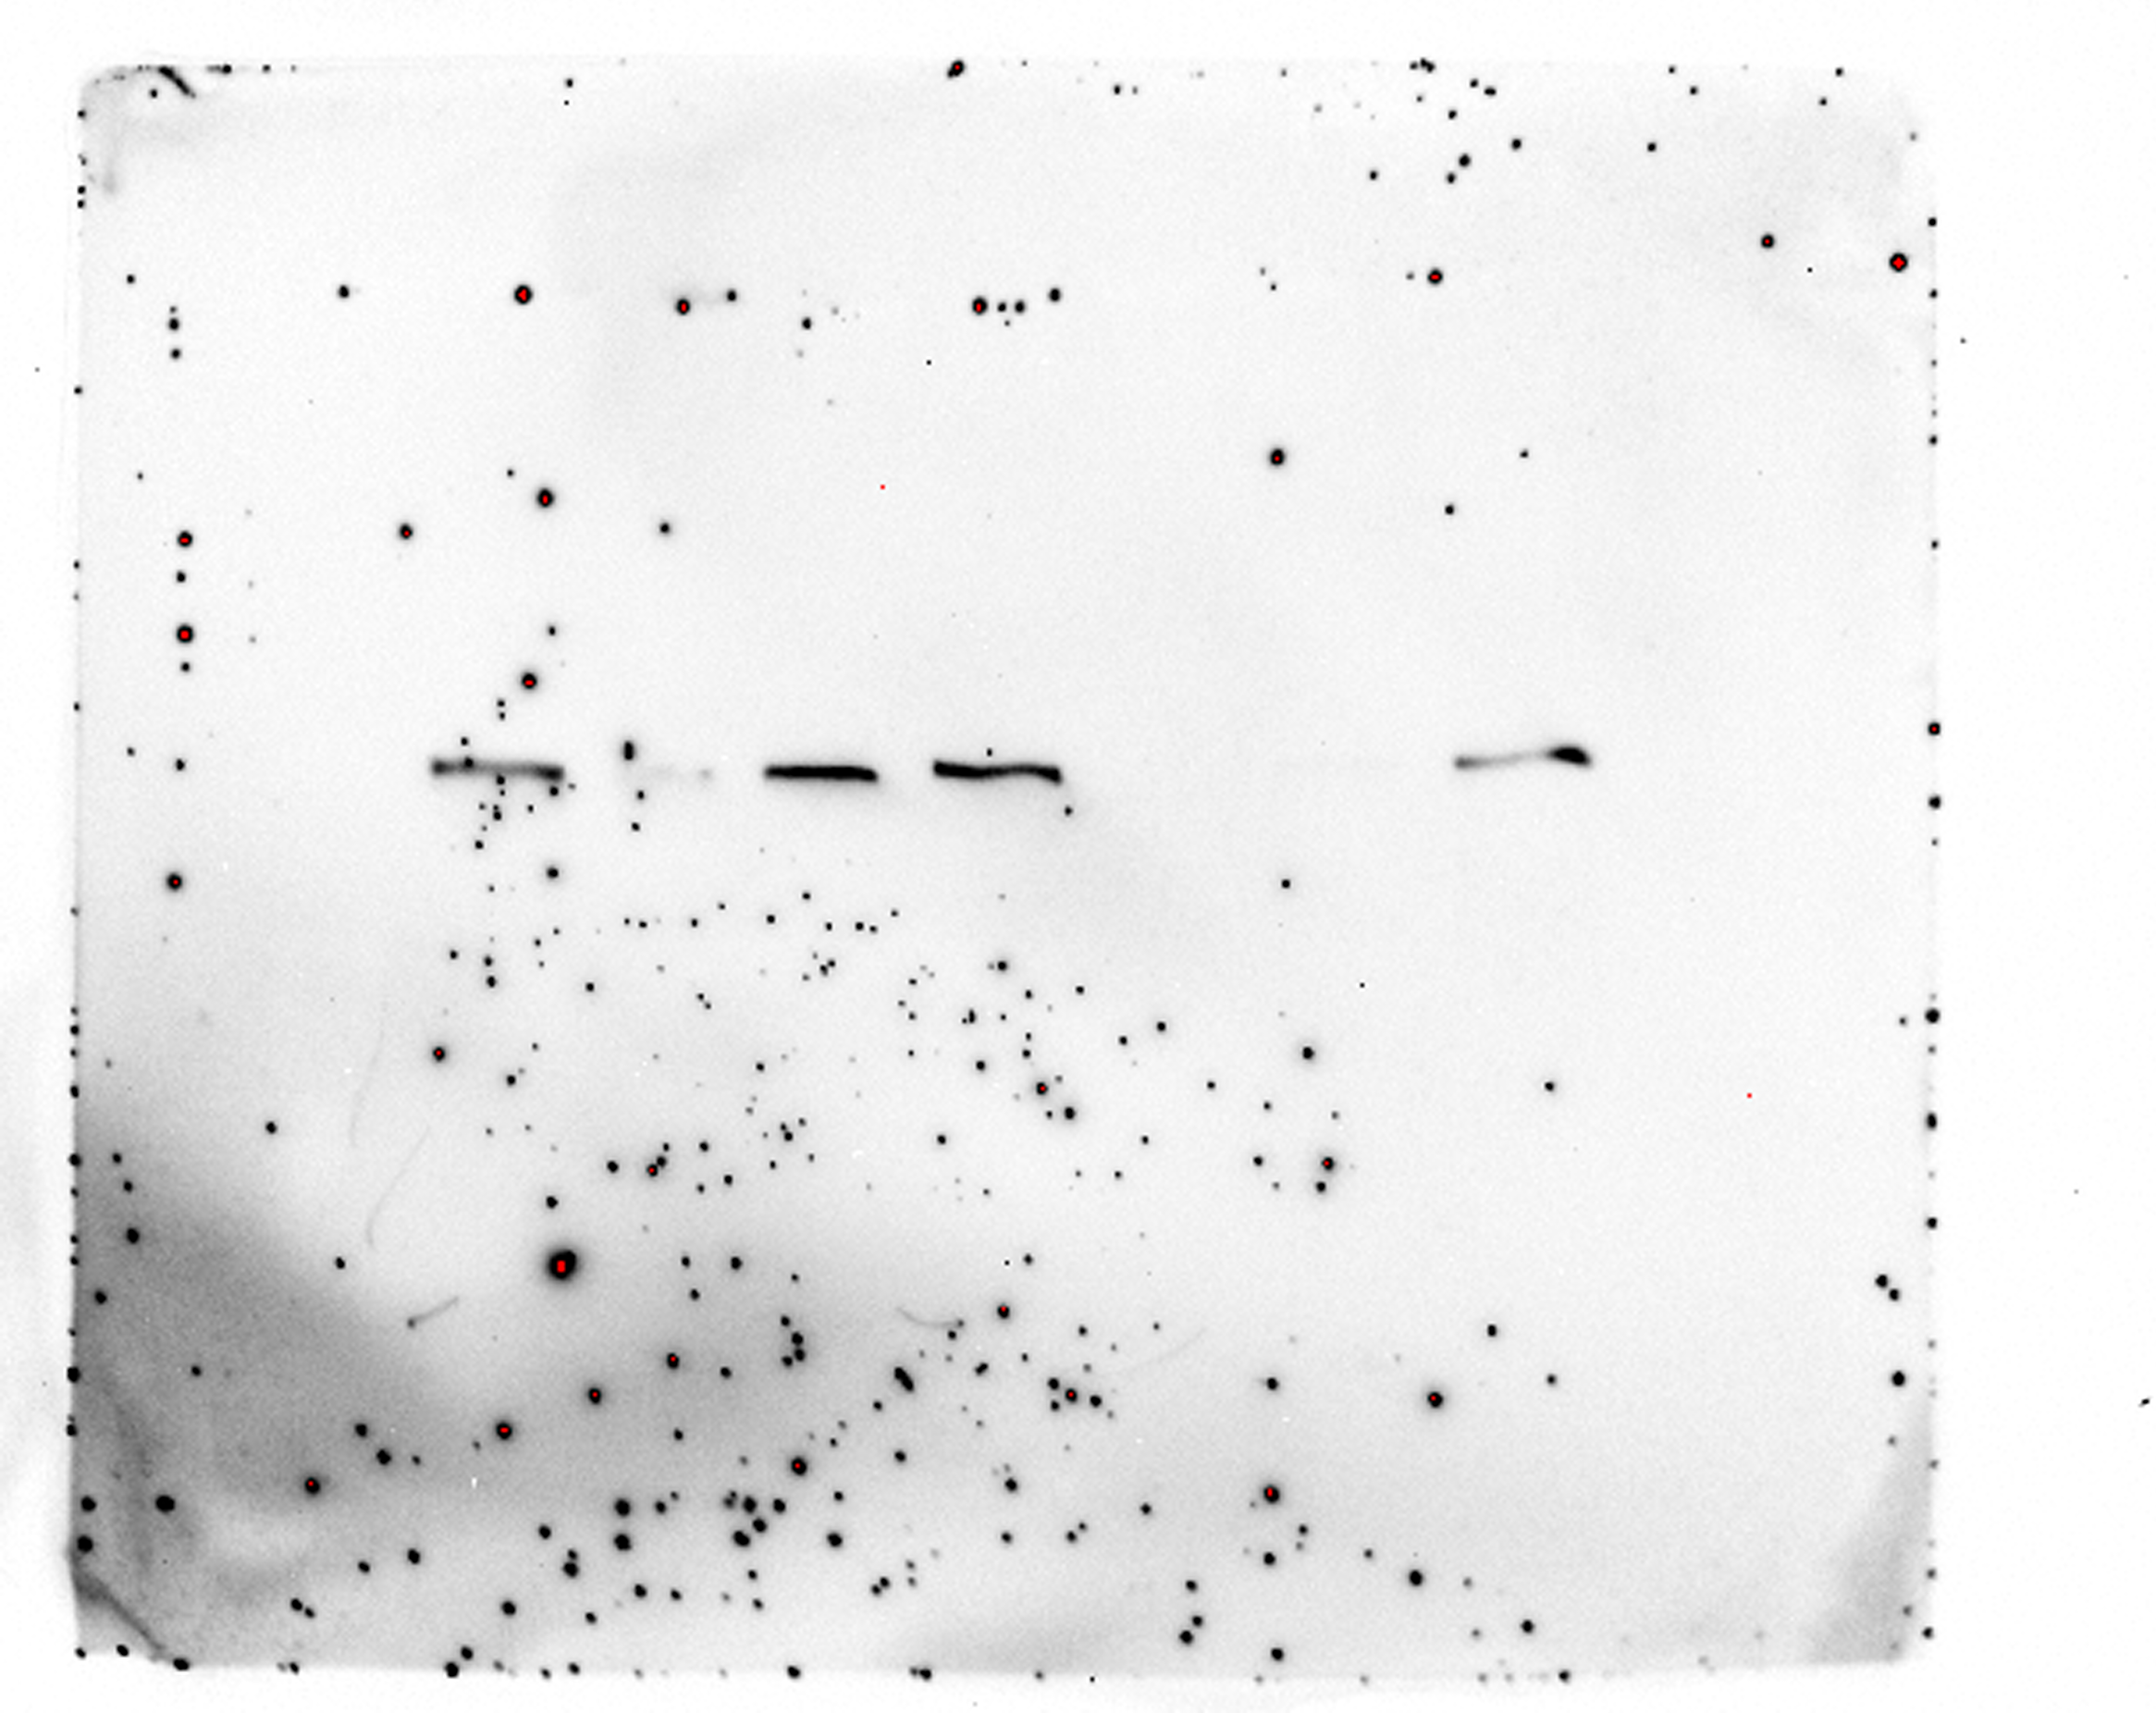
Full unedited gel for Supp. Figure 3G
YAP
B-actin
Ladder
1 2 3 4 5 6 7
1 2 3 4 5 6 7
b-Actin
(45KDa)
Line 1: siNT_2 – Lane used in figure
Line 2: Skipped - bad sample
Line 3: siYAP_2 – Lane used in figure
Line 4: siYAP_3
Line 5: Skipped – comb issue
Line 6: Skipped – comb issue
Line 7: siNT_3

Slide 4
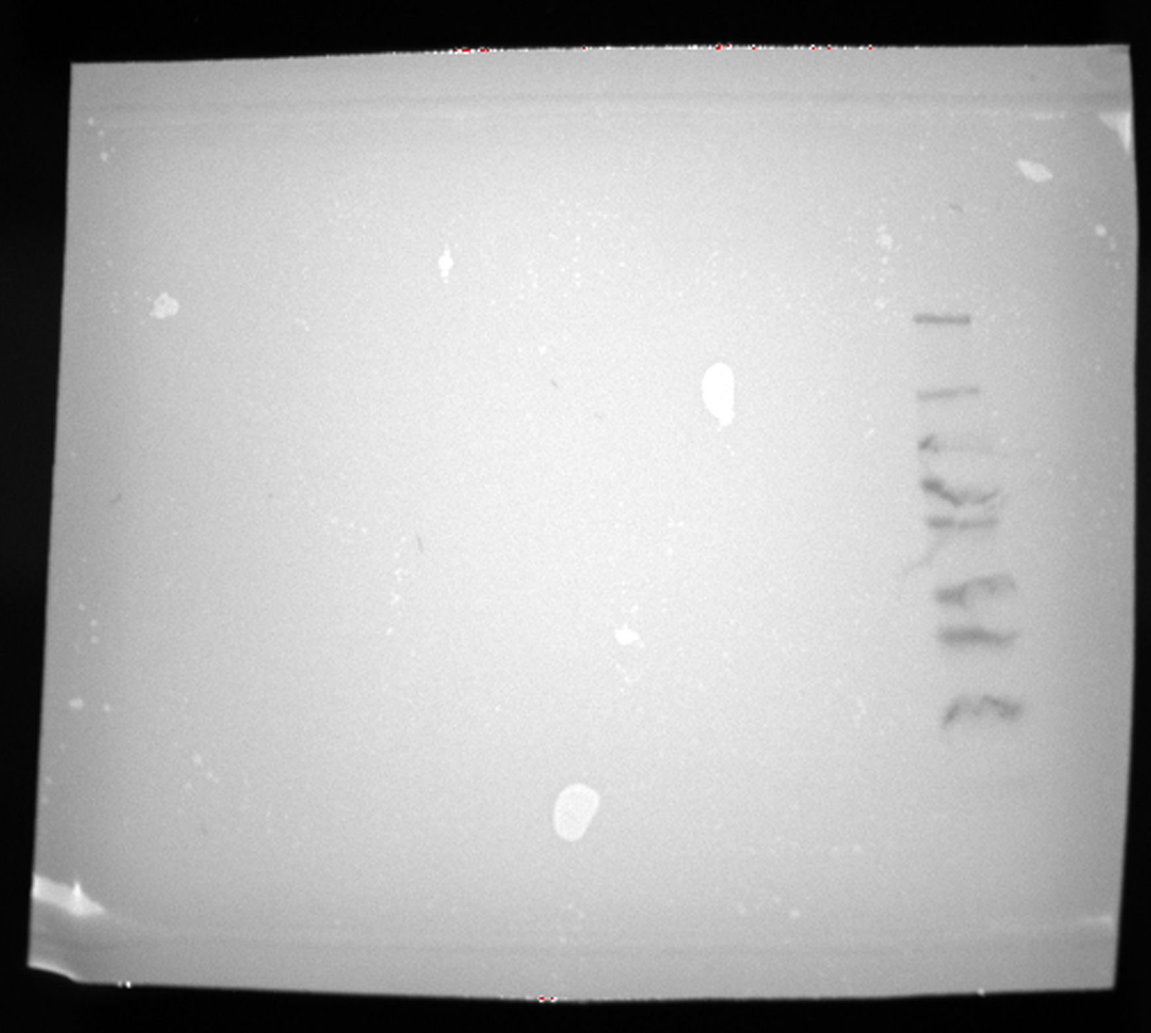
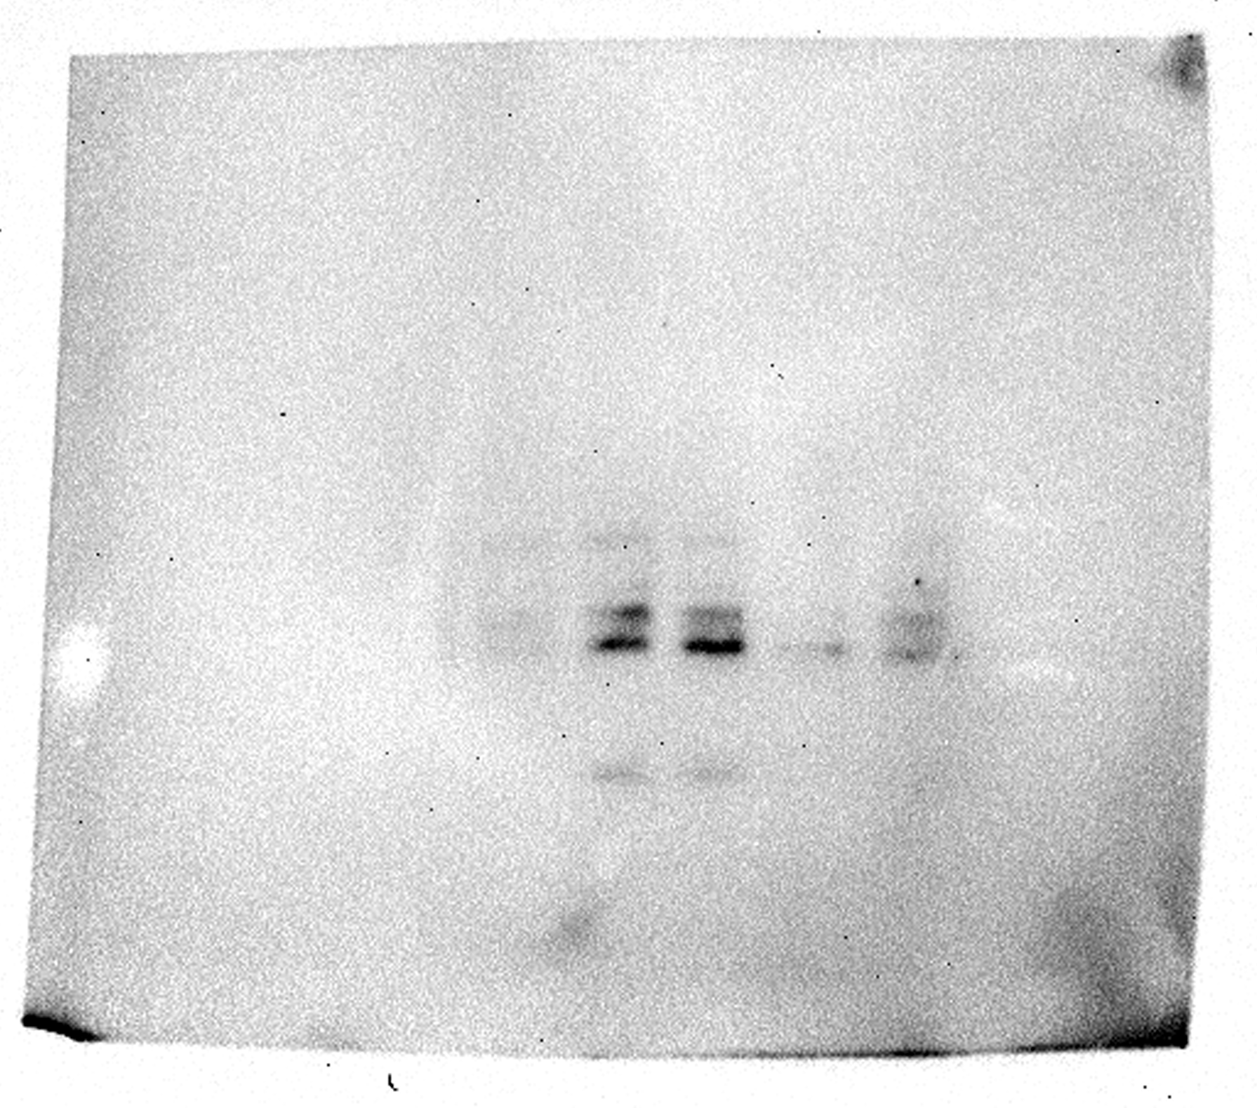
Full unedited gel for Supp. Figure 4A
TAZ
Ladder
6 5 4 3 2 1
TAZ (40KDa)
(right to left)
Line 1: siNT_1
Line 2: siTAZ_1
Line 3: siNT_2 – Lane used in figure
Line 4: siNT_3
Line 5: siTAZ_2 – Lane used in figure
Line 6: siTAZ_3

Slide 5
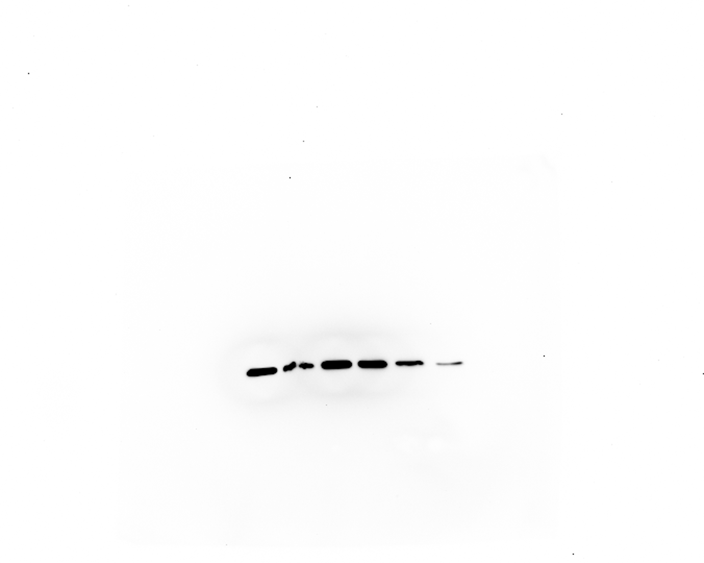
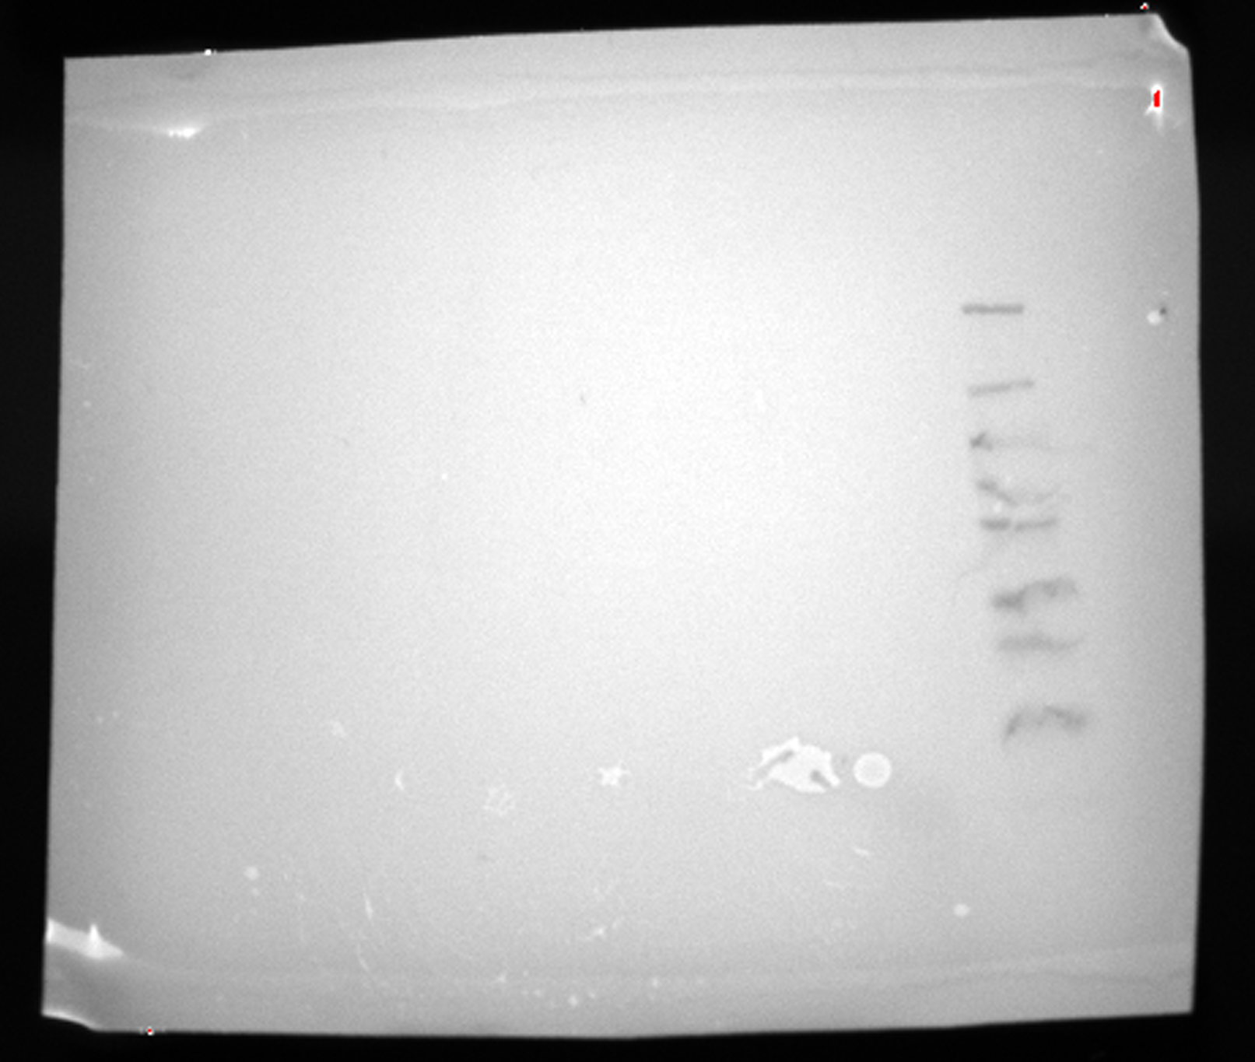
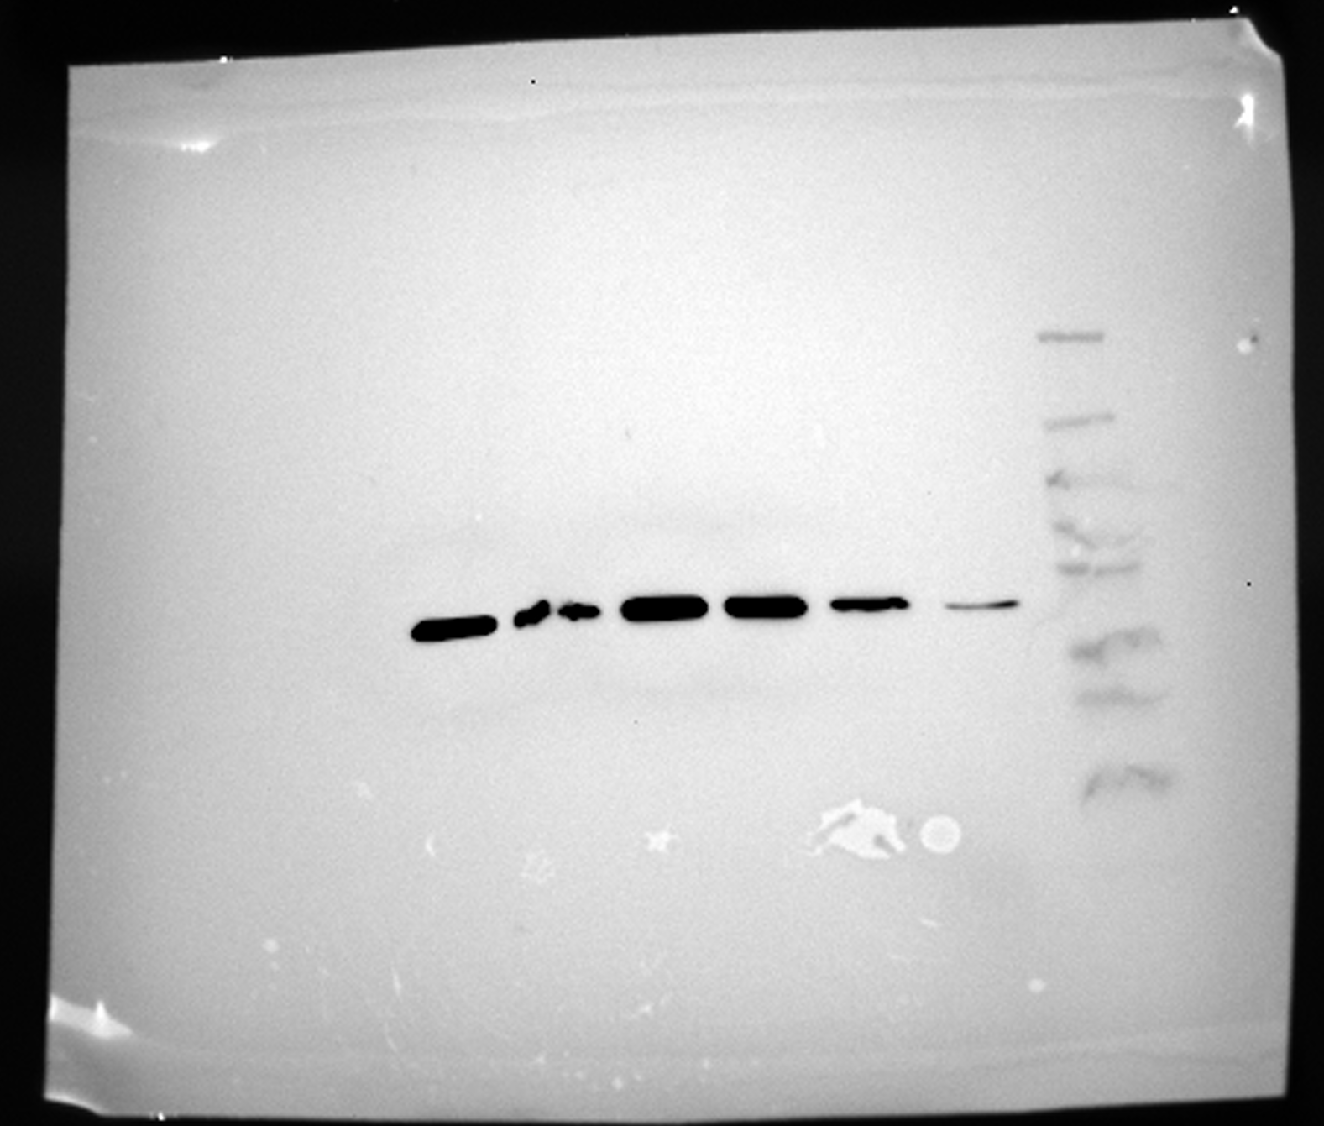
Full unedited gel for Supp. Figure 4A
B-actin
Ladder
6 5 4 3 2 1
Overlay
b-Actin (45KDa)
(right to left)
Line 1: siNT_1
Line 2: siTAZ_1
Line 3: siNT_2 – Lane used in figure
Line 4: siNT_3
Line 5: siTAZ_2 – Lane used in figure
Line 6: siTAZ_3

Slide 6
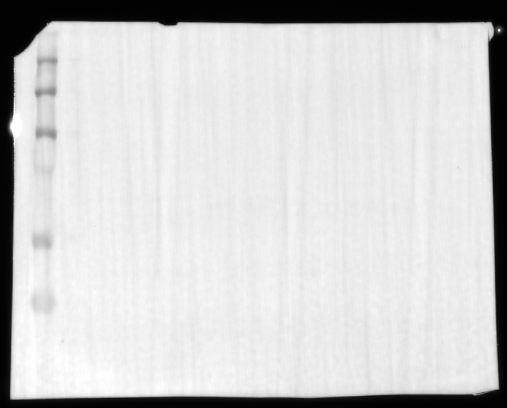
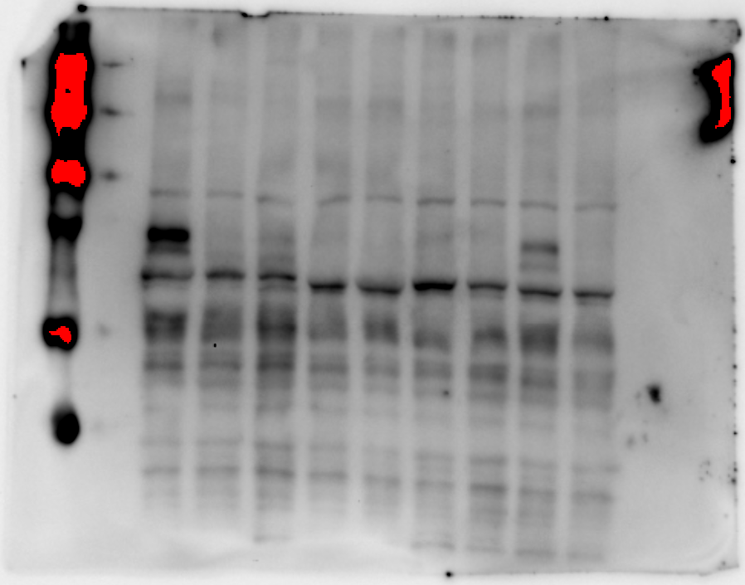
Full unedited gel for Supp. Figure 5C
1 2 3 4 5 6 7 8 9
----250
----150
----100
----75
YAP1 (65KDa)
----50
----37
----25
----20
Line 1: siUTR + WT 1
Line 2: siUTR + WT 2
Line 3: siUTR + WT 3 – Lane used in figure
Line 4: siNT 1 – Lane used in figure
Line 5: siNT 2
Line 6 : siNT 3 – Lane used in figure
Line 7: siUTR + YAP 1 – Lane used in figure
Line 8: siUTR + YAP 2
Line 9: siUTR + YAP 3

Slide 7
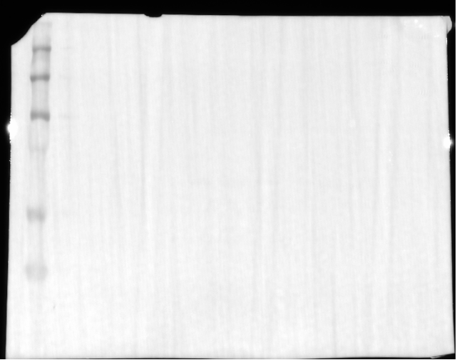
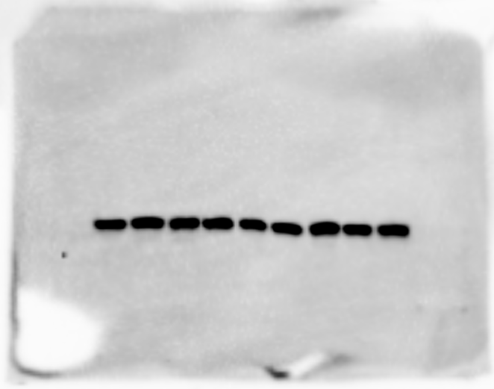
Full unedited gel for Supp. Figure 5C
1 2 3 4 5 6 7 8 9
----250
----150
----100
----75
----50
b-Tubulin (50KDa)
----37
----25
----20
----15
Line 1: siUTR + WT 1
Line 2: siUTR + WT 2
Line 3: siUTR + WT 3 – Lane used in figure
Line 4: siNT 1 – Lane used in figure
Line 5: siNT 2
Line 6 : siNT 3 – Lane used in figure
Line 7: siUTR + YAP 1 – Lane used in figure
Line 8: siUTR + YAP 2
Line 9: siUTR + YAP 3

