Slide 1
Unedited blot and gel images

Slide 2
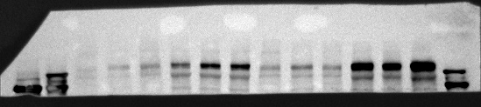
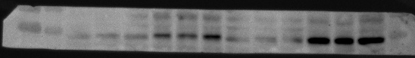
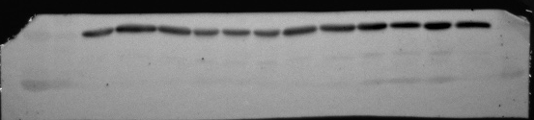
Figure 1 D
Sham
UUO7
Sham
UUO14
FN
245kd
180kd
100kd
GARP
75kd
40kd
GAPDH
35kd

Slide 3
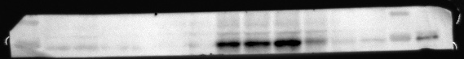
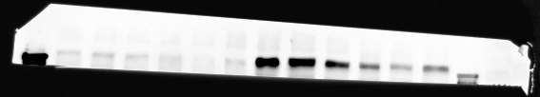
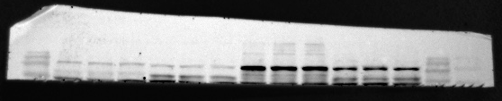
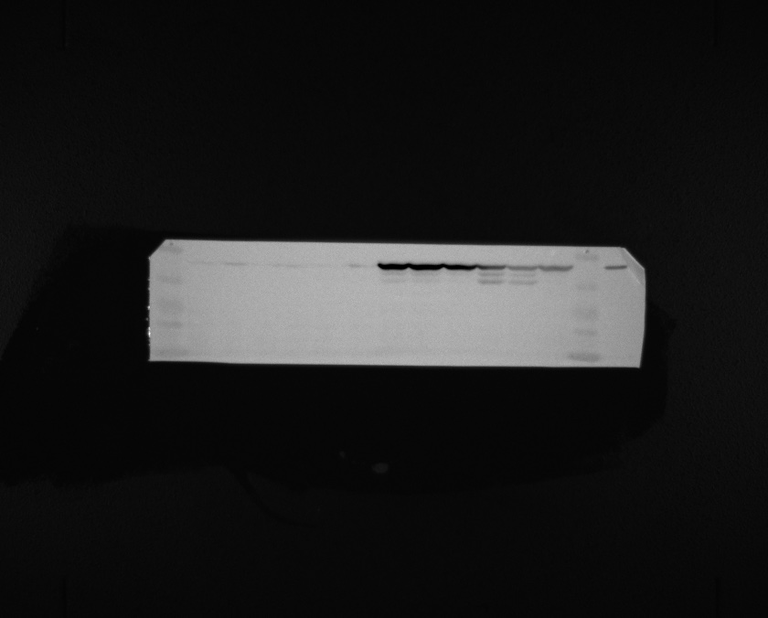
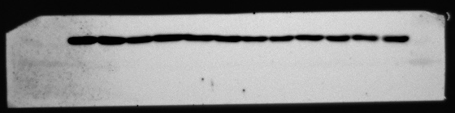
Figure 2 C
Sham
UUO
GARP-KO
GARP OE
GARP-KO
WT
WT
100kd
GARP
75kd
FN
245kd
180kd
COL1A1
180kd
140kd
100kd
Vimentin
60kd
50kd
40kd
GAPDH
40kd
35kd

Slide 4
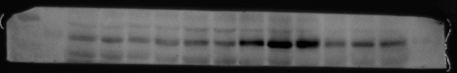
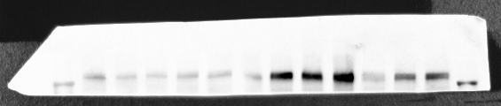
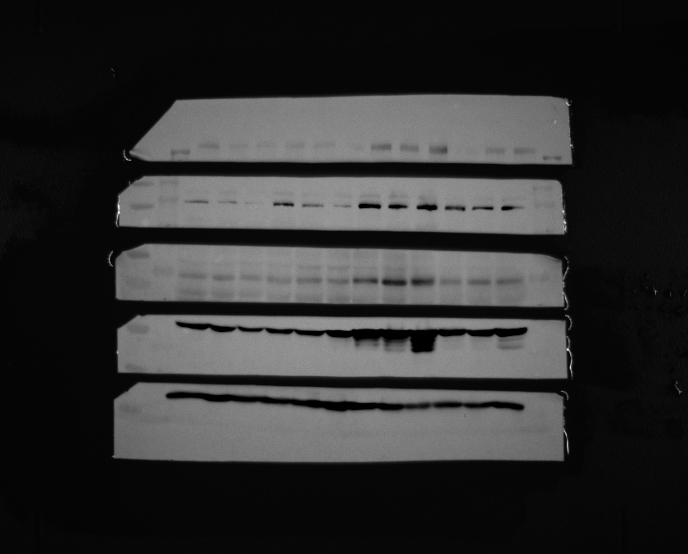
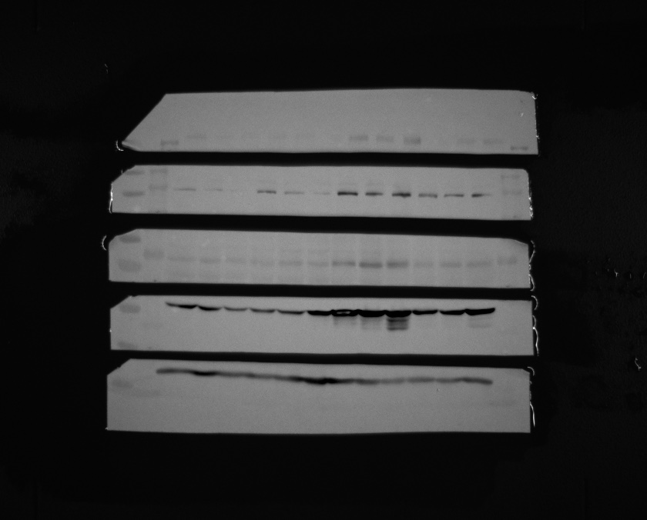
Figure 3 B
Sham
UUO
GARP-CKO
GARP-CKO
WT
WT
100kd
70kd
GARP
245kd
FN
180kd
140kd
COL1A1
55kd
Vimentin
40kd
35kd
GAPDH

Slide 5
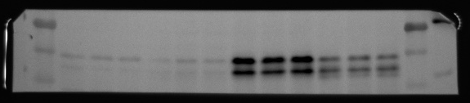
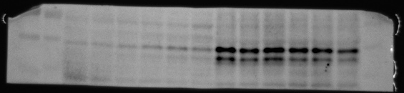
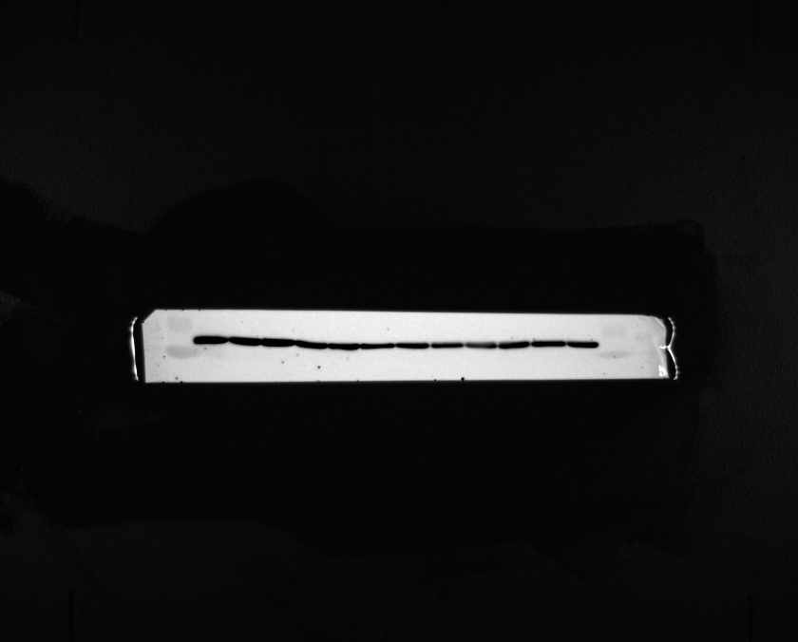
Figure 5 C
Sham
UUO
GARP-KO
GARP-KO
WT
WT
75kd
P-smad2/3
60kd
50kd
75kd
Smad2/3
60kd
50kd
GAPDH
40kd
35kd

Slide 6
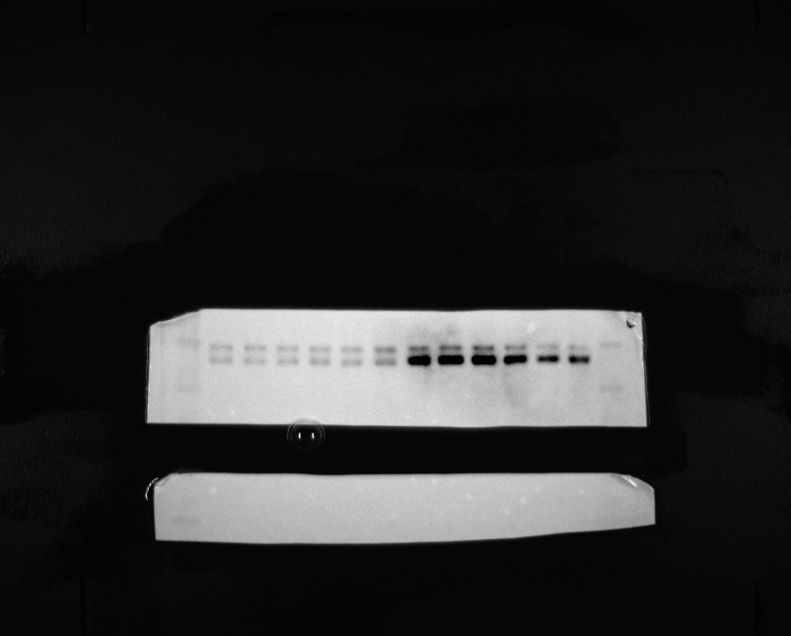
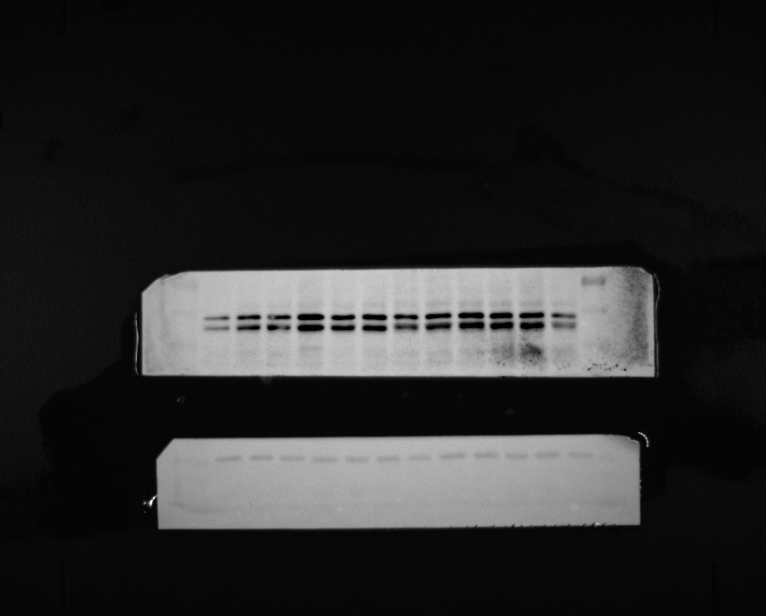
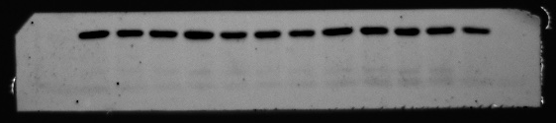
Figure 5 F
medium
TGF-β1
GARP-
KO
GARP-
KO
WT
WT
75kd
P-smad2/3
60kd
50kd
75kd
Smad2/3
60kd
50kd
40kd
GAPDH
35kd

Slide 7
Figure 5 I
GARP
TGF-β1
- + - +
- - + +
250kd
130kd
100kd
70kd
Pro-TGF-β1
55kd
40kd
35kd
25kd
20kd
15kd
Mature-TGF-β1
10kd
40kd
GAPDH
35kd

Slide 8
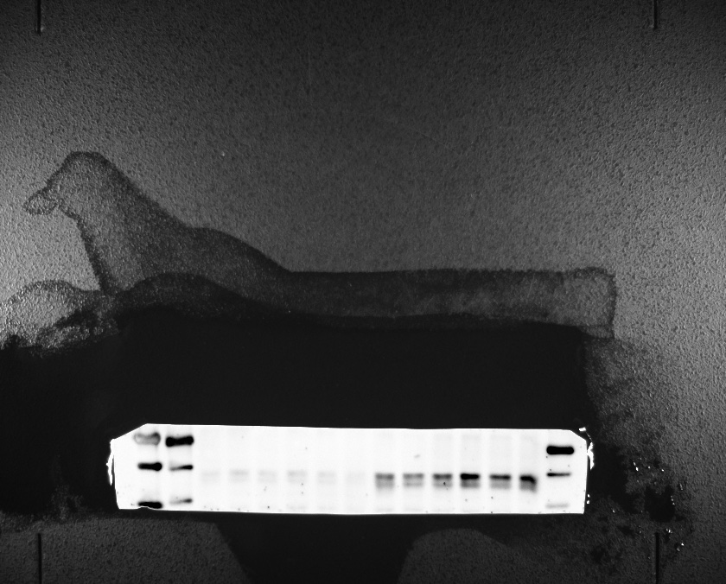
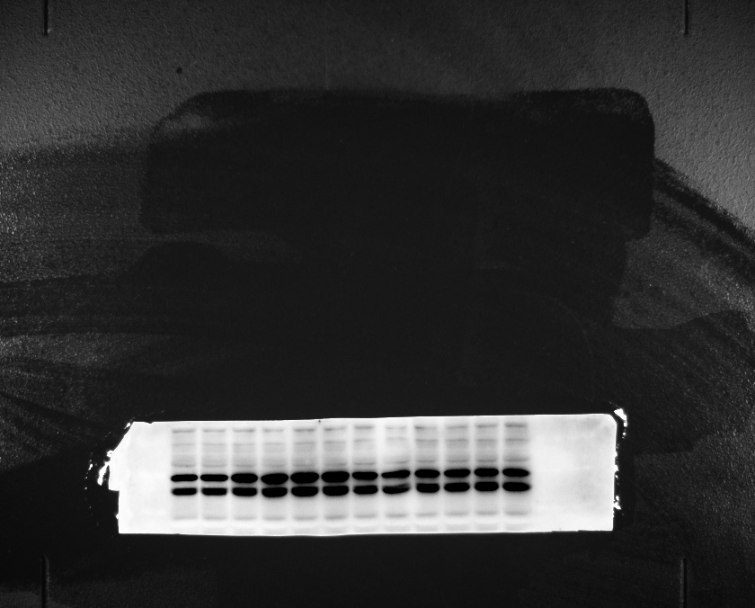
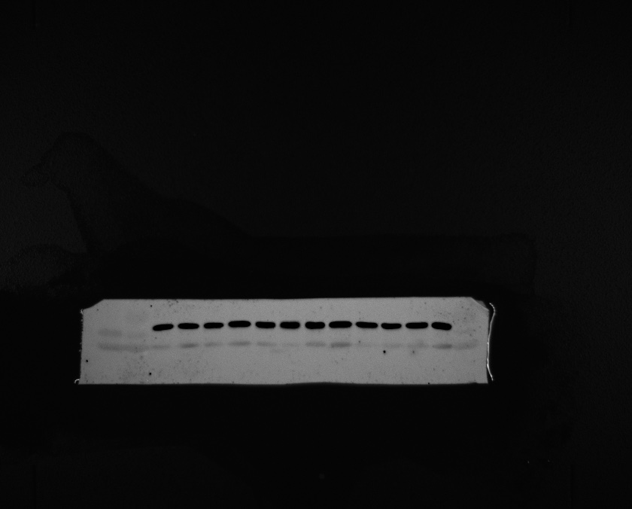
Figure 5 K
medium
TGF-β1
LV-vector
LV-GARP
LV-vector
LV-GARP
75kd
P-smad2/3
60kd
50kd
75kd
60kd
Smad2/3
50kd
40kd
GAPDH
35kd

Slide 9
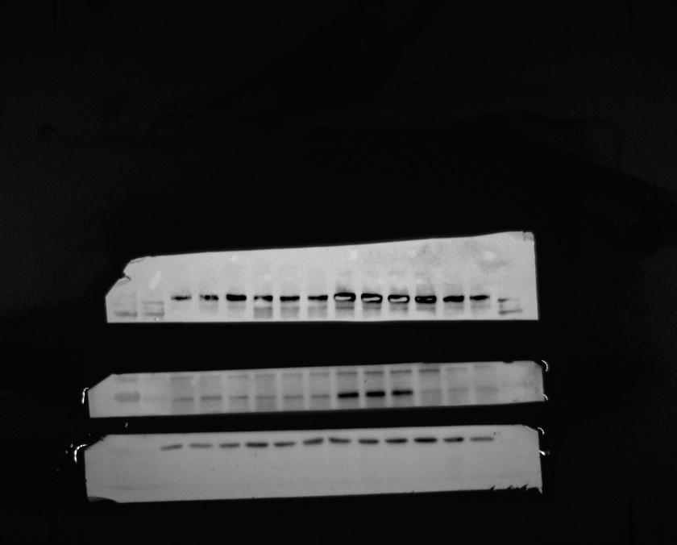
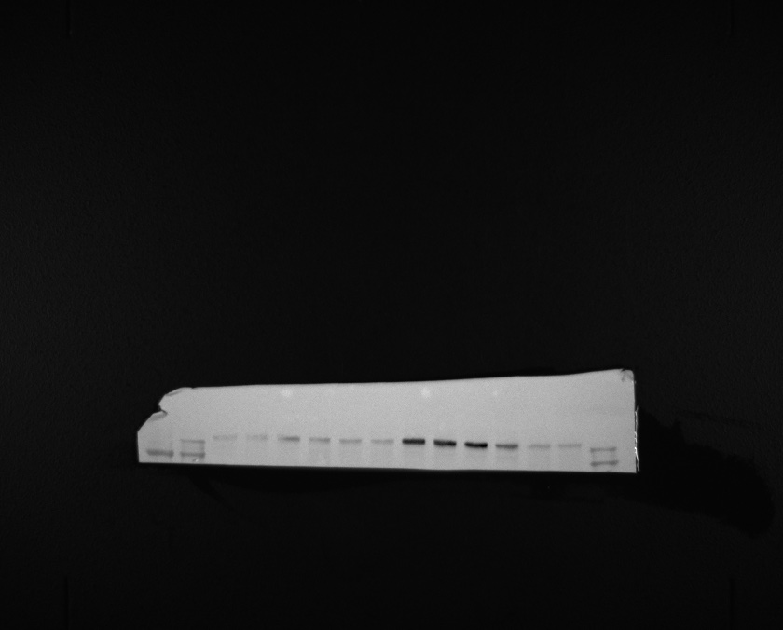
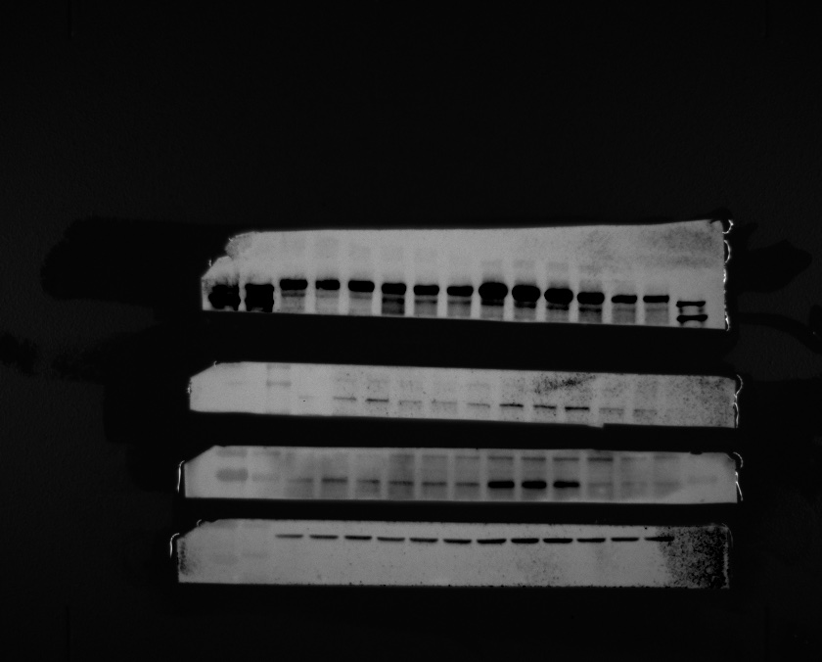
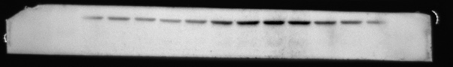
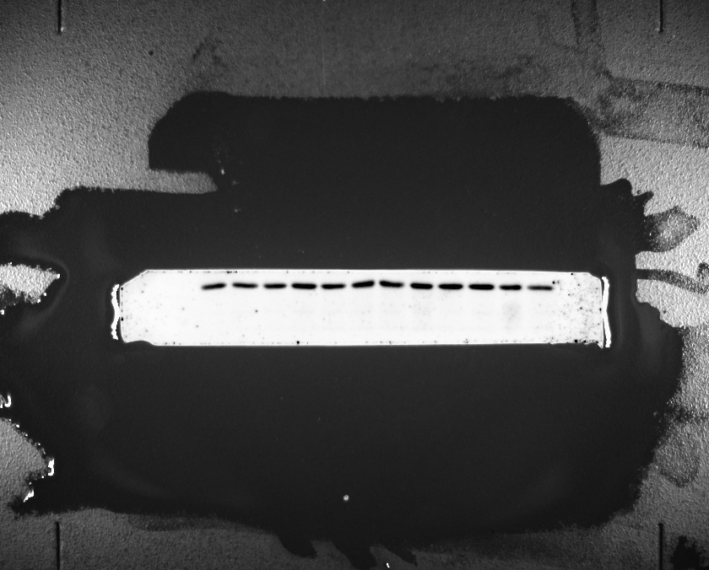
Figure 5 M
medium
TGF-β1
WT
GARP-KO
WT
GARP-KO
100kd
GARP
75kd
FN
245kd
180kd
180kd
140kd
COL1A1
100kd
60kd
Vimentin
50kd
40kd
GAPDH

Slide 10
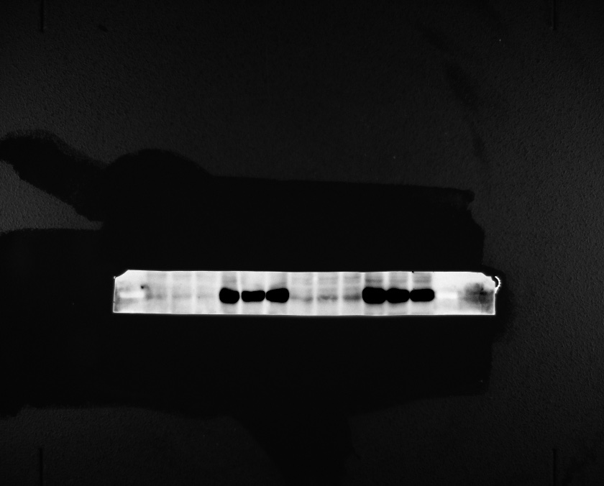
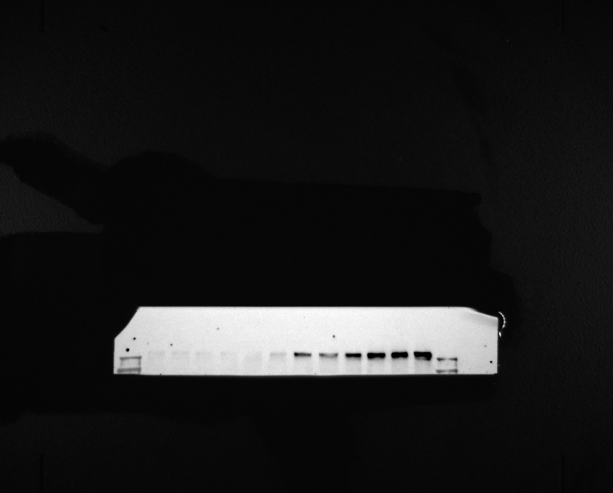
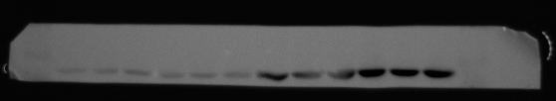
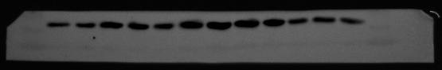
Figure 5 O
medium
TGF-β1
LV-vector
LV-GARP
LV-vector
LV-GARP
GARP
75kd
60kd
FN
245kd
180kd
60kd
α- SMA
50kd
40kd
40kd
GAPDH
35kd

Slide 11
Figure 6 D
Images without marker
TNF(h) 0 4 24 48
100kd
GARP
70kd
40kd
GAPDH
35kd

Slide 12
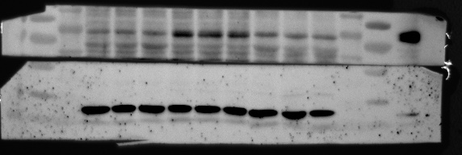
Figure 6 F
LV-GARP
medium
TNF
TNF+PDTC
GARP
100kd
75kd
60kd
55kd
GAPDH
40kd

Slide 13
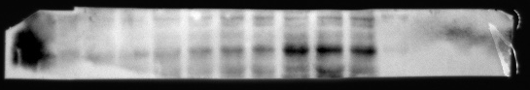
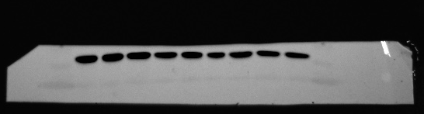
Figure 6 K
TGF-β1(h)
0
36
72
100kd
75kd
GARP
40kd
GAPDH
35kd

Slide 14
Figure 6 N
TNF
TGF-β1
- + - +
Images without marker
- - + +
100kd
GARP
70kd
40kd
GAPDH
35kd

Slide 15
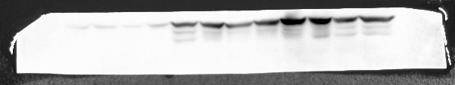
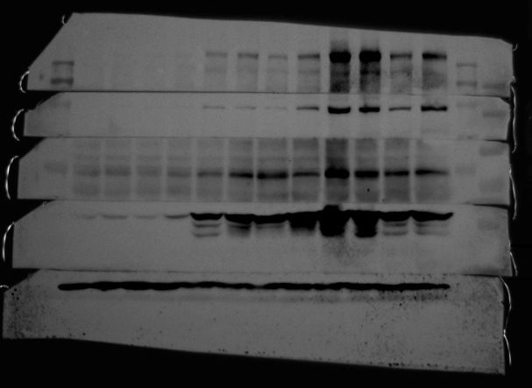
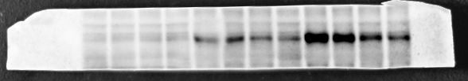
Figure 7 B
UUO D0
UUO D7
UUO D14
WT
CKO
WT
CKO
WT
CKO
Vimentin
55kd
40kd
FN
245kd
180kd
COL1A1
140kd
100kd
55kd
GAPDH
40kd
GARP
100kd
70kd

Slide 16
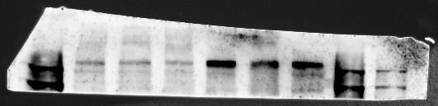
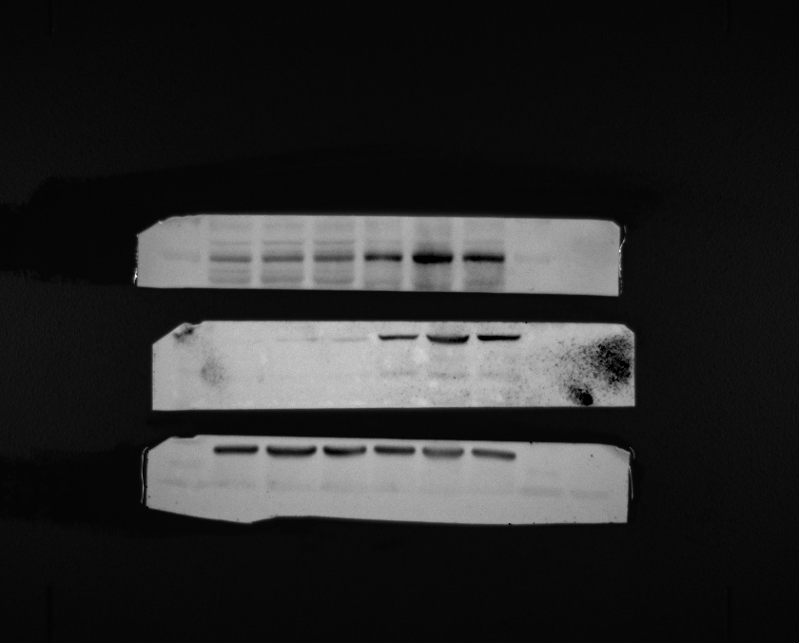
Supplemental Figure 1 B
Sham
5/6NX
FN
245kd
180kd
100kd
GARP
75kd
40kd
35kd
GAPDH

Slide 17
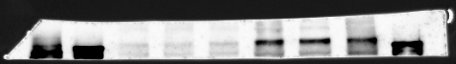
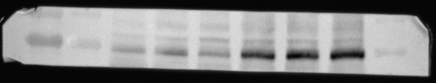
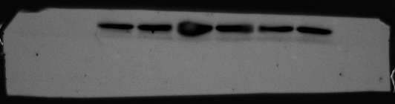
Supplemental Figure 1 E
Sham
UIRI
FN
245kd
100kd
GARP
75kd
GAPDH
35kd

Slide 18
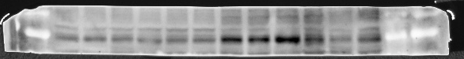
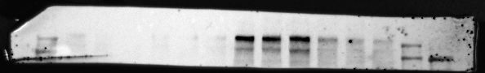
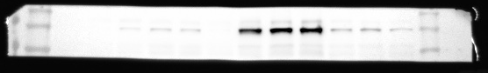

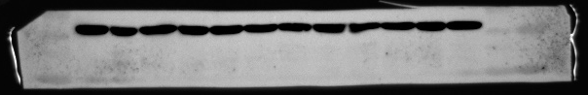
Supplemental Figure 2 B
Sham
UIRI
GARP-KO
GARP-KO
WT
WT
100kd
GARP
75kd
60kd
Fibronectin
245kd
180kd
180kd
COL1A1
140kd
100kd
60kd
50kd
Vimentin
40kd
40kd
GAPDH
35kd

Slide 19
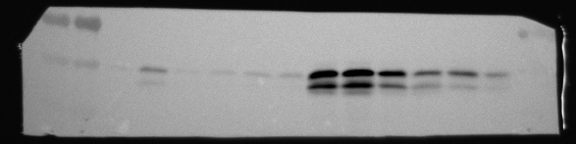
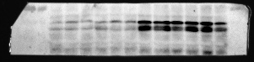
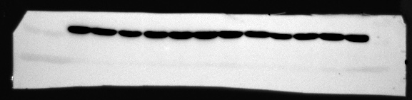
Supplemental Figure 6 A
Sham
UIRI
GARP-KO
GARP-KO
WT
WT
75kd
60kd
P-smad2/3
50kd
75kd
60kd
Smad2/3
50kd
35kd
GAPDH

Slide 20
Supplemental Figure 7 C
LV-vector
LV-GARP
LV-vector
LV-GARP
TGF-β1
CWHM12
- - - - + + + +
- + - + - + - +
130kd
100kd
GARP
70kd
70kd
Smad2/3
55kd
70kd
P-smad2/3
55kd
40kd
GAPDH
35kd

Slide 21
Supplemental Figure 7 D
LV-vector
LV-GARP
LV-vector
LV-GARP
TGF-β1
SB431542
- - - - + + + +
- + - + - + - +
130kd
100kd
GARP
70kd
70kd
Smad2/3
55kd
70kd
P-smad2/3
55kd
40kd
GAPDH
35kd

Slide 22
Supplemental Figure 8 B
LV-GARP
130kd
100kd
70kd
GARP
250kd
130kd
p-P105
100kd
70kd
p-P65
55kd
70kd
P65
55kd
40kd
IκBα
35kd
40kd
35kd
GAPDH
TNF(min) 0 10 30 60 240 1440

Slide 23
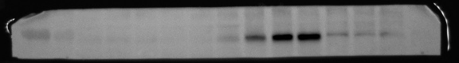
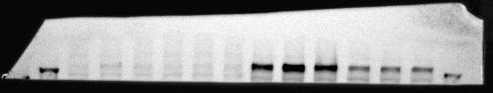



Supplemental Figure 9 B
Sham
UUO D14
GARP-KO
GARP-KO
WT
WT
100kd
GARP
75kd
FN
245kd
180kd
140kd
COL1A1
100kd
Vimentin
60kd
50kd
40kd
40kd
GAPDH
35kd

Slide 24



Supplemental Figure 9 F
Sham
UUO D14
GARP-KO
GARP-KO
WT
WT
75kd
60kd
P-smad2/3
50kd
75kd
60kd
50kd
Smad2/3
GAPDH
35kd

