Slide 1
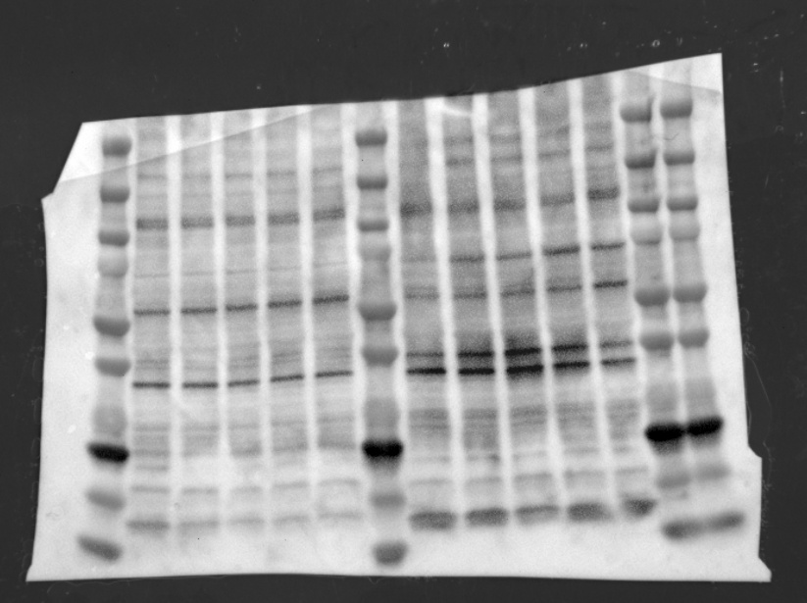
Full unedited gel for Supplemental Figure 1A: upper left western blot (WT chimera, anti-C3)

Slide 2
Full unedited gel for Supplemental Figure 1A: lower left western blot (WT chimera, anti-beta actin)

Slide 3
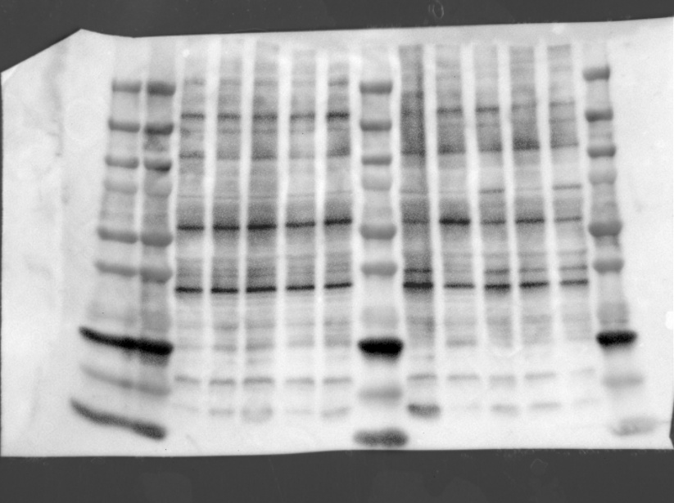
Full unedited gel for Supplemental Figure 1A: upper right western blot (MBL-KO chimera, anti-C3)

Slide 4
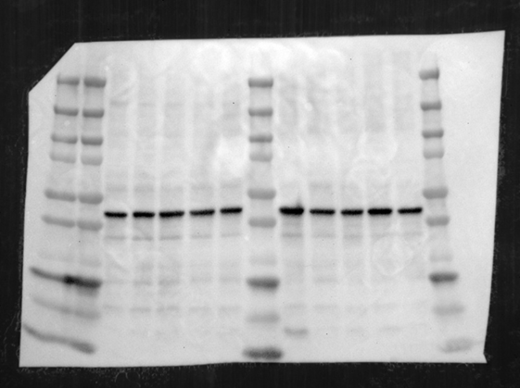
Full unedited gel for Supplemental Figure 1A: lower right western blot (MBL-KO chimera, anti-beta actin)

