Slide 1
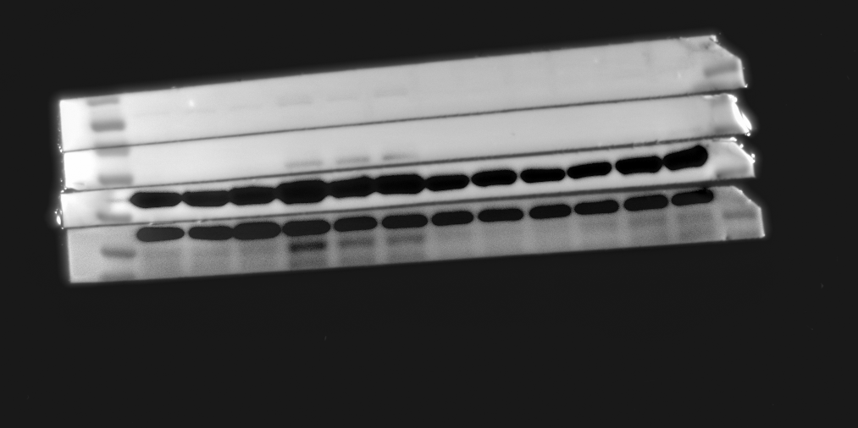
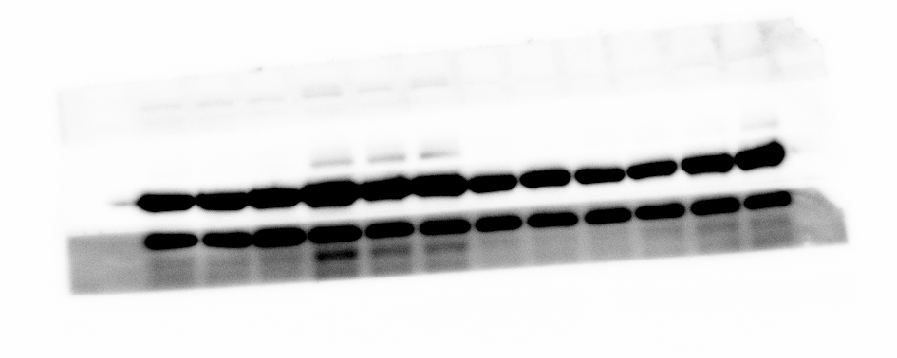
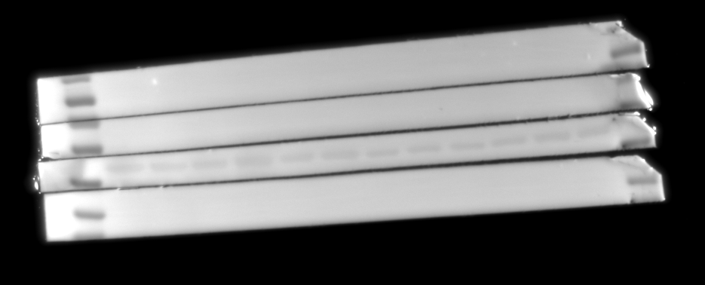
Figure 5D VIM and α-SMA
VIM
70
α-SMA
55
GAPDH
40
35

Slide 2
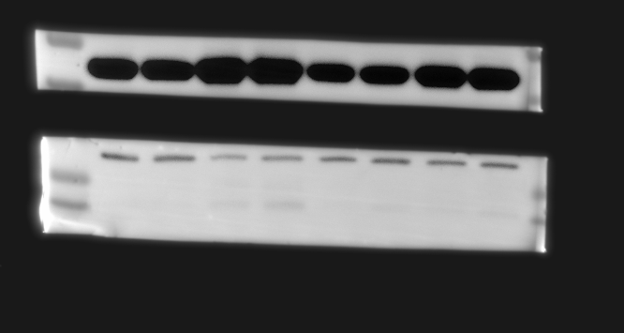
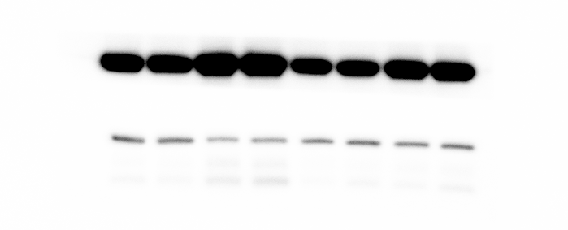
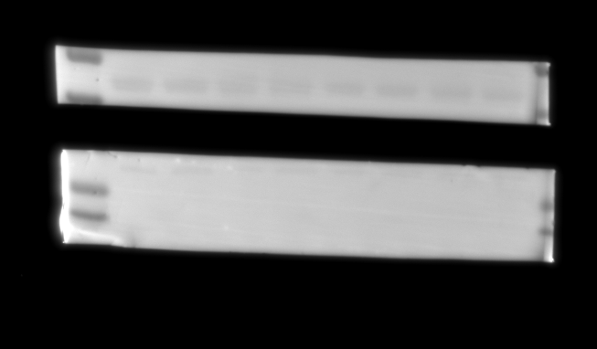
Figure 7E α-SMA
55
40
α-SMA
35
GAPDH

Slide 3
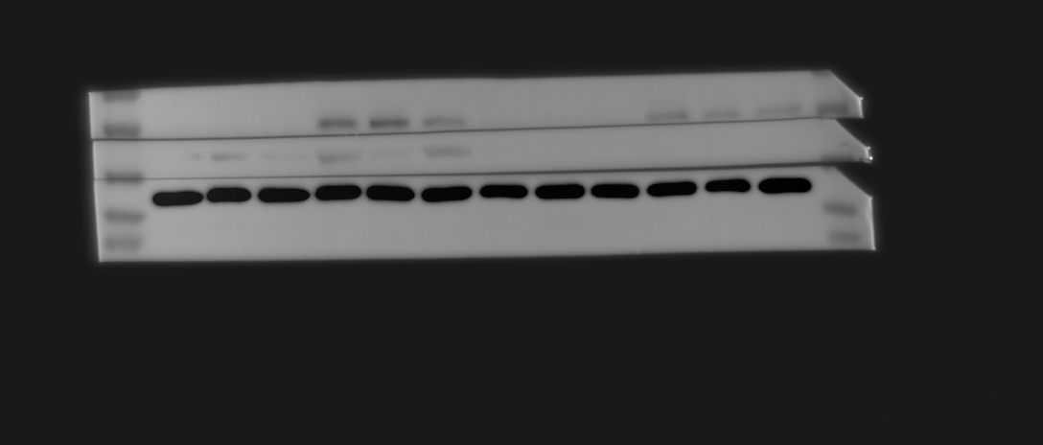
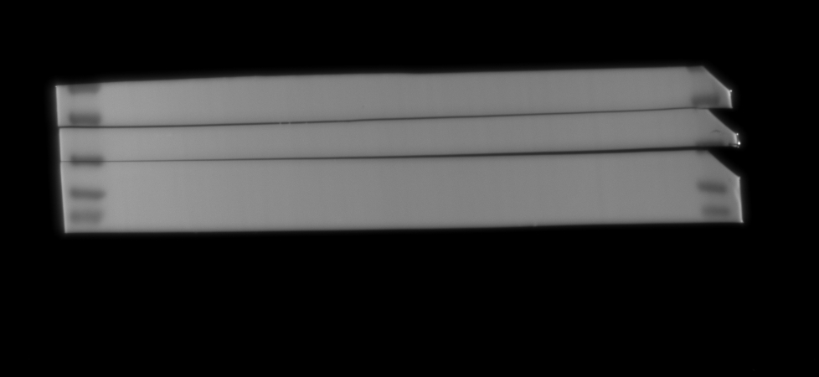
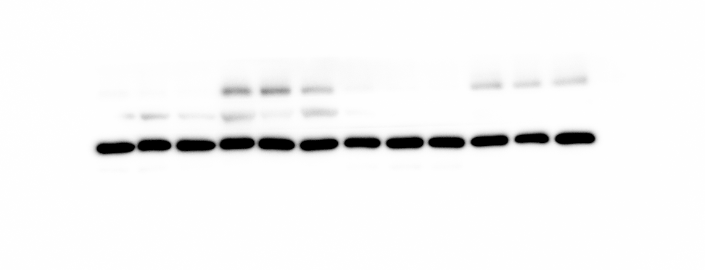
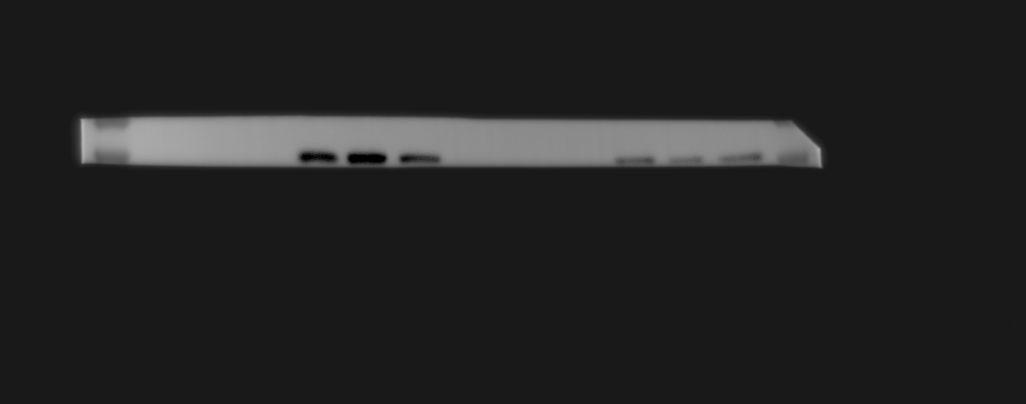
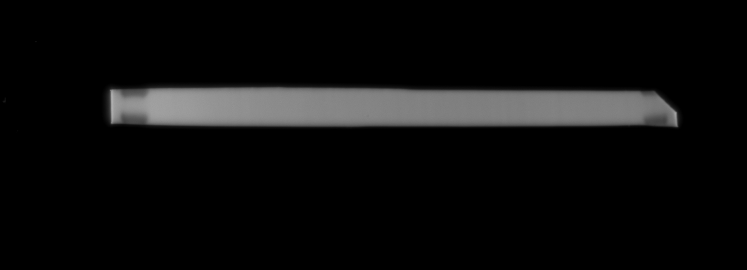

Figure 7E VIM
70
VIM
55
40
GAPDH
35
VIM bands obtained after adjusting the exposure time

Slide 4
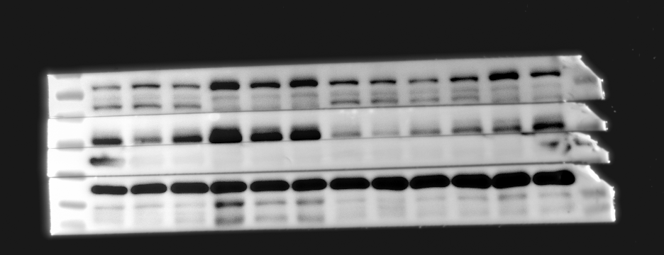
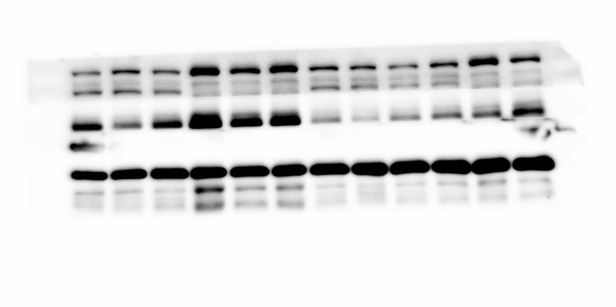
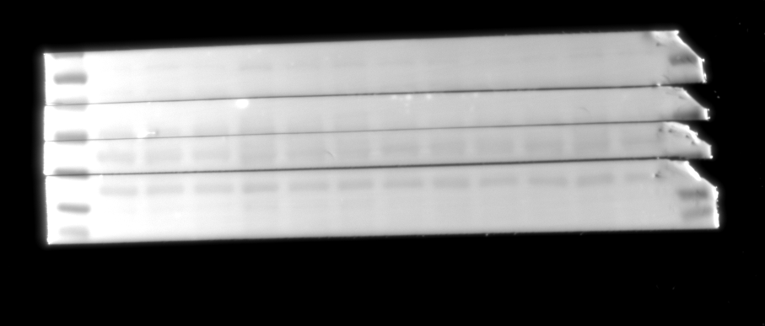
Figure 9D MMP9
130
MMP9
100
70
VIM
55
40
GAPDH
35

Slide 5
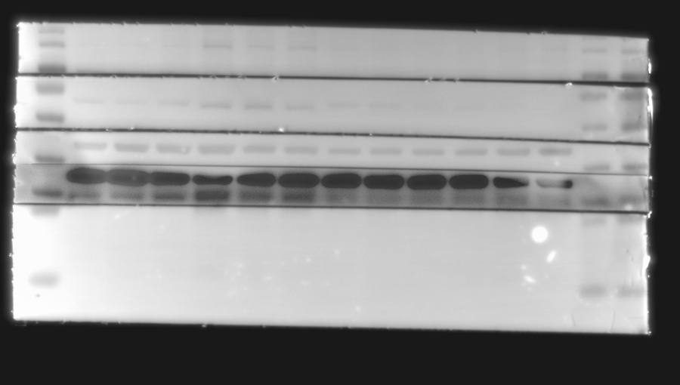
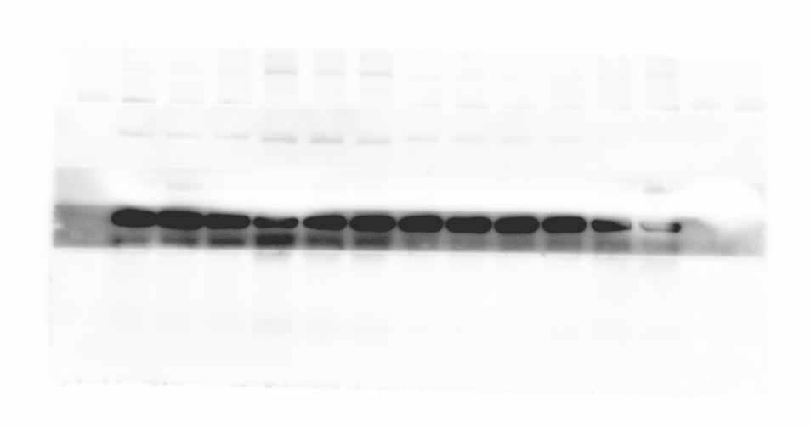
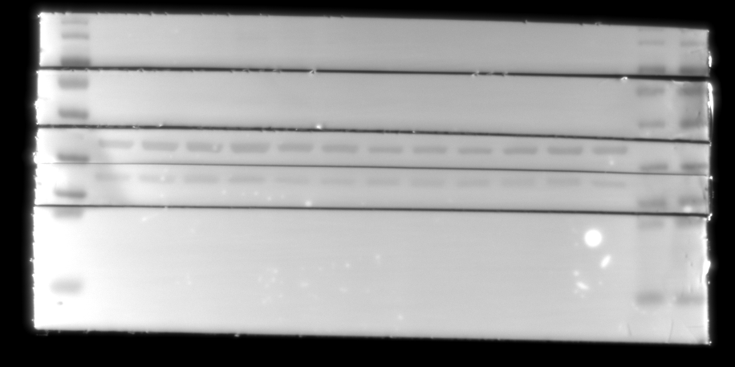
Figure 8C F4/80 and TNF-α and supplementary figure 3B IRF5
130
F4/80
100
70
55
Irf5
40
35
GAPDH
25
15
TNF-α

Slide 6
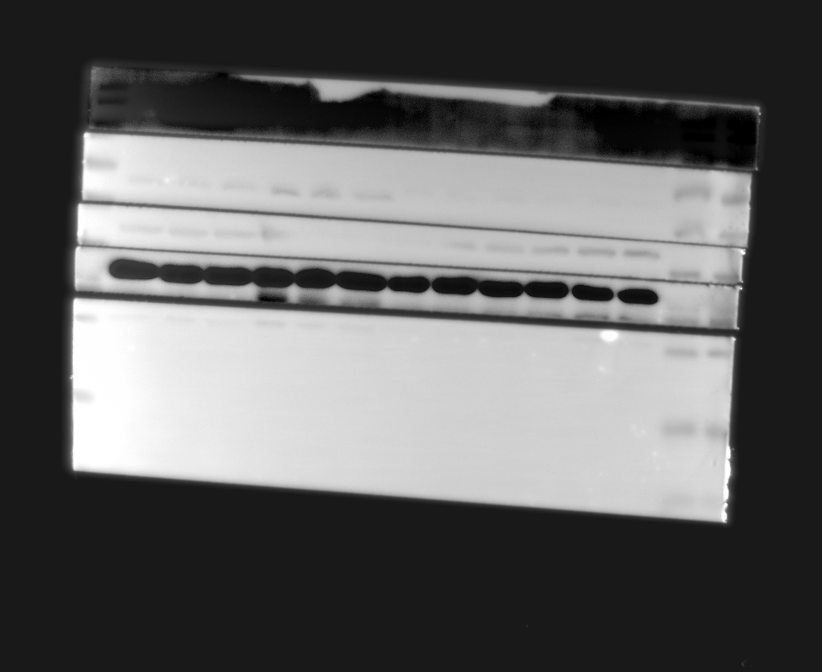
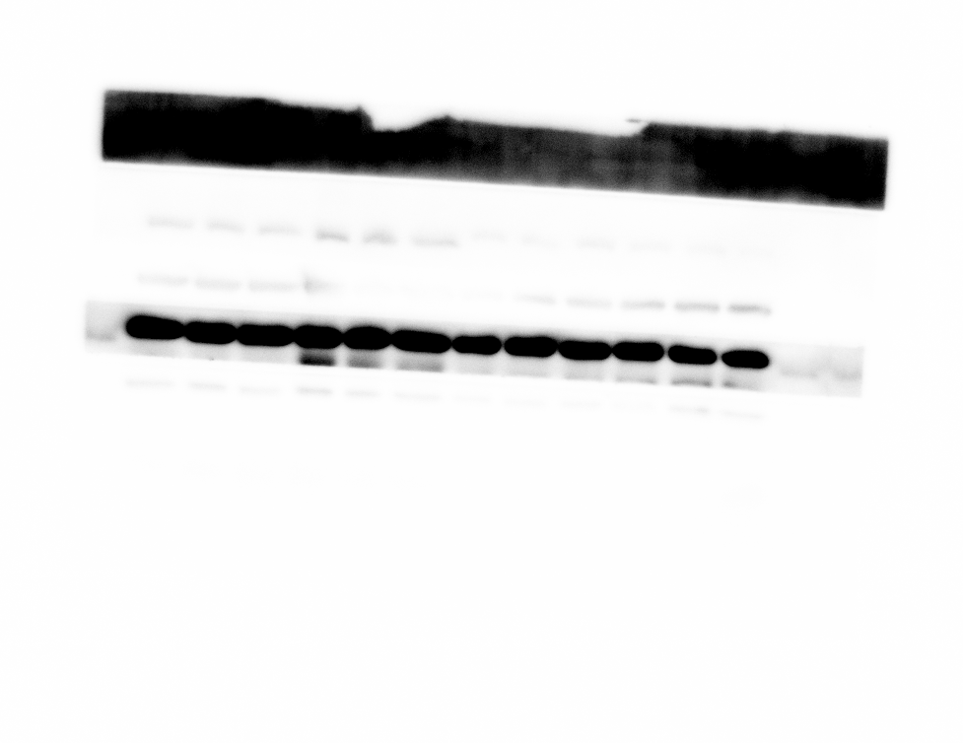
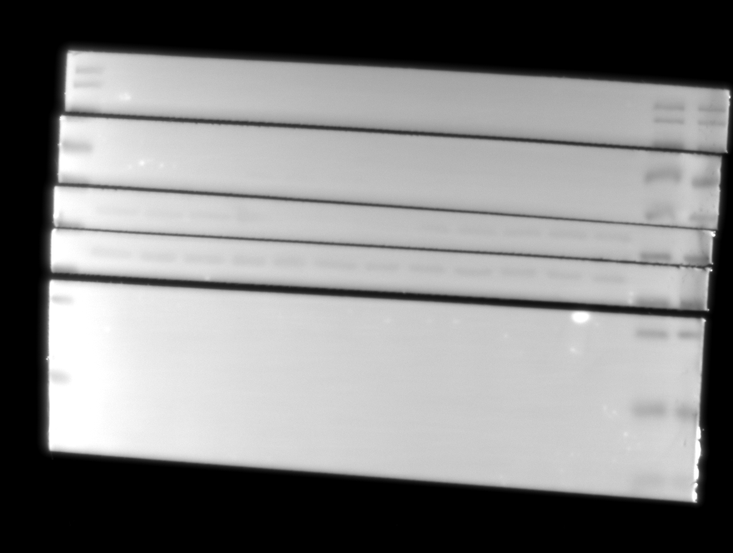
Figure 8C IL-1β
40
35
GAPDH
25
IL-1β

Slide 7
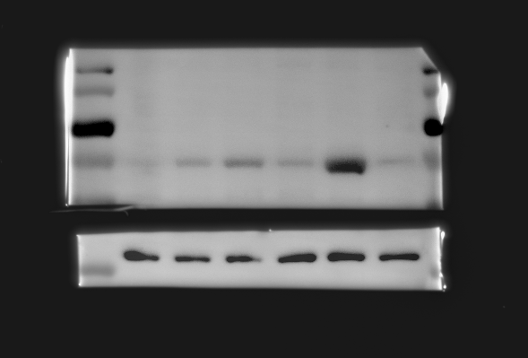
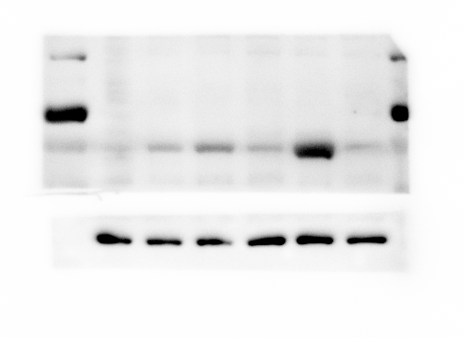
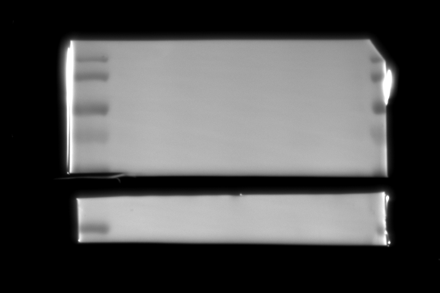
Figure 10 D
MMP9
130
100
MMP9
70
55
actin
40

Slide 8
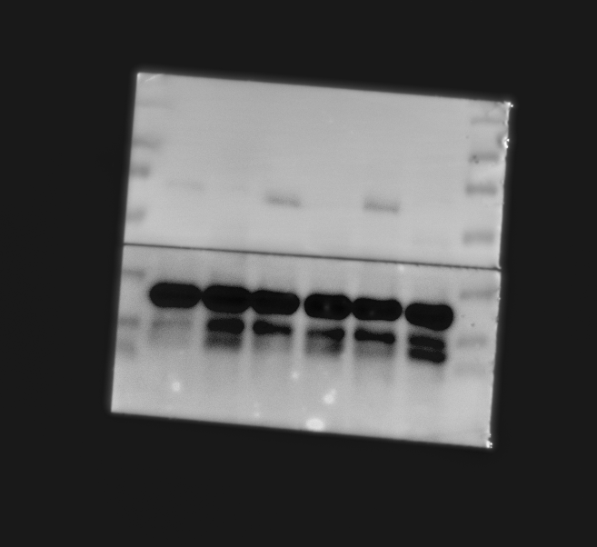
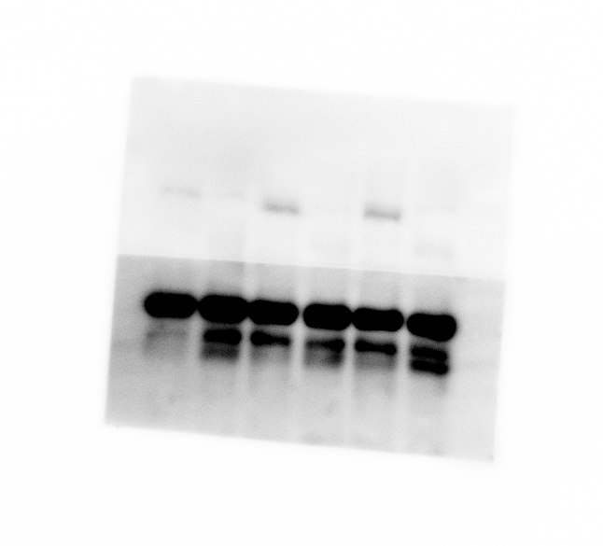
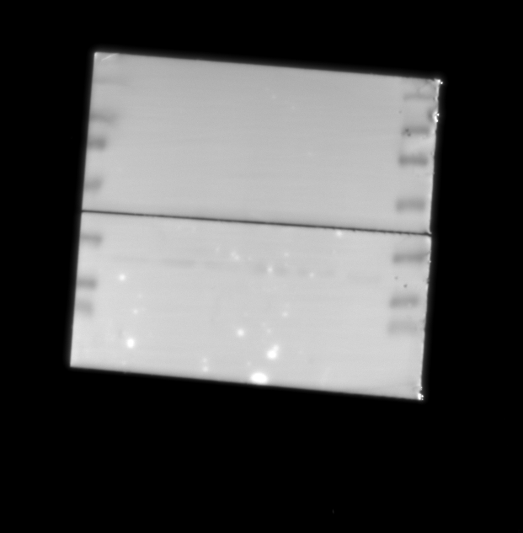
supplementary figure 3C IRF5
130
100
70
55
IRF5
40
35
GAPDH

Slide 9
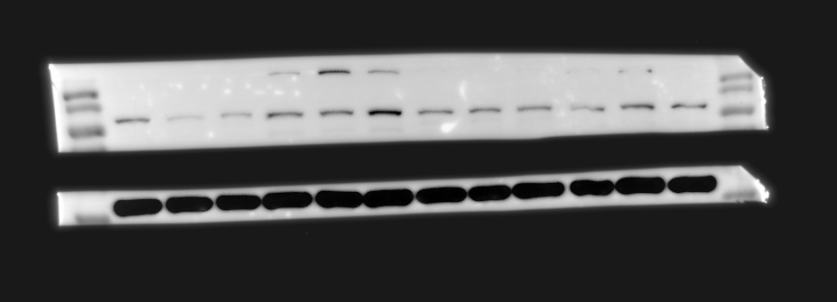
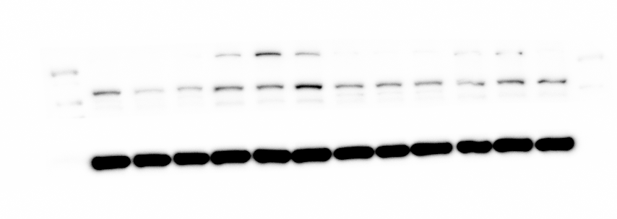

Figure 12 F
MMP9
100
MMP9
70
actin
55
40

Slide 10



Figure 12F α-SMA
55
α-SMA
40
GAPDH
35

Slide 11
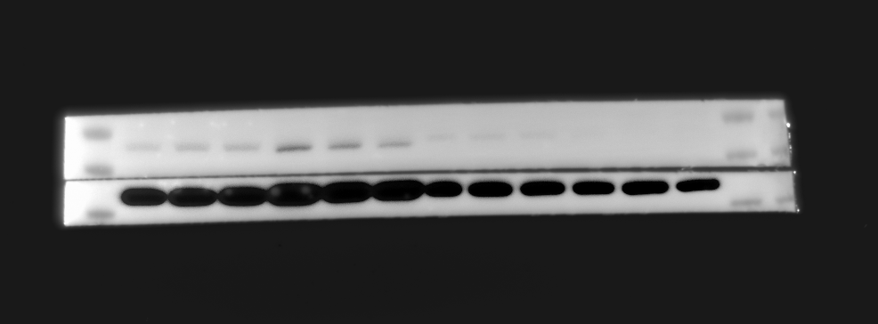
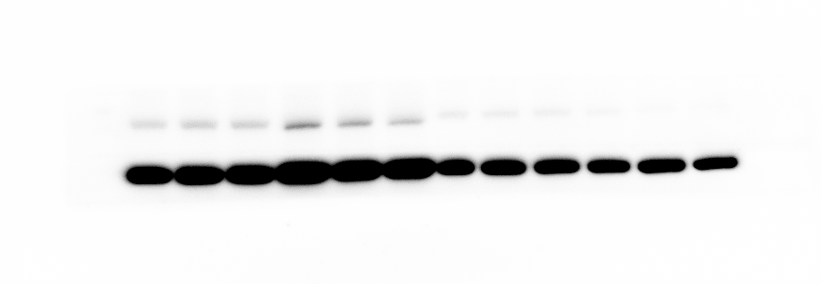

supplementary figure 3A IRF5
70
Irf5
55
actin
40

Slide 12
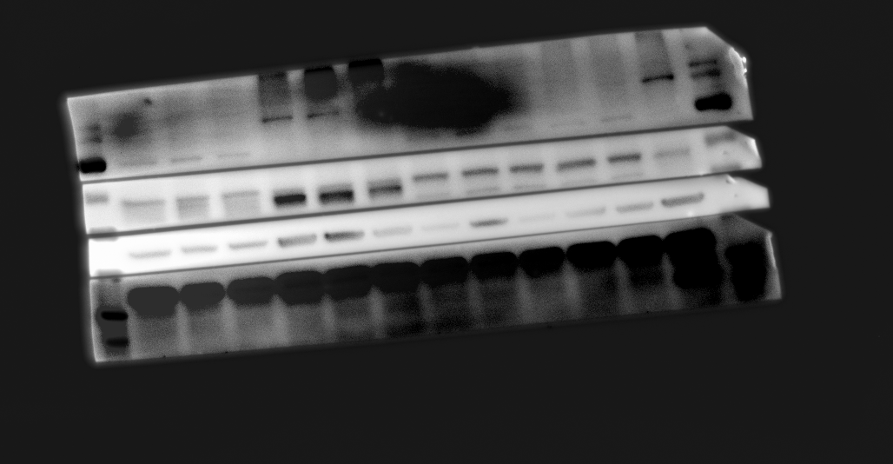
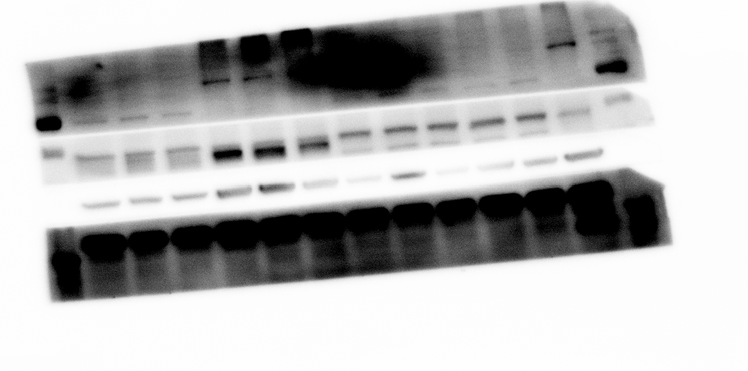
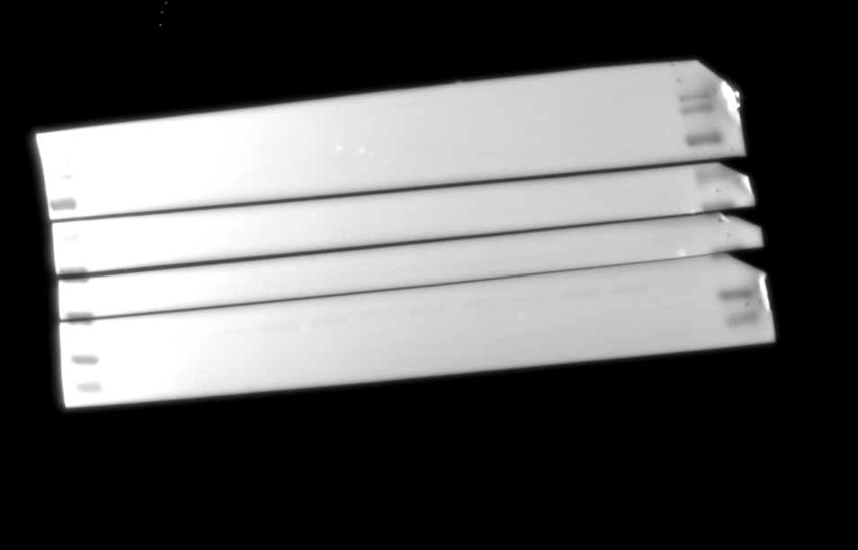
supplementary figure 3D IRF5
70
IRF5
55
GAPDH
40
35

