Slide 1
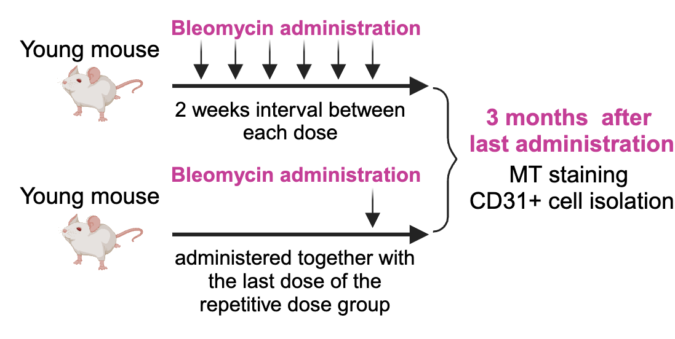
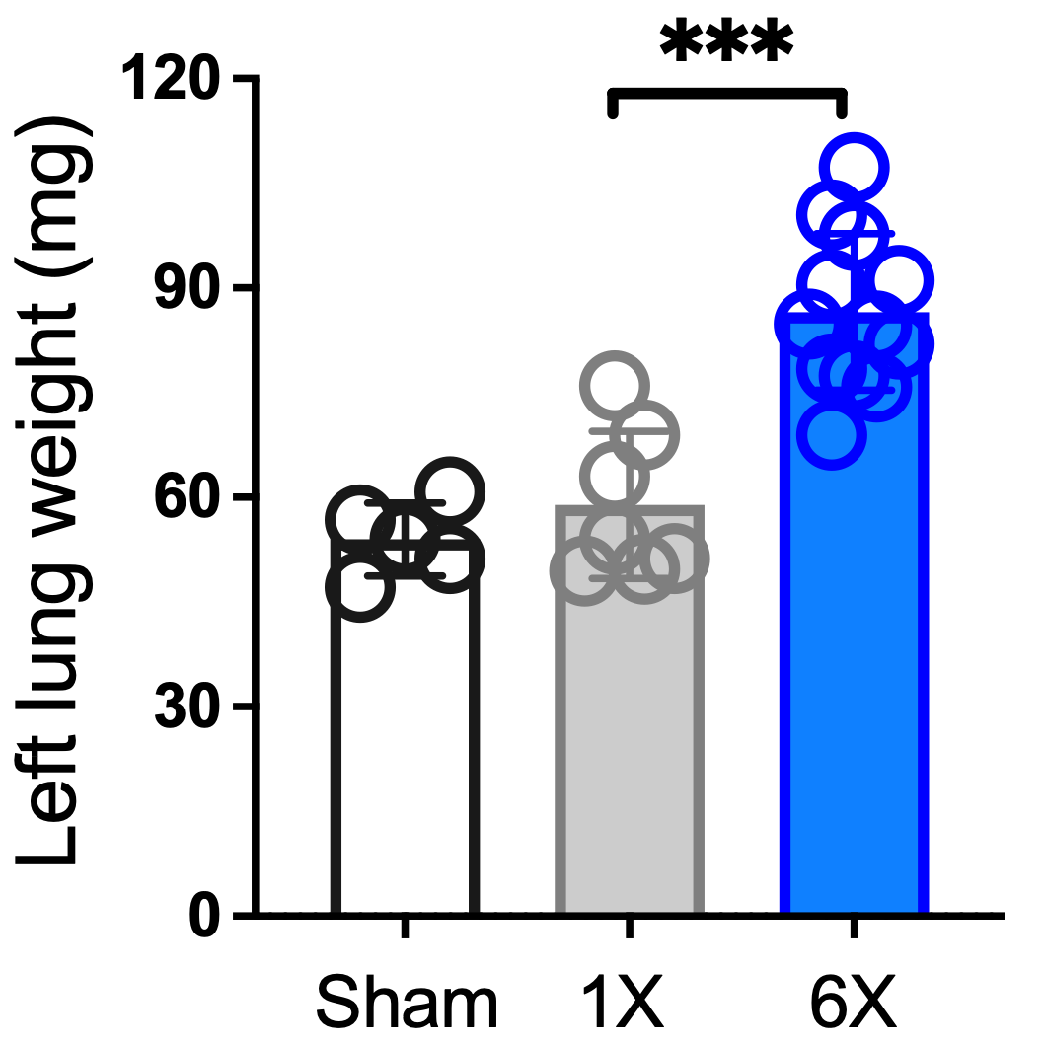
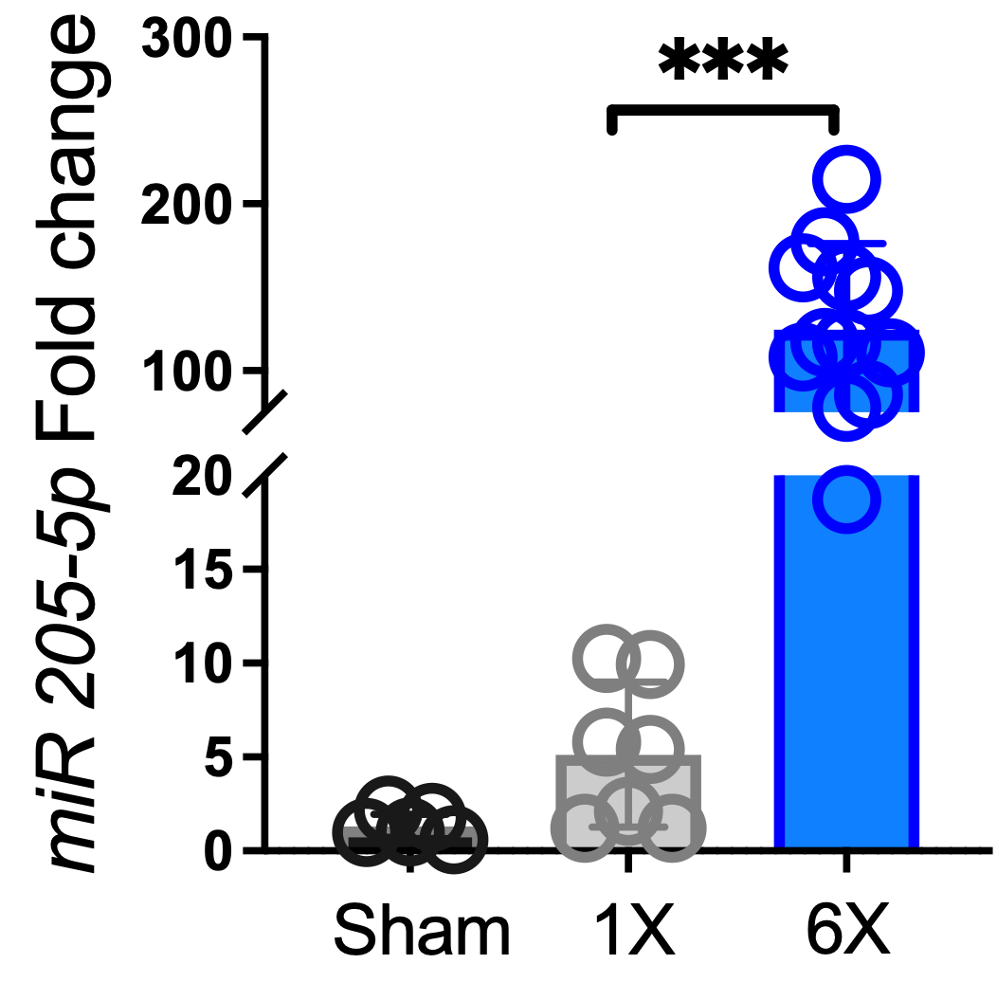
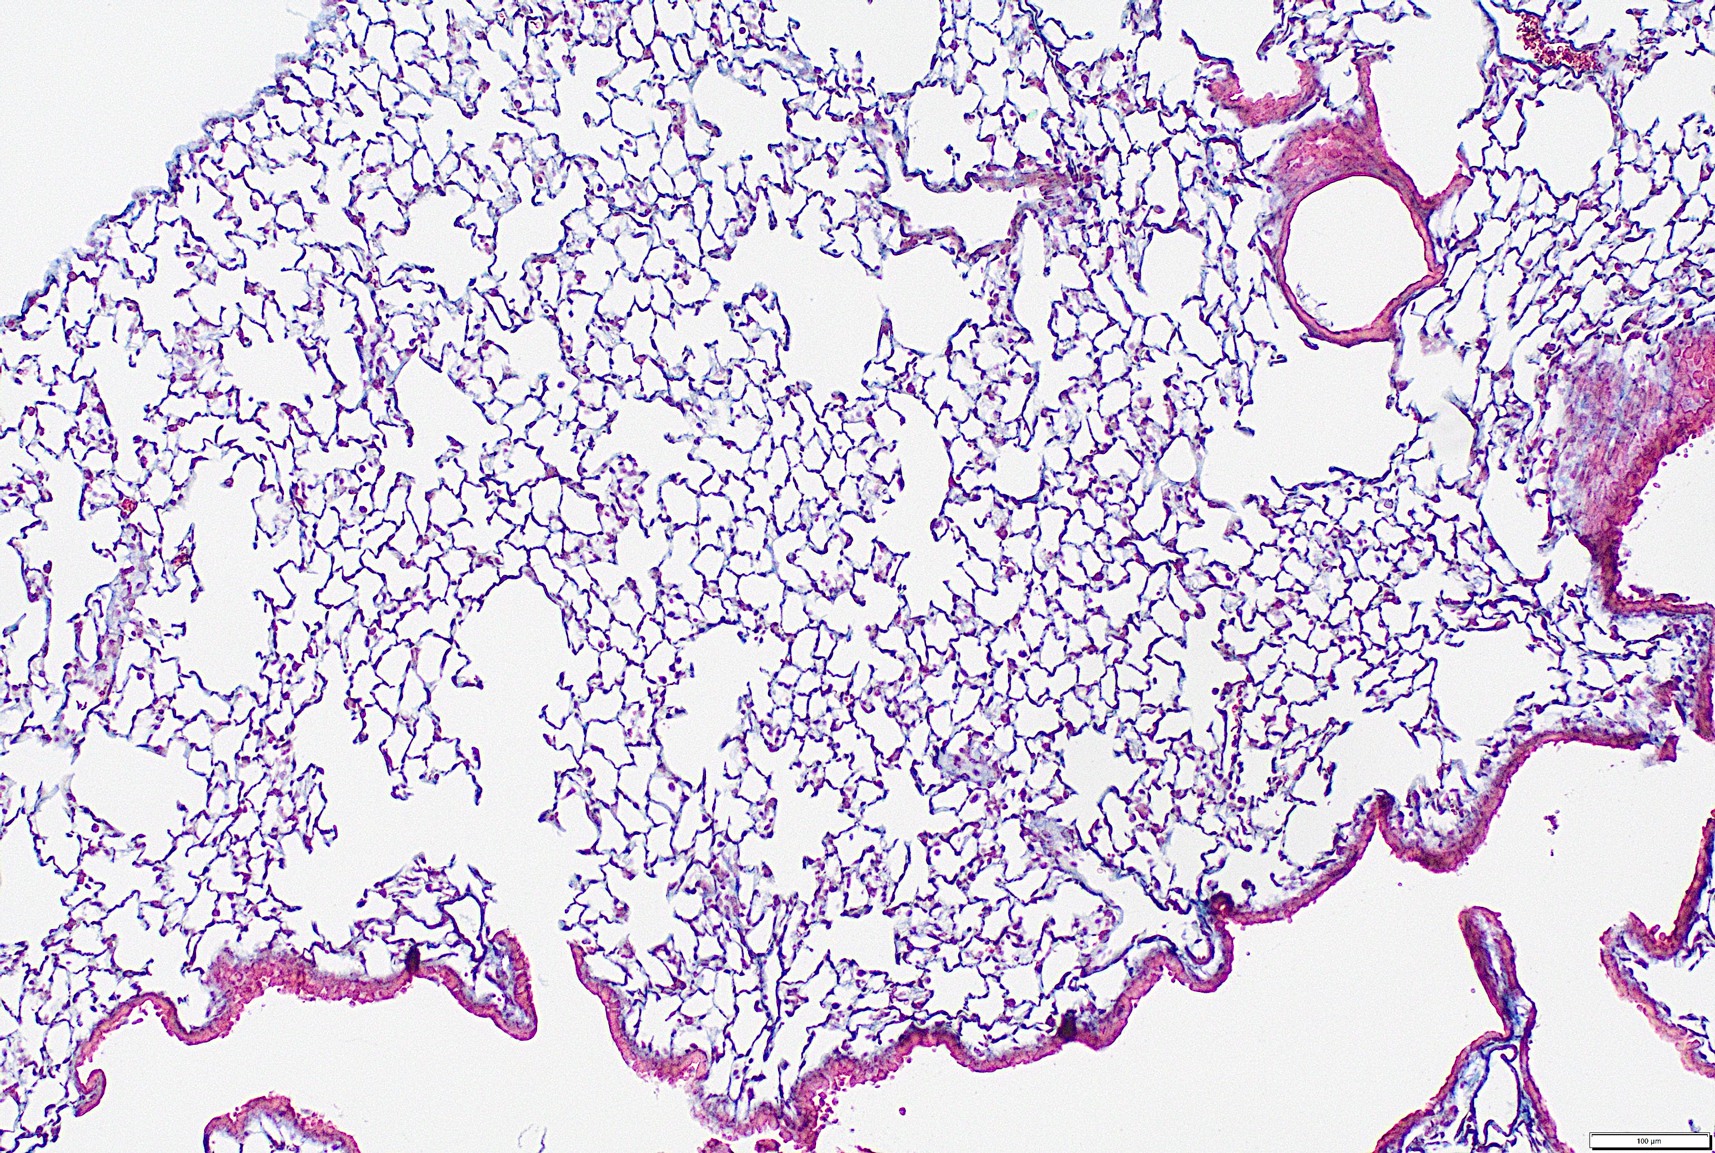
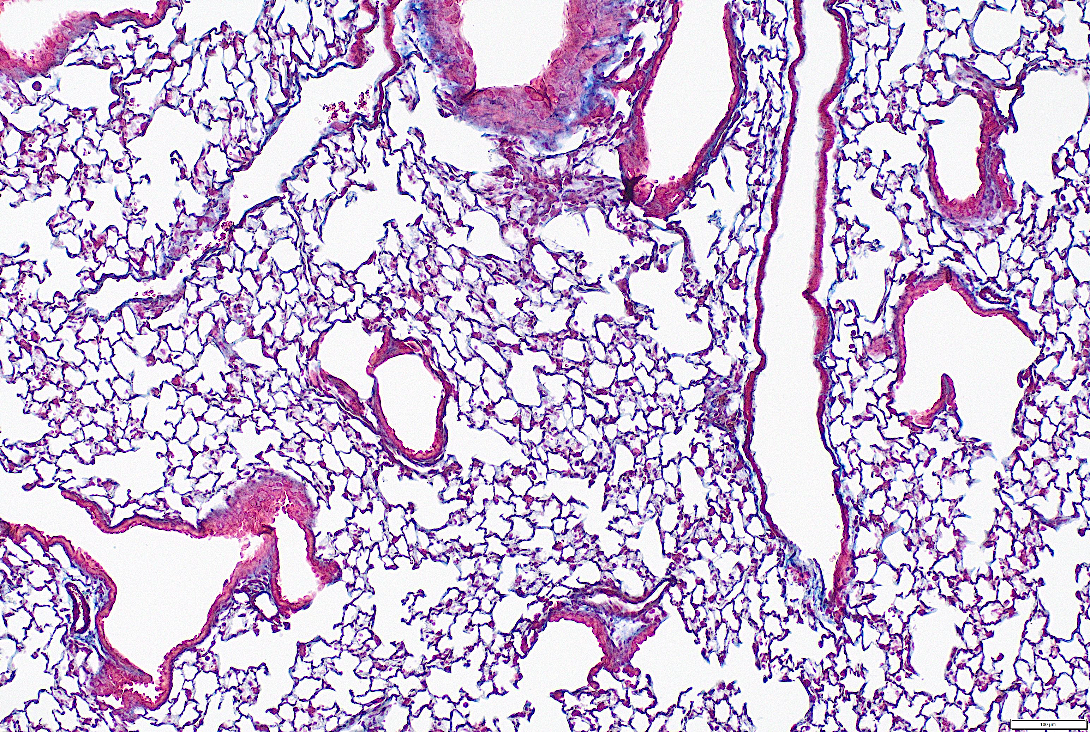
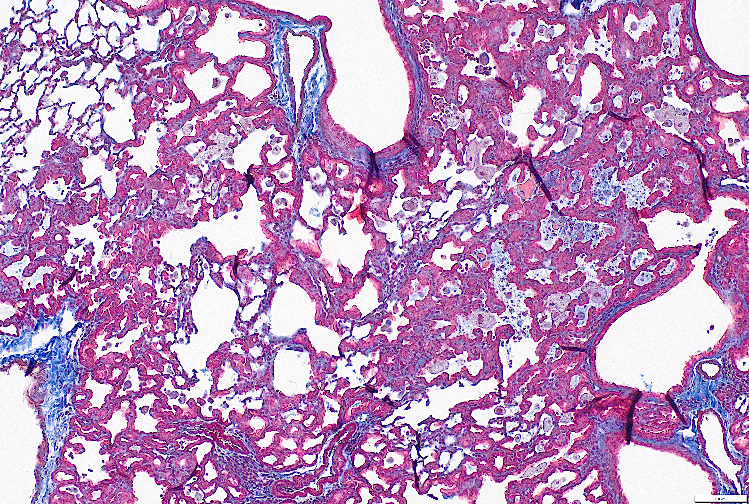
A
Repetitive injury young mice
B
D
mmu-miR-205-5p
6X
1X
C
Sham
1X Bleomycin
6X Bleomycin
Collagen stained in blue

Slide 2
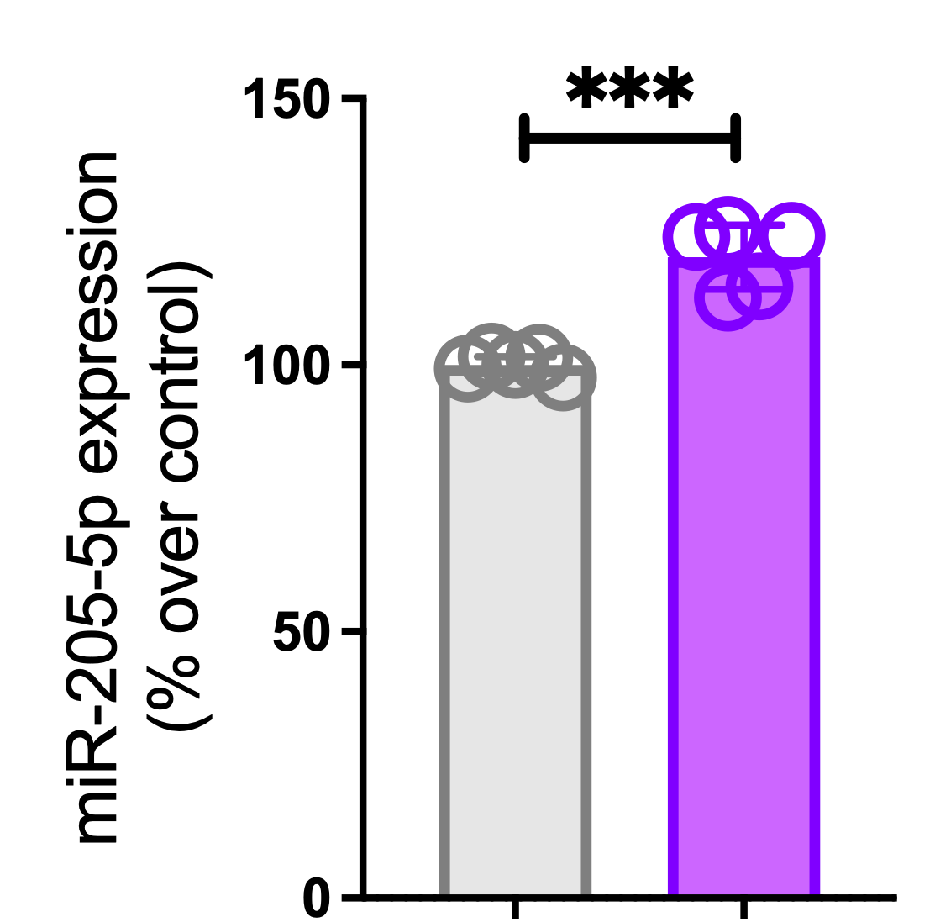
Healthy
IPF

Slide 3
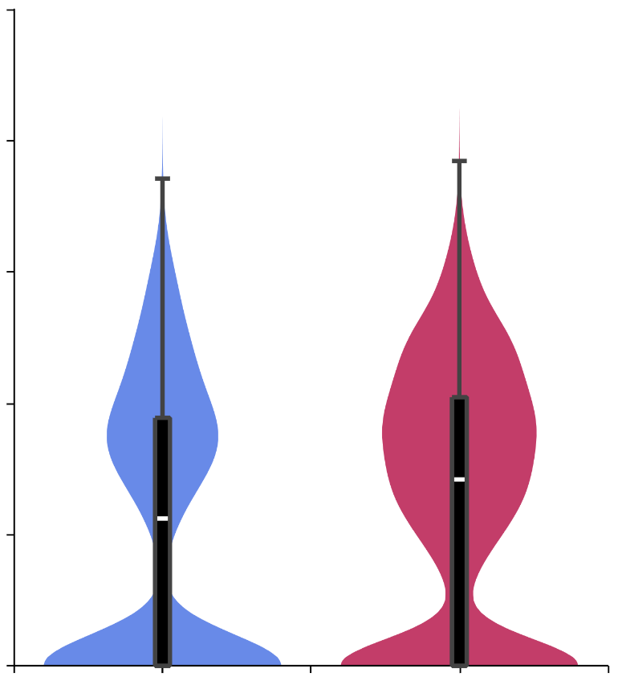
5
Tsukui et al. dataset
CDKN1A
4
3
Normalized expression
2
1
0
Healthy
IPF

Slide 4
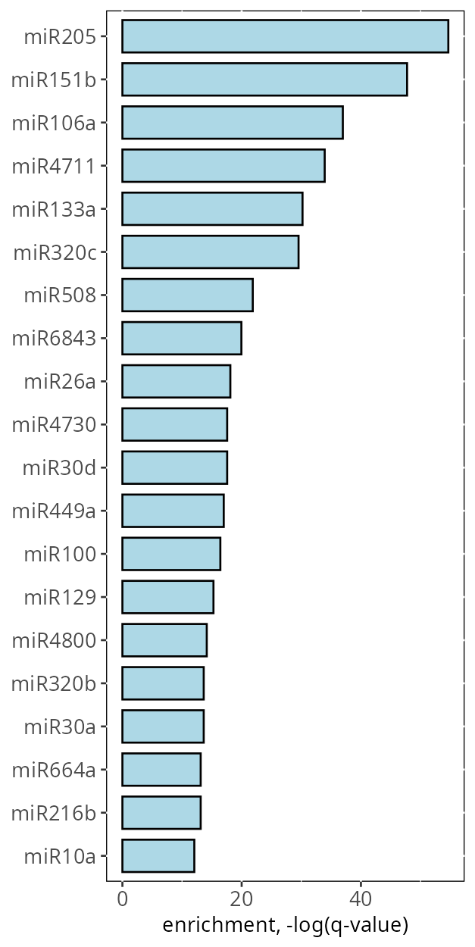
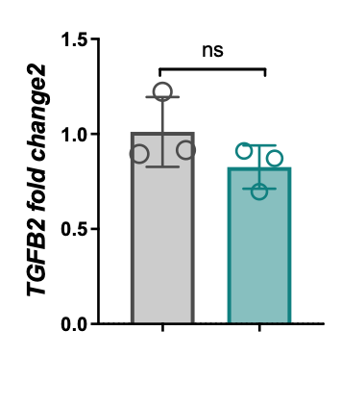
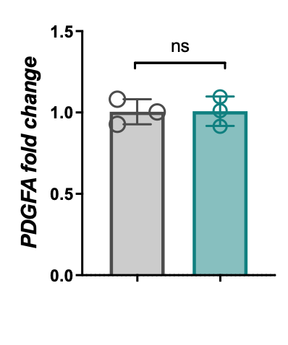
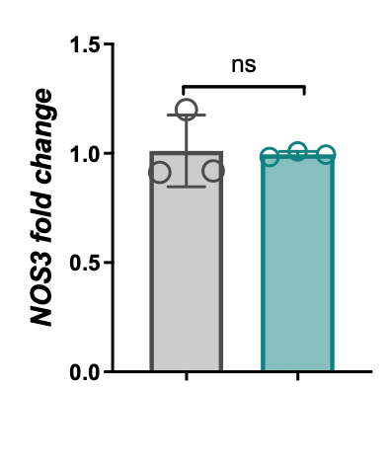
A
B
Profibrotic genes
Healthy
IPF
Healthy
IPF
Healthy
IPF

Slide 5
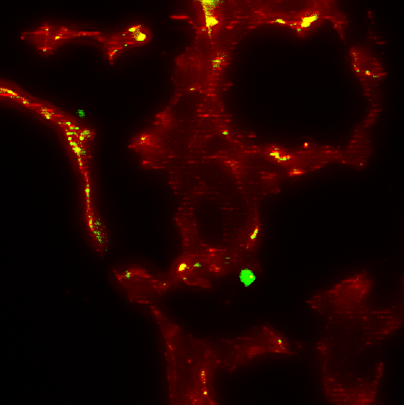
CD31
negative
inhibitor

