Slide 1
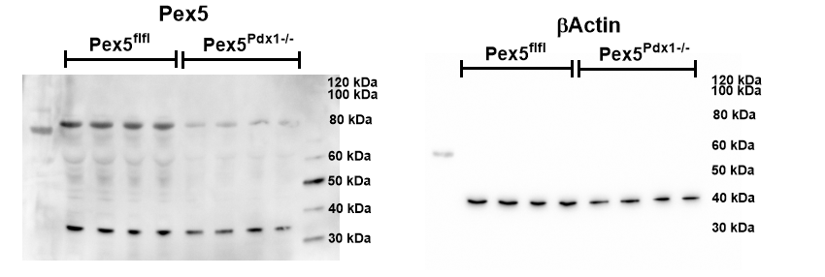
Full unedited gel for Figure 1B

Slide 2
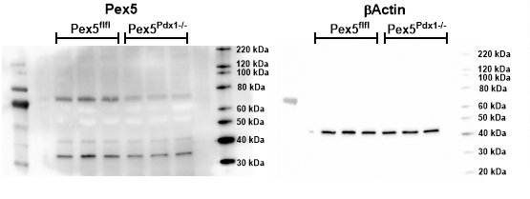
Full unedited gel for Figure 1C

Slide 3
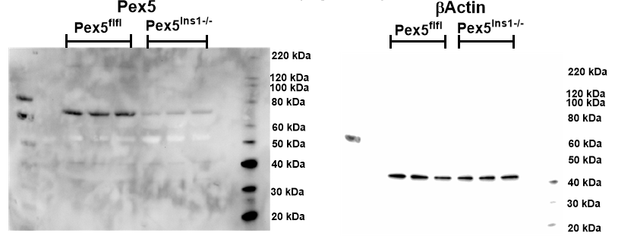
Full unedited gel for Figure 1J

Slide 4
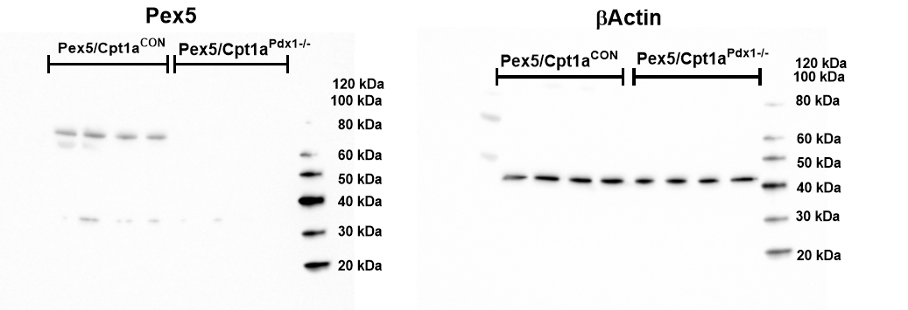
Full unedited gel for Figure 6B

