Slide 1
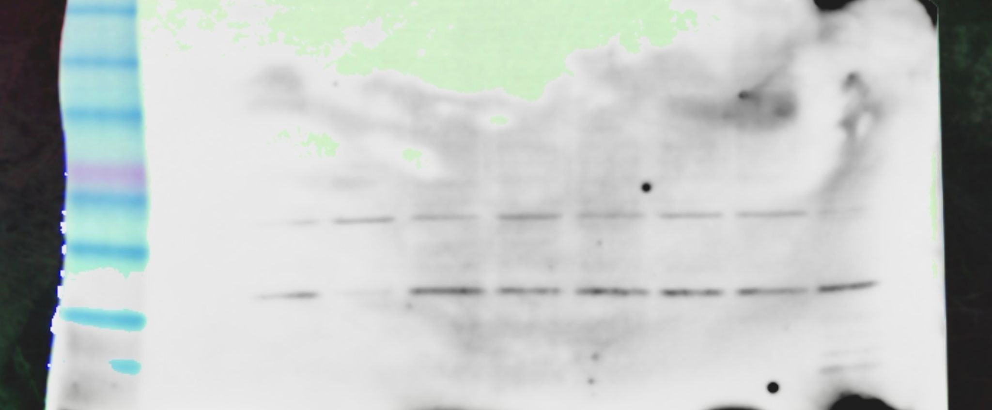
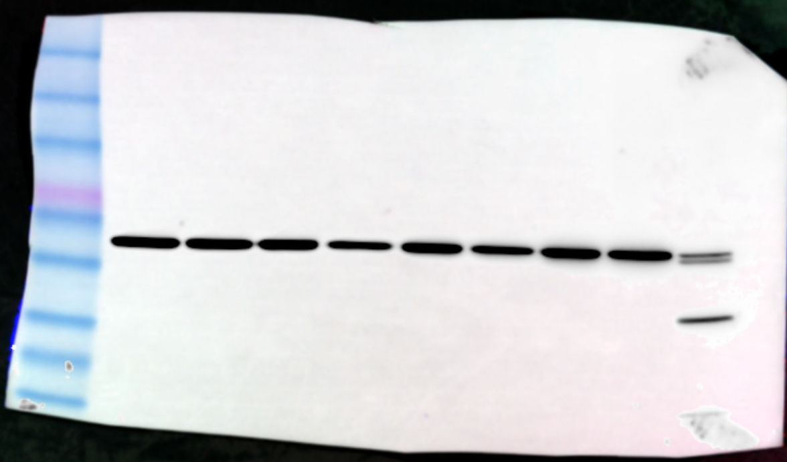
Figure 3A
Alb
Alb + Palm
AP
0
+
0
+
BL
+
0
+
+
CHOP
β-actin

Slide 2
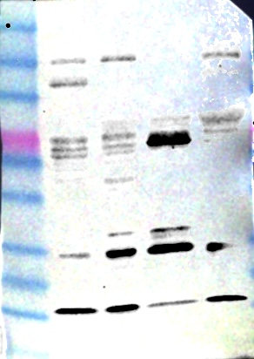

Figure 3C
Slc27a2
+/+
+/+
+/+
-/-
eNOS
+/+
+/+
-/-
-/-
Lepr
+/+
db/db
db/db
db/db
CHOP
β-Actin

Slide 3
Supplemental Figure 4
AP palm
+
+
BL palm
+
+
+
+
Lipofermata
+
+
+
- CHOP

Slide 4
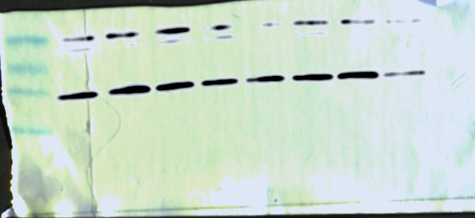

Figure 5E
Bilateral Palm
BL Palm
[PF-06424439] (µM)
1
3
10
1
3
10
CHOP
β-Actin

Slide 5
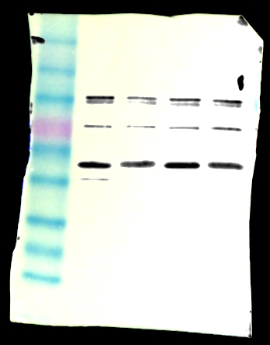
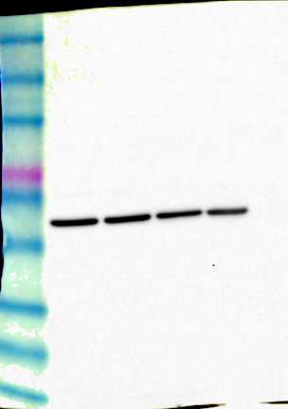
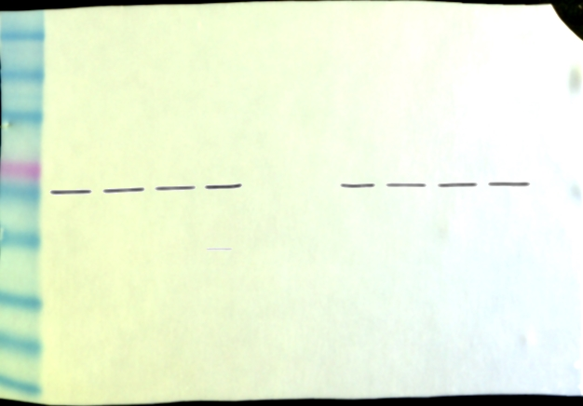
Figure 7G
Alb
Alb + Palm
Alb
Alb + Palm
AP
+
+
0
+
AP
+
+
0
+
Alb
Alb + Palm
BL
0
0
+
+
BL
0
0
+
+
SPTLC1
AP
+
+
0
+
BL
0
0
+
+
CerS6
β-actin

Slide 6
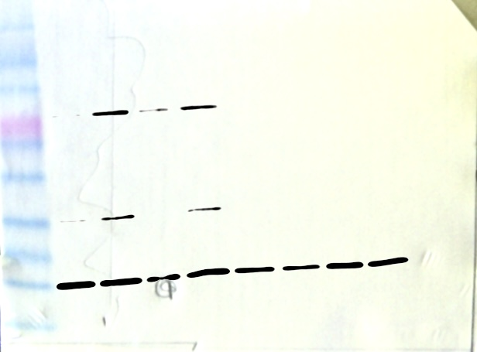
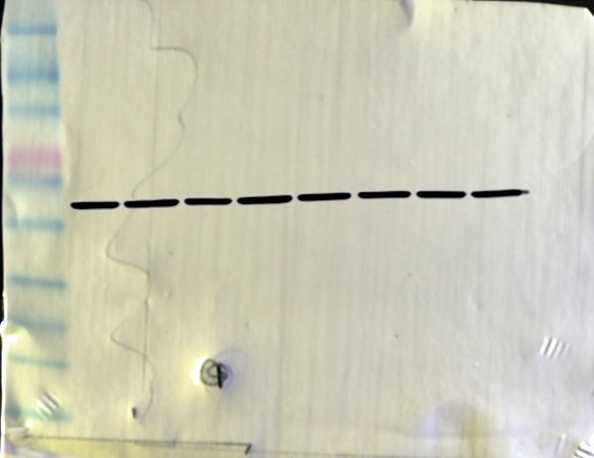
AMG PERK44
+
+
+
+
Supplemental Figure 6
AP palm
+
+
+
+
BL palm
+
+
+
+
BSA
+
+
+
+
+
+
+
+
CHOP
β-actin

Slide 7
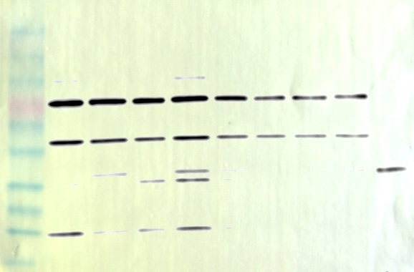
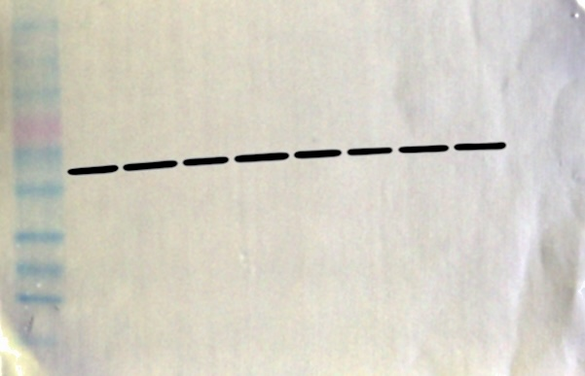
Figure 8B
Myriocin
+
+
+
+
AP palm
+
+
+
+
BL palm
+
+
+
+
CHOP
β-Actin

Slide 8
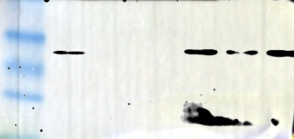
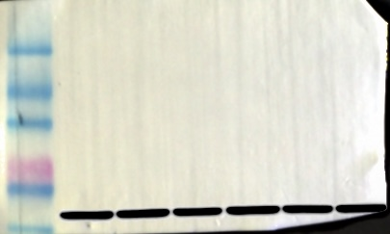
Figure 8C
LF control
C16-cer
CHOP
β-actin

Slide 9
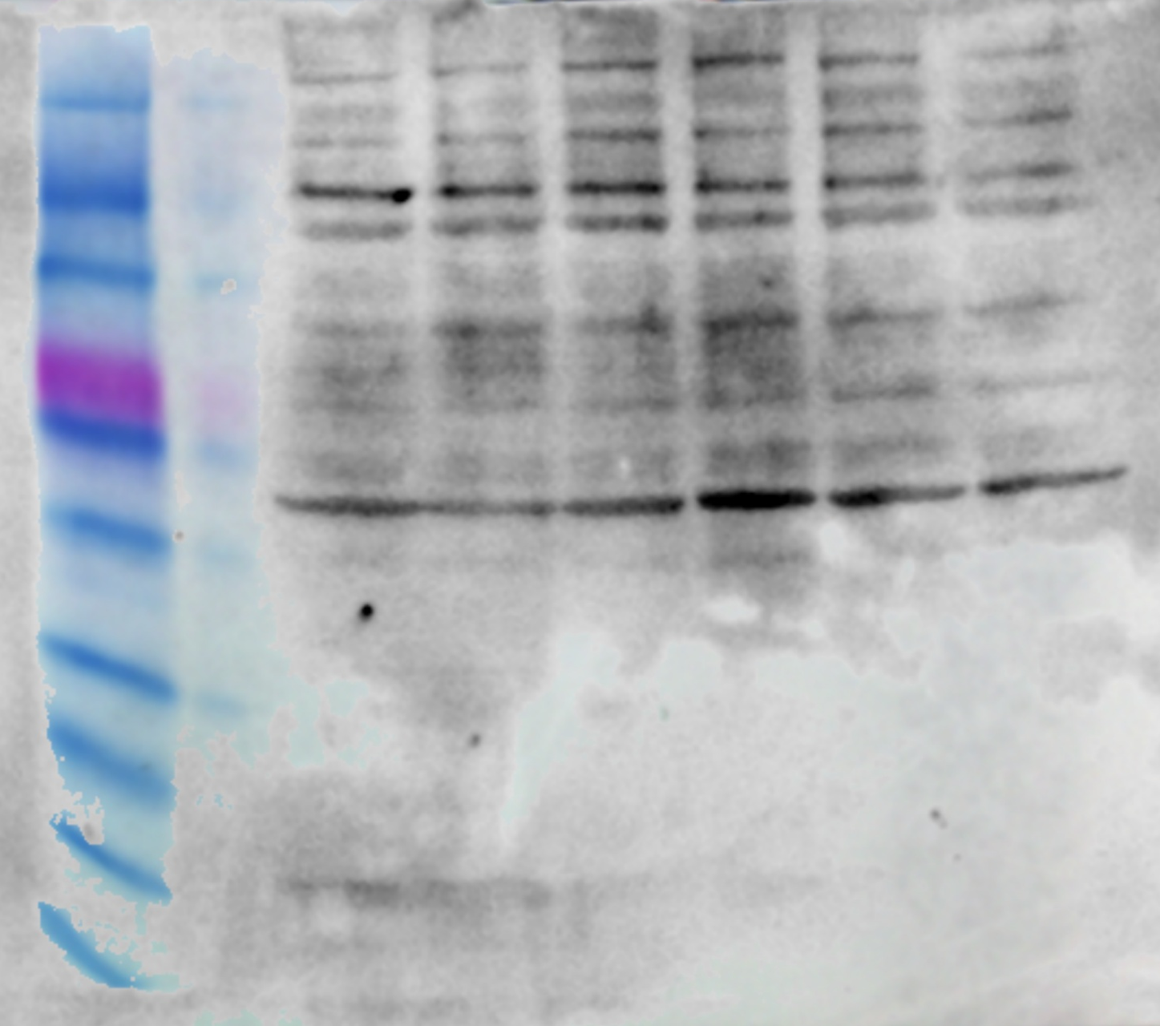
Supplemental Figure 7B
AP palm
+
+
BL palm
+
+
+
+
Myriocin
+
+
+
- TIP47

