Slide 1
Full unedited gels for figure 2A
Calpain-1
Calpain-2
HMGB1
GAPDH

Slide 2
Full unedited gels for figure 2F
Calpain-1
Calpain-2
HMGB1
β-Actin

Slide 3
Full unedited gels for figure 5B
HMGB1
β-Actin

Slide 4
Full unedited gels for figure 8B
HMGB1
β-Actin

Slide 5
Full unedited gels for figure 9A
HMGB1
β-Actin

Slide 6
Full unedited gels for figure 9C
HMGB1
β-Actin

Slide 7
Full unedited gels for figure 11A
HMGB1
β-Actin

Slide 8
Full unedited gels for figure 13F
HMGB1
β-Actin

Slide 9
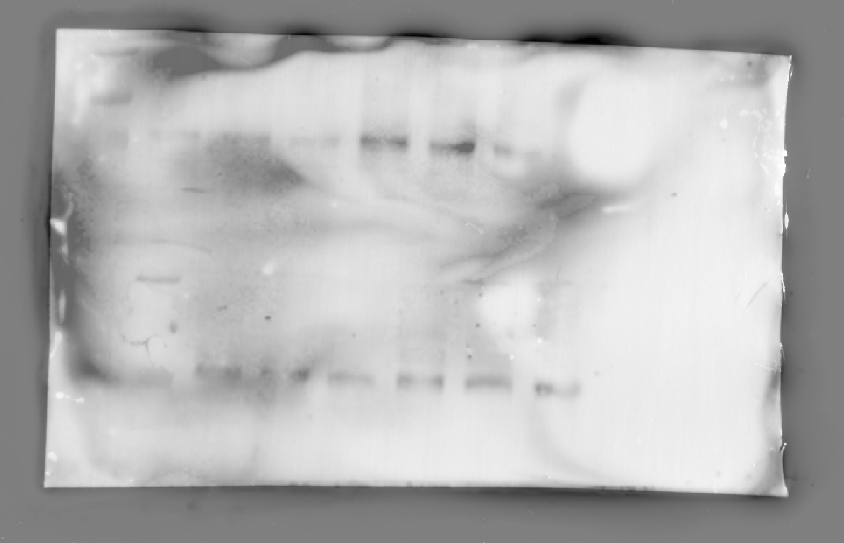
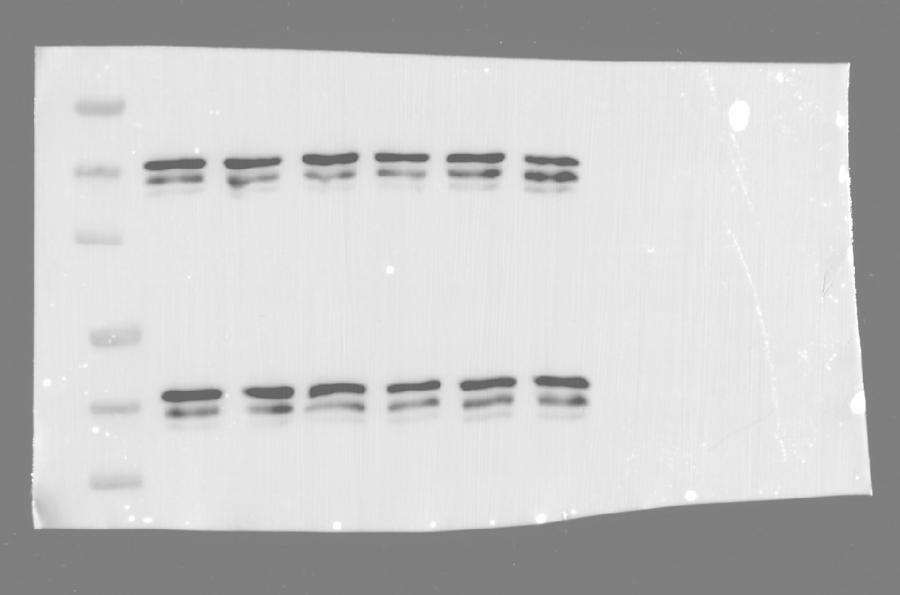
Full unedited gels for supplemental figure 3A
Calpain-1
β-Actin

Slide 10
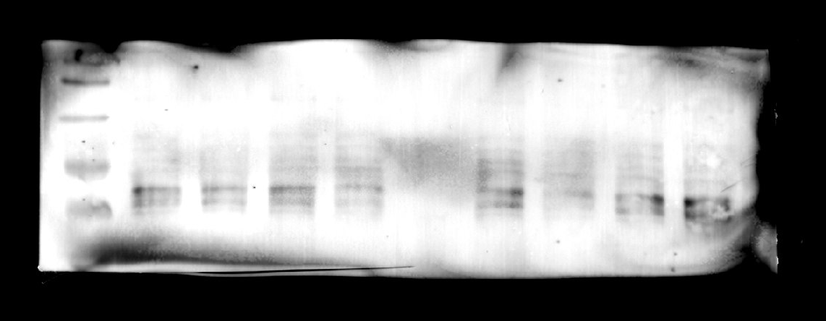
Full unedited gels for supplemental figure 3B
Calpain-1
β-Actin

Slide 11
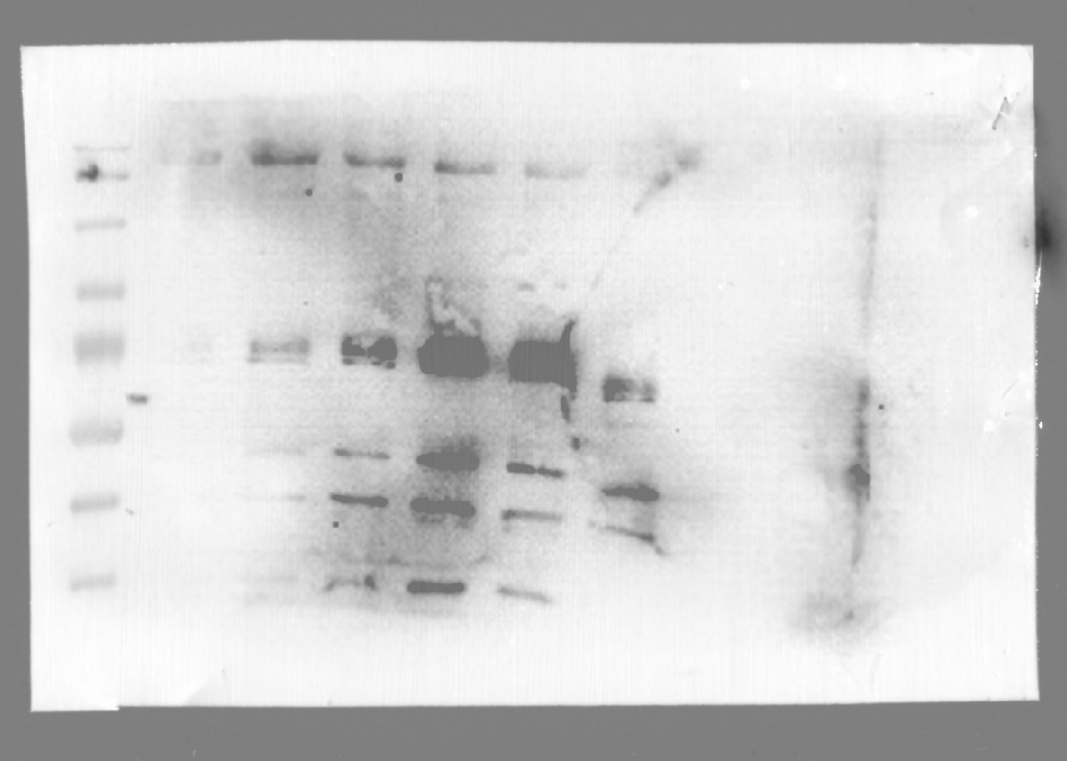
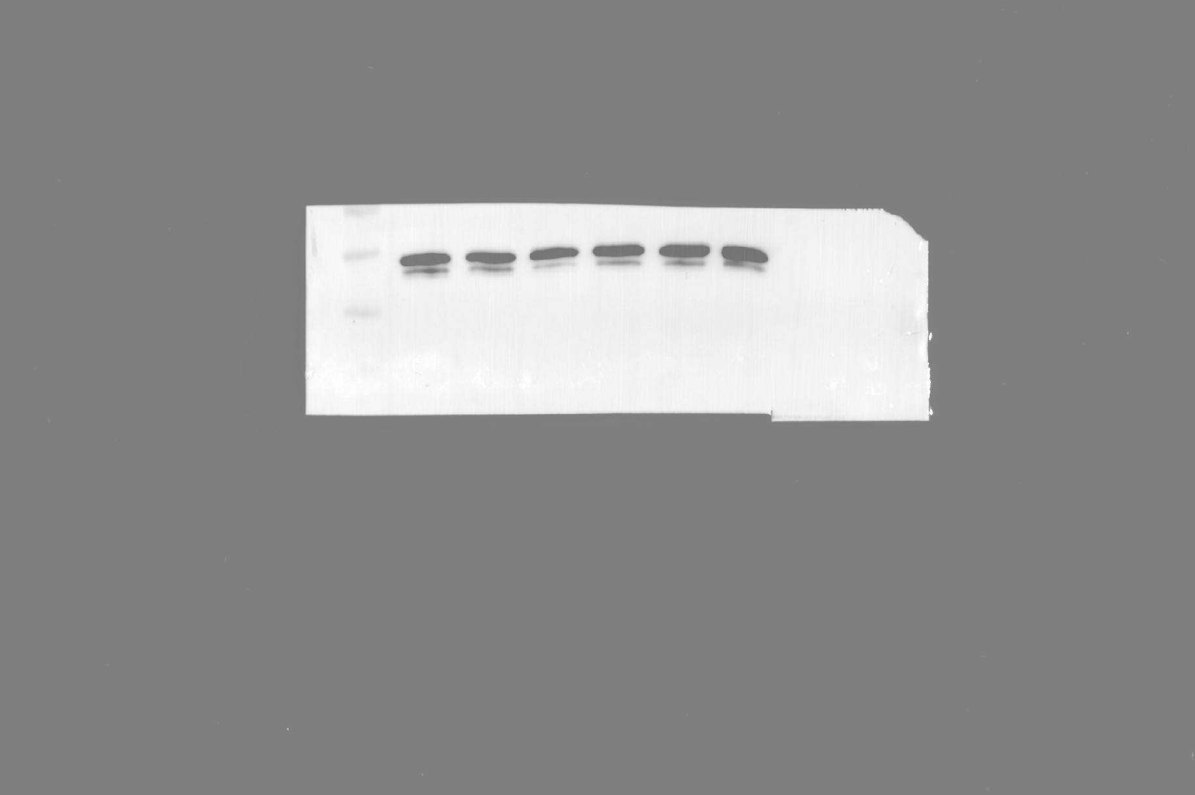
Full unedited gels for supplemental figure 4A
Calpain-1
β-Actin

Slide 12
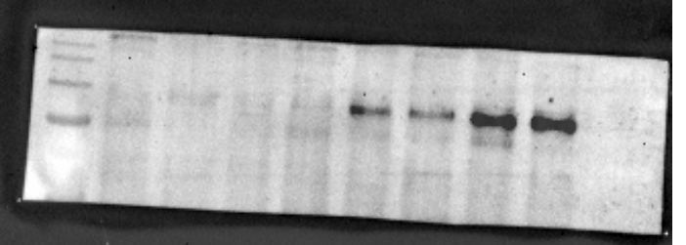
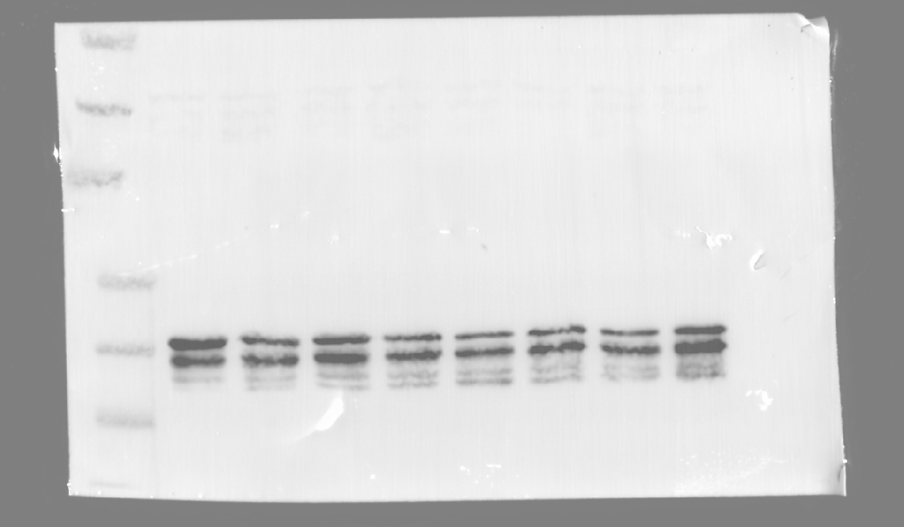
Full unedited gels for supplemental figure 5B
CAST
β-Actin

Slide 13
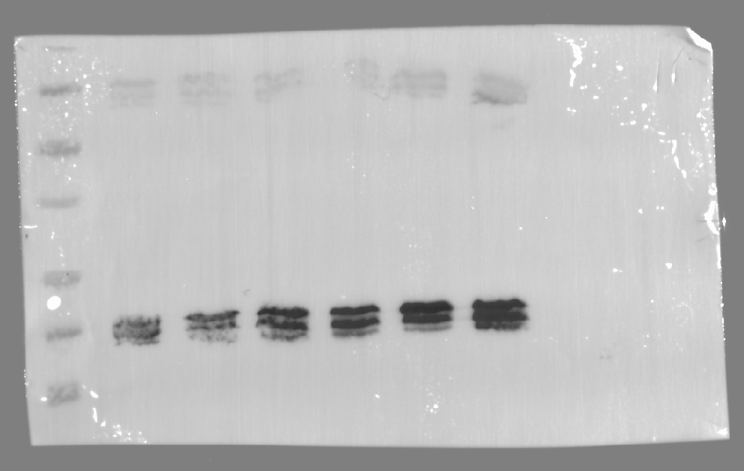
Full unedited gels for supplemental figure 13
CAST
β-Actin

