Slide 1
Raw Data for Western Blots
SMOC2-pEMT
2025-07-28

Slide 2
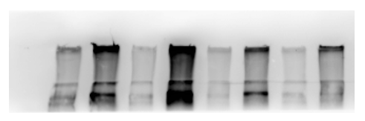
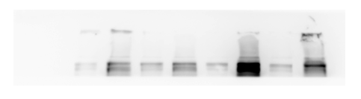
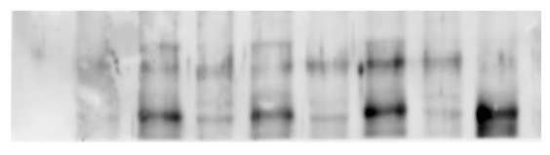
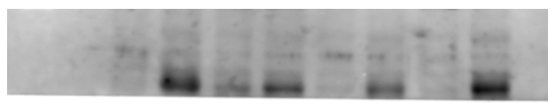
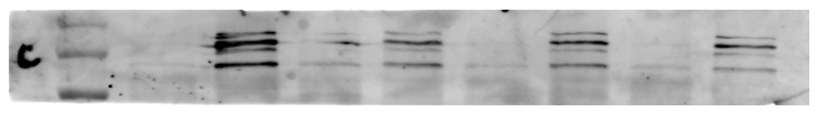
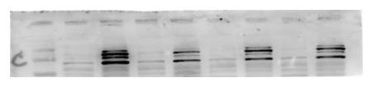
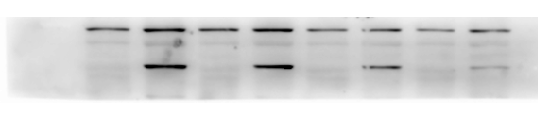
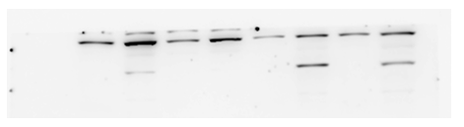
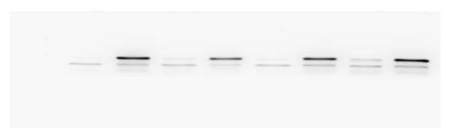
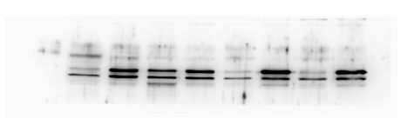
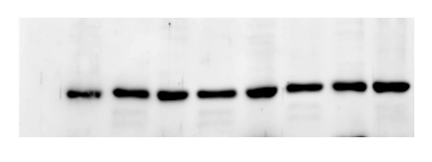
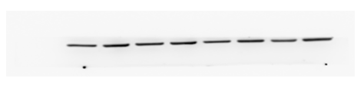
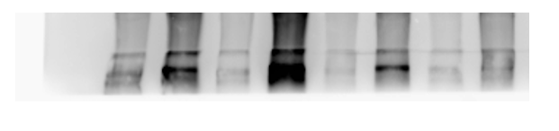
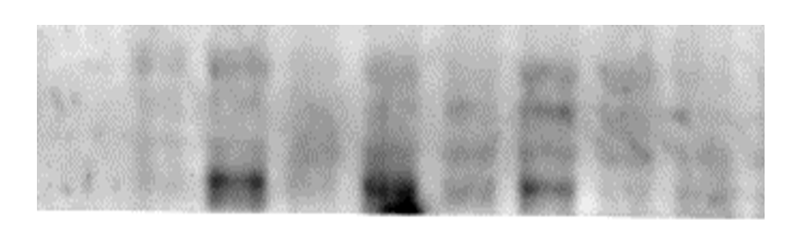
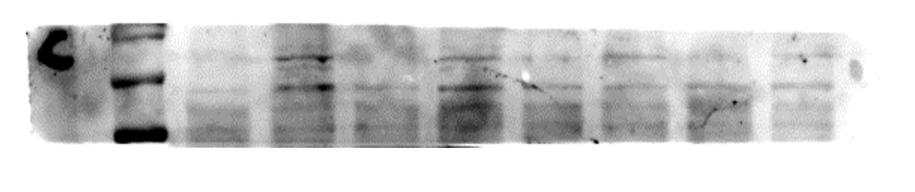
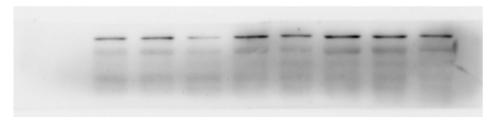
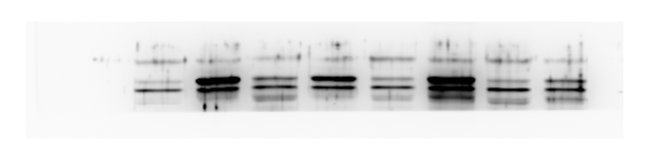
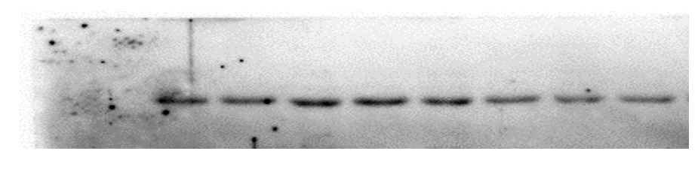
Figure 3
Ladder
Ladder
Sham 1
Sham 2
Sham 3
Sham 4
CoK 4
UUO 2
UUO 4
CoK 3
UUO 1
UUO 3
IR 1
CoK 1
CoK 2
IR 2
IR 3
IR 4
Fibronectin
- 250 kD
- 250 kD
SMOC2
- 50 kD
- 50 kD
Collagen I
- 150 kD
- 150 kD
Vimentin
- 50 kD
- 50 kD
CK18
- 37 kD
- 37 kD
GAPDH
- 37 kD
- 37 kD
Ladder
Control 1
Control 2
Control 3
Control 4
FA 1
FA 2
FA 3
FA 4
Fibronectin
- 250 kD
SMOC2
- 50 kD
Collagen I
- 150 kD
Vimentin
- 50 kD
CK18
- 37 kD
GAPDH
- 37 kD

Slide 3
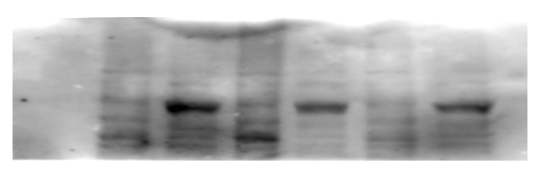
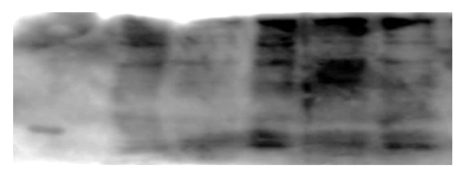
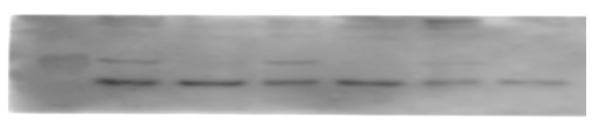
Figure 4
Tubules
Ladder
CoK 1
UUO 1
UUO 2
CoK 2
CoK 3
UUO 3
FOXK1
- 75 kD
TWIST1
- 25 kD
GAPDH
- 37 kD

Slide 4
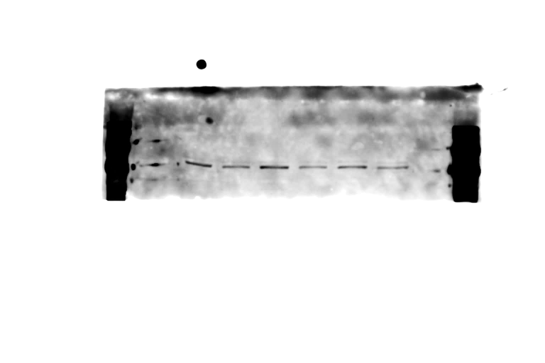
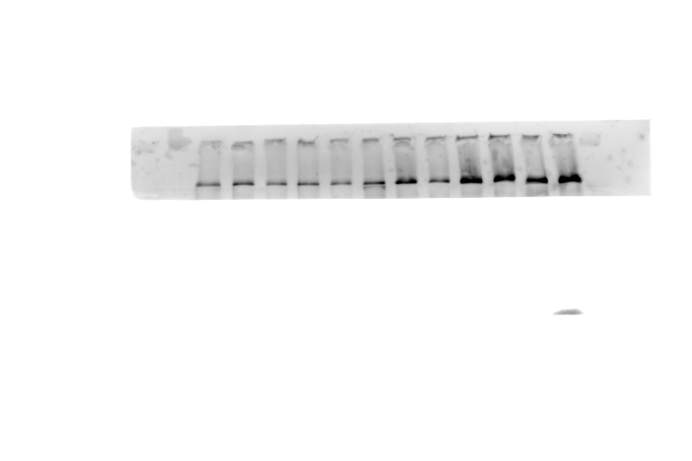
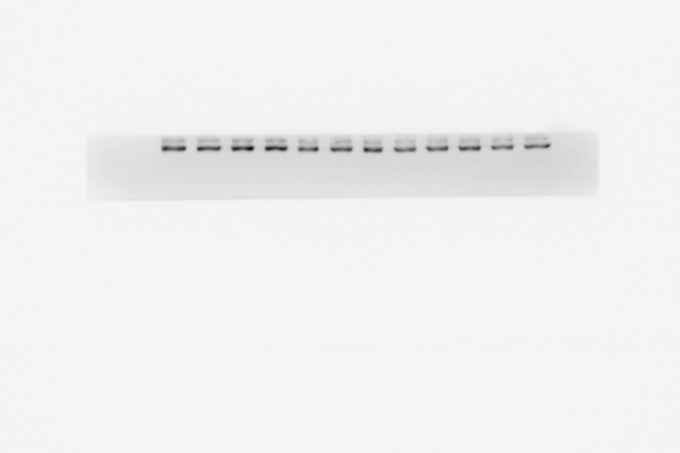
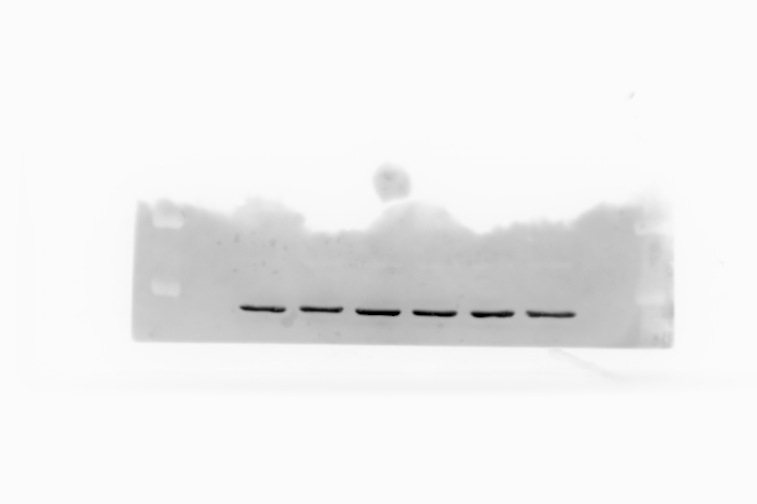
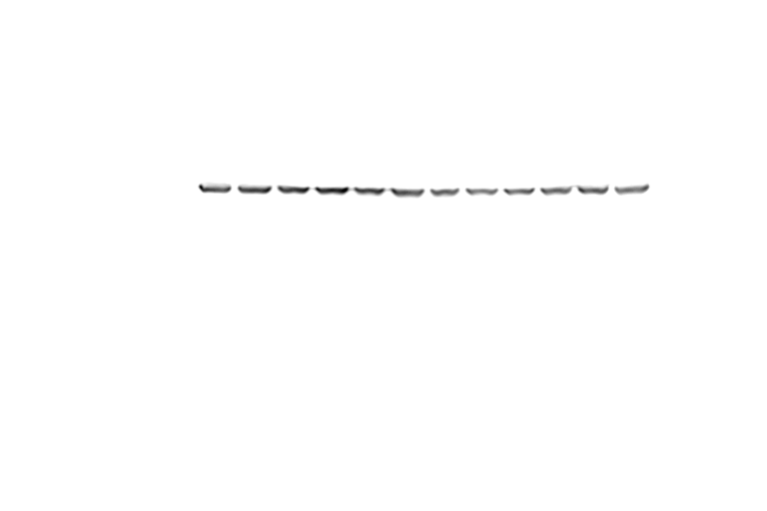
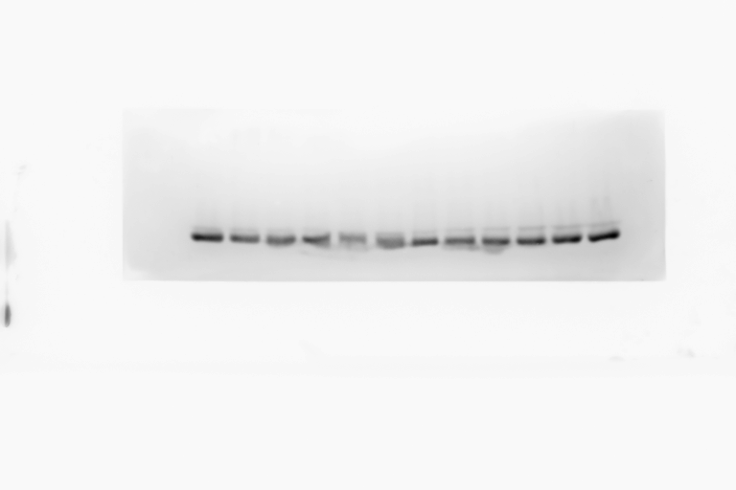
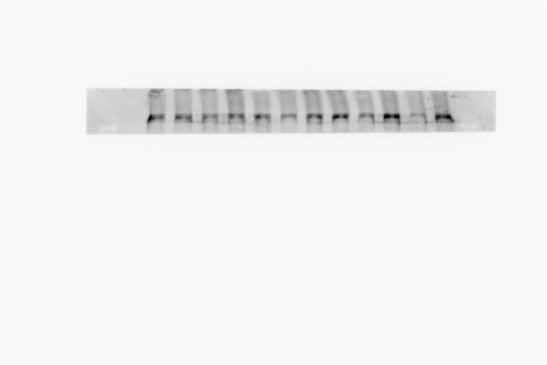
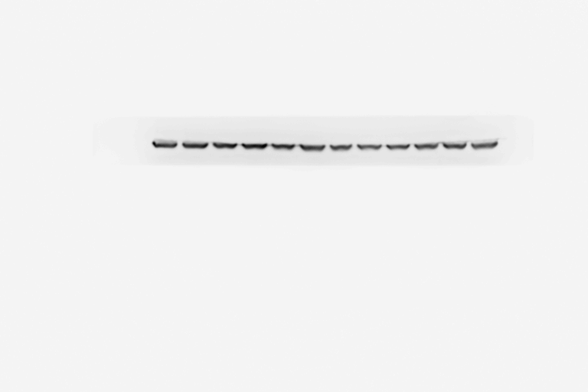
Figures 7 and supplemental 3
Ladder
Ladder
Ladder
rhSMOC2 (5ng/ml) - + - + - +
rhSMOC2 (5ng/ml) - + - + - +
E-cadherin
- 150 kD
Fibronectin
- 250 kD
- 100 kD
- 150 kD
N-cadherin
- 100 kD
GAPDH
- 37 kD
Vimentin
- 50 kD
GAPDH
- 37 kD
16h – Gel 1
16h – Gel 2
Ladder
rhSMOC2 (5ng/ml) - + - + - +
Fibronectin
- 250 kD
- 150 kD
N-cadherin
- 100 kD
Vimentin
- 50 kD
GAPDH
- 37 kD
24h

Slide 5
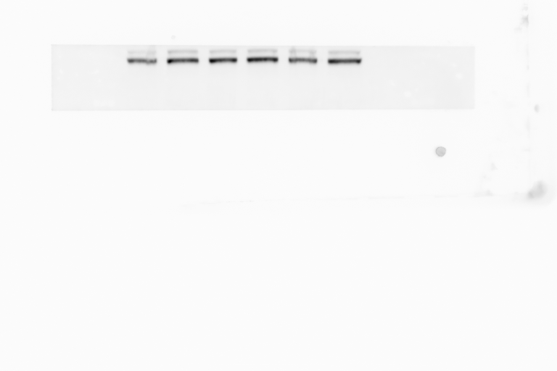
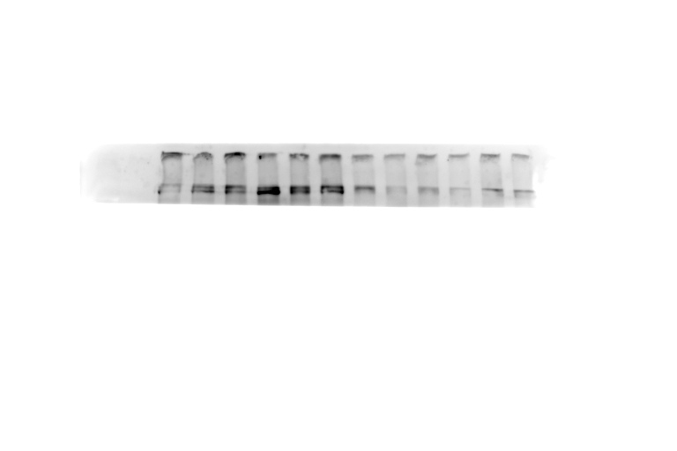
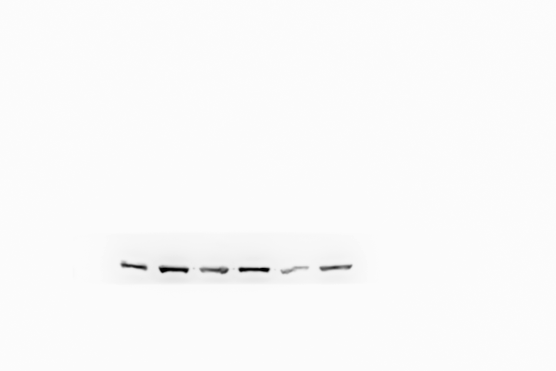
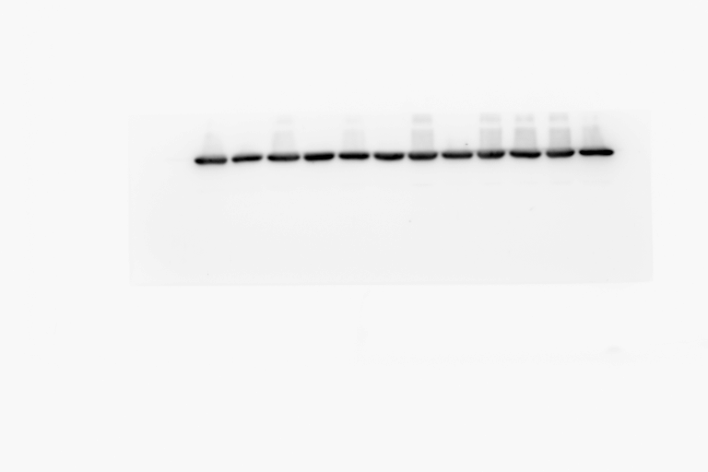
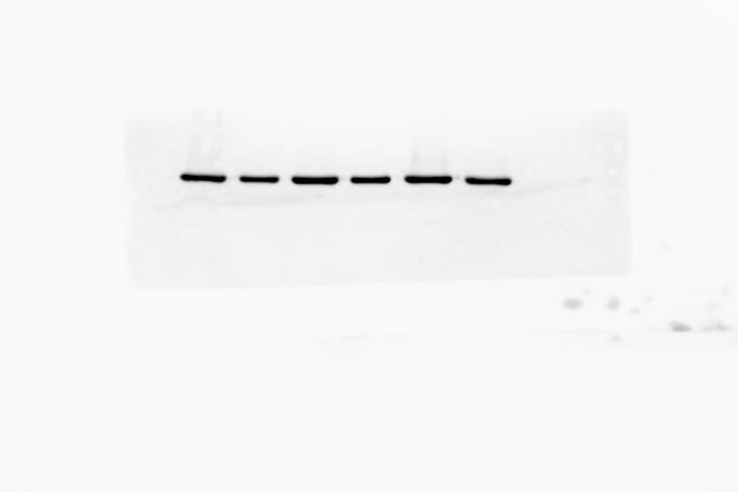
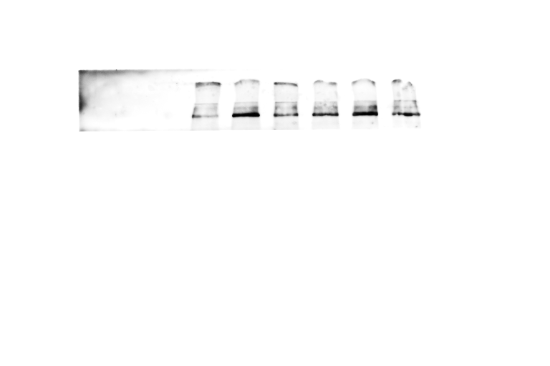
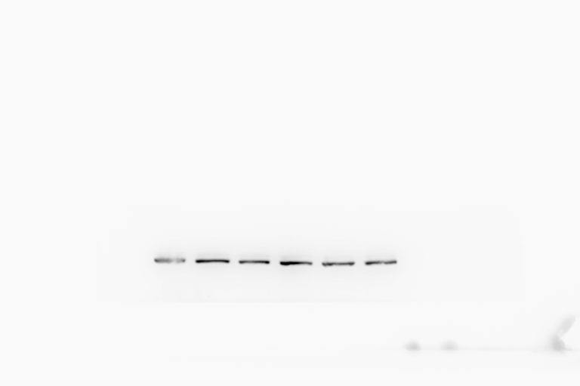
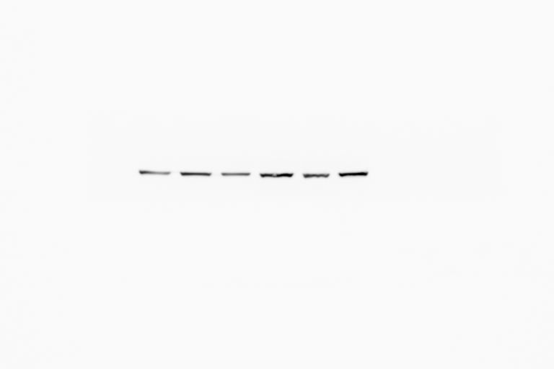
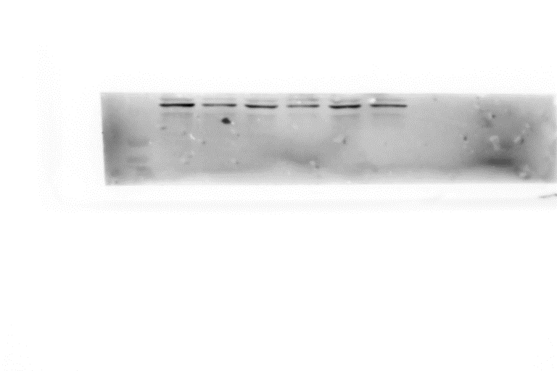
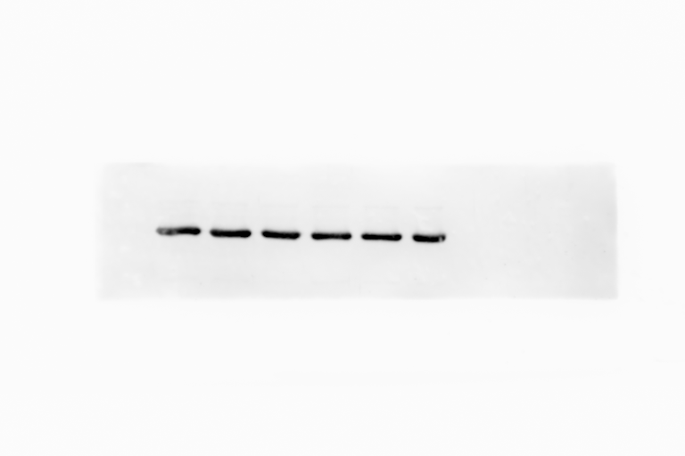
Figures 7 and supplemental 3 (cont.)
Ladder
Ladder
rhSMOC2 (5ng/ml) - + - + - +
- 150 kD
rhSMOC2 (5ng/ml) - + - + - +
N-cadherin
- 100 kD
Fibronectin
- 250 kD
GAPDH
- 37 kD
Vimentin
- 50 kD
48h – Gel 2
GAPDH
- 37 kD
48h – Gel 1
Ladder
rhSMOC2 (5ng/ml) - + - + - +
Fibronectin
- 250 kD
N-cadherin
- 150 kD
- 100 kD
Vimentin
- 50 kD
AQP1
- 37 kD
GAPDH
- 37 kD
72h

Slide 6
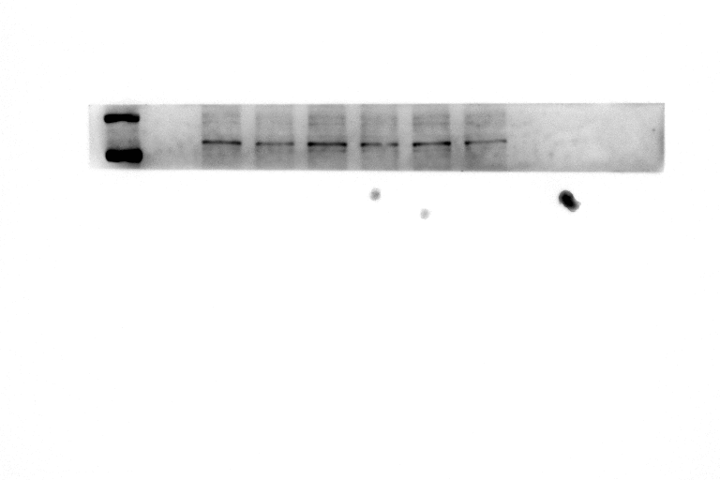
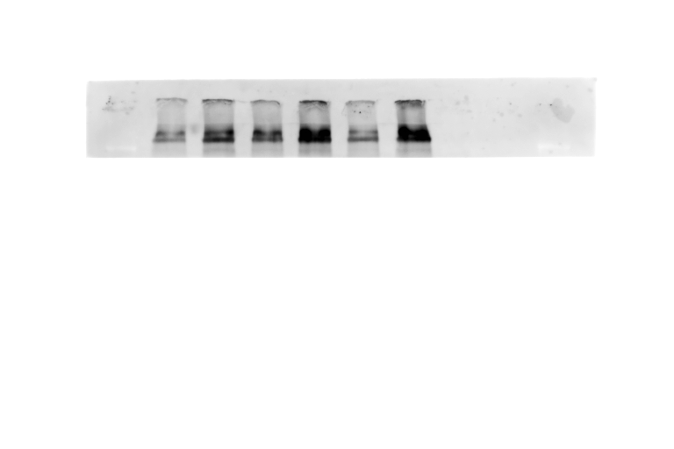
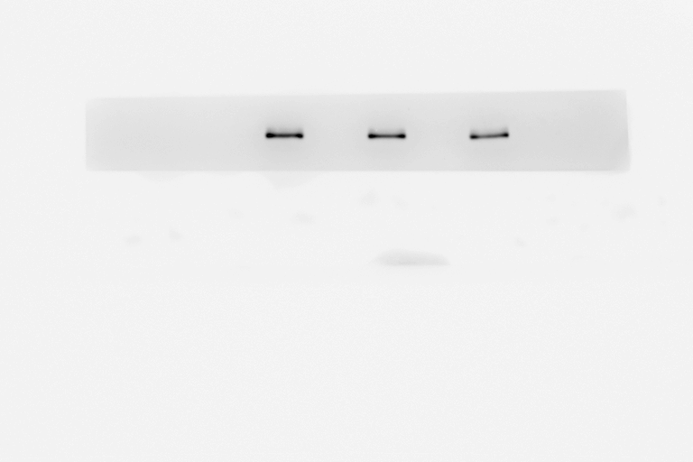
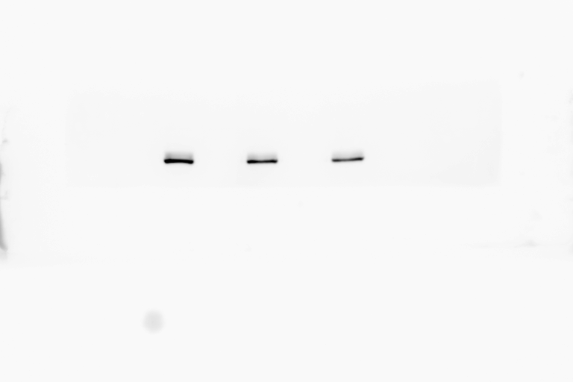
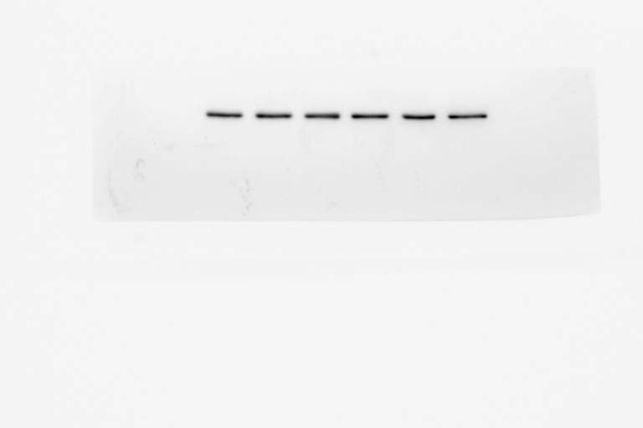
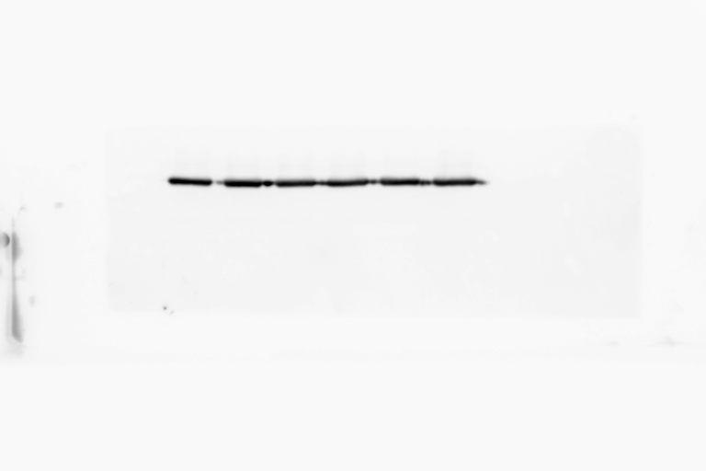
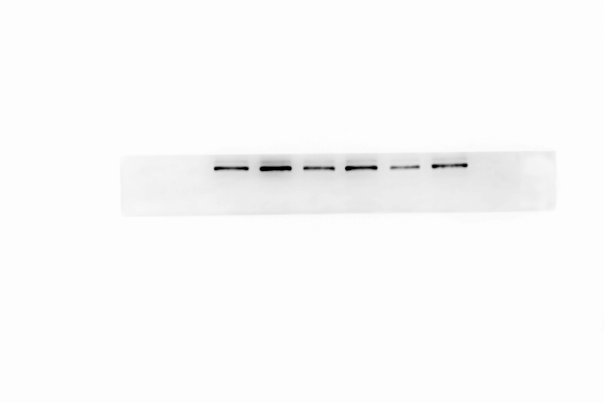
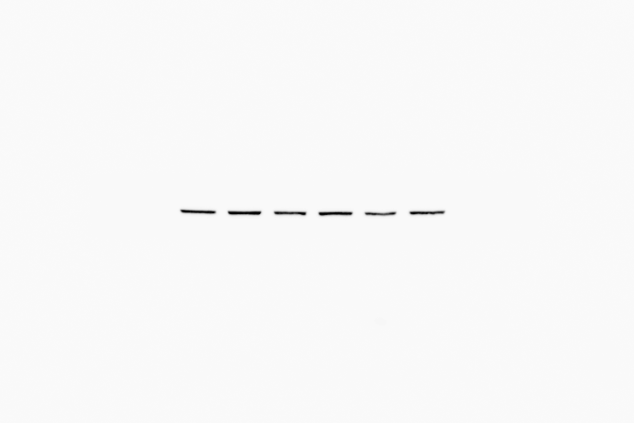
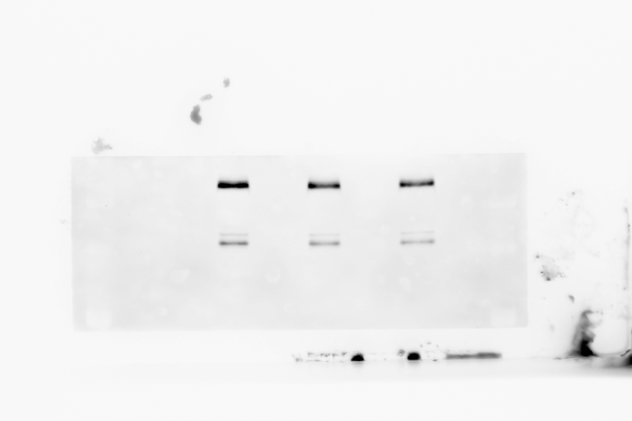
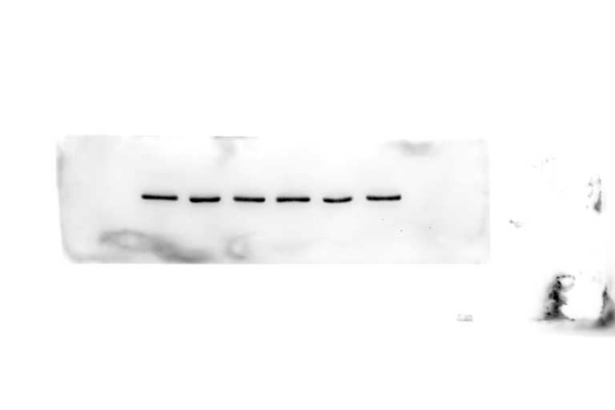
Figure 9
vSMOC2-Myc
vSMOC2-Myc
vSMOC2-Myc
vSMOC2-Myc
vSMOC2-Myc
vEmpty-Myc
vSMOC2-Myc
Ladder
vEmpty-Myc
vEmpty-Myc
vEmpty-Myc
vEmpty-Myc
vEmpty-Myc
Ladder
Ladder
- 150 kD
E-cadherin
- 100 kD
Fibronectin
- 250 kD
SMOC2-Myc
- 50 kD
SMOC2-Myc
- 50 kD
GAPDH
- 37 kD
GAPDH
- 37 kD
16h
24h
vSMOC2-Myc
vSMOC2-Myc
vSMOC2-Myc
vEmpty-Myc
Ladder
vEmpty-Myc
vEmpty-Myc
Ladder
- 150 kD
N-cadherin
- 100 kD
Vimentin
- 50 kD
SMOC2-Myc
- 50 kD
GAPDH
- 37 kD
48h

Slide 7
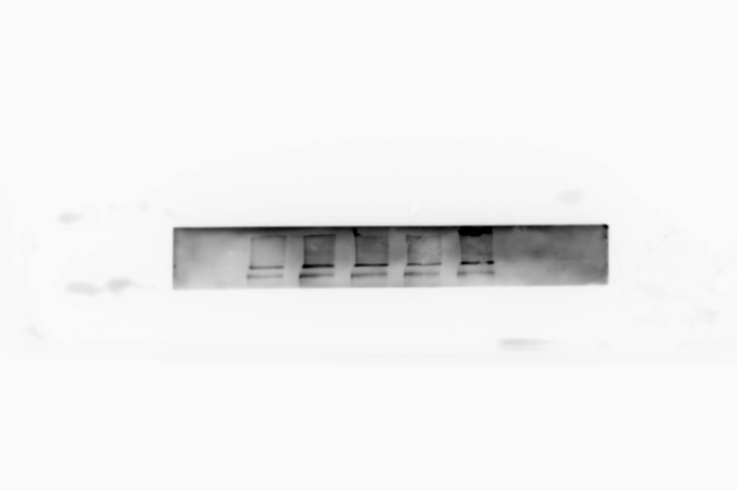




















Figure 11
vSMOC2
vSMOC2
vSMOC2
vΔEC
vΔEC
Ladder
vEC
vΔFS
vΔEC
vΔFS
Ladder
vEC
vΔFS
EV
vEC
Ladder
EV
EV
Fibronectin
N-cadherin
Whole cell
extracts
Vimentin
GAPDH
Replicate 1
Replicate 2
Replicate 3
vSMOC2
vSMOC2
vSMOC2
vΔEC
Ladder
vΔFS
Ladder
vΔEC
vΔEC
vEC
Ladder
vΔFS
Ladder
vΔFS
EV
vEC
Ladder
vEC
Ladder
EV
EV
SMOC2
Extracellular
matrix
Ponceau
- 50 kD
- 37 kD
- 25 kD
Replicate 1
Replicate 2
Replicate 3
vSMOC2
vΔEC
Ladder
vEC
vΔFS
Ladder
EV
SMOC2
10% gel
SMOC2
7.5% gel
Media
Ponceau
- 75 kD
- 50 kD

Slide 8



















Figure 14
FAKi 10 μM
rhSMOC2 (5 ng/ml) - - - + + +
rhSMOC2 (5 ng/ml) - - - + + + + + +
p-FAK (Y397)
Fibronectin
-100 kD
-250 kD
FAK
-100 kD
p-Paxilin (Y118)
-75 kD
N-cadherin
-100 kD
-50 kD
Paxillin
-75 kD
-50 kD
Vimentin
GAPDH
-37 kD
-50 kD
GAPDH
-37 kD
FAKi
12.5 μM
FAKi
15 μM
Control
FAKi
17.5 μM
FAKi 20 μM
Control
FAKi 10 μM
p-FAK (Y397)
-100 kD
FAK
-100 kD
-75 kD
p-Paxilin (Y118)
-50 kD
Paxillin
-75 kD
-50 kD
GAPDH
-37 kD

Slide 9























Figure 15
HK-2 cells
IP: Myc
ITGα4
- 150 kD
1.5% Input
Supernatant
Pellet
Myc-Empty vector
+
+
+
ITGα5
- 150 kD
Myc-SMOC2
+
+
+
ITGαV
- 150 kD
ITGB3
-100 kD
- 150 kD
ITGB1
-100 kD
ITGB1
SMOC2-Myc
ITGB3
- 150 kD
-50 kD
GAPDH
Light chain (20 kD)
ITGB4
- 250 kD
ITGB5
- 100 kD
GAPDH
- 37 kD
ssiRNA
ITGB3 siRNA
ssiRNA
ITGB1 siRNA
rhSMOC2 (5 ng/ml) - - - + + + + + + - - - + + + + + +
Fibronectin
Fibronectin
-250 kD
N-cadherin
N-cadherin
-100 kD
ITGB3
ITGB1
-100 kD
Vimentin
Vimentin
-50 kD
GAPDH
GAPDH
-37 kD

Slide 10














Figure 16
WT
Smoc2-KO
WT
KO
UUO 1
CoK 1
UUO 1
CoK 3
UUO 1
CoK 3
CoK 1
CoK 1
UUO 2
UUO 2
UUO 3
UUO 1
UUO 3
CoK 2
CoK 1
CoK 2
Fibronectin
-250 kD
p-FAK (Y397)
-100 kD
FAK
-100 kD
p-Paxilin (Y118)
-50 kD
Paxillin
-50 kD
α-SMA
-37 kD
GAPDH
-37 kD

Slide 11







Figure 17
Ladder
Ladder
Conditioned media C SM C SM C SM
Fibronectin
- 250 kD
α-SMA
- 37 kD
24h
GAPDH
- 37 kD
Collagen I
- 150 kD
- 100 kD
Periostin
48h
TGFβ1
- 25 kD
GAPDH
- 37 kD

Slide 12












Supplemental 4
rhSMOC2 (ng/ml) - 5 - 1 2.5 5 7.5 - 5 - 1 2.5 5 7.5 - - 1 2.5 5 7.5 5
rhTGFβ1 (5ng/ml) - - + + + + + - - + + + + + - + + + + + -
p-SMAD3
(S423/425)
-75 kD
T-SMAD3
-50 kD
-75 kD
-50 kD
Replicate 1
(representative)
Replicate 2
Replicate 3
rhSMOC2 (ng/ml) - - 1 2.5 5 7.5 - 1 - 2.5 5 7.5 - - 1 2.5 5 7.5
rhTGFβ1 (5ng/ml) - + + + + + + + - + + + - + + + + +
Fibronectin
-250 kD
N-cadherin
-100 kD
Vimentin
-50 kD
GAPDH
-37 kD
Replicate 1
Replicate 2
Replicate 3
(representative)

Slide 13













Supplemental 6
ssiRNA
siITGB1
siITGB3
rhSMOC2 5ng/ml - - - + + + + + + + + +
ITGB1
-100 kD
ITGB3
-100 kD
pFAK
-100 kD
FAK
-100 kD
pPaxillin
-50 kD
Paxillin
-50 kD
GAPDH
-37 kD
Cil. 1nM
Cil. 2.5 nM
Cil. 5 nM
Cil. 10 nM
Cil. 15 nM
rhSMOC2 5ng/ml - - - + + + + + + + + + - - - + + + + + + + + +
pFAK
-100 kD
FAK
-100 kD
GAPDH
-37 kD

