Slide 1
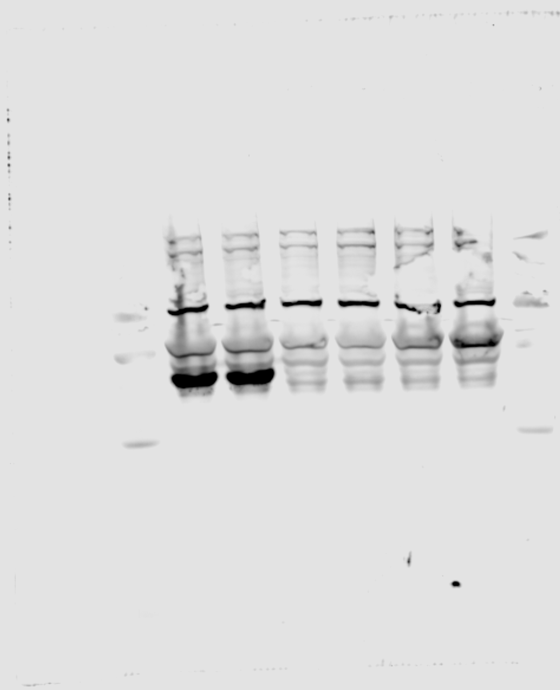
Figure 6B: TEX264
Rabbit anti-TEX264
ProteinTech #25858-1-AP

Slide 2
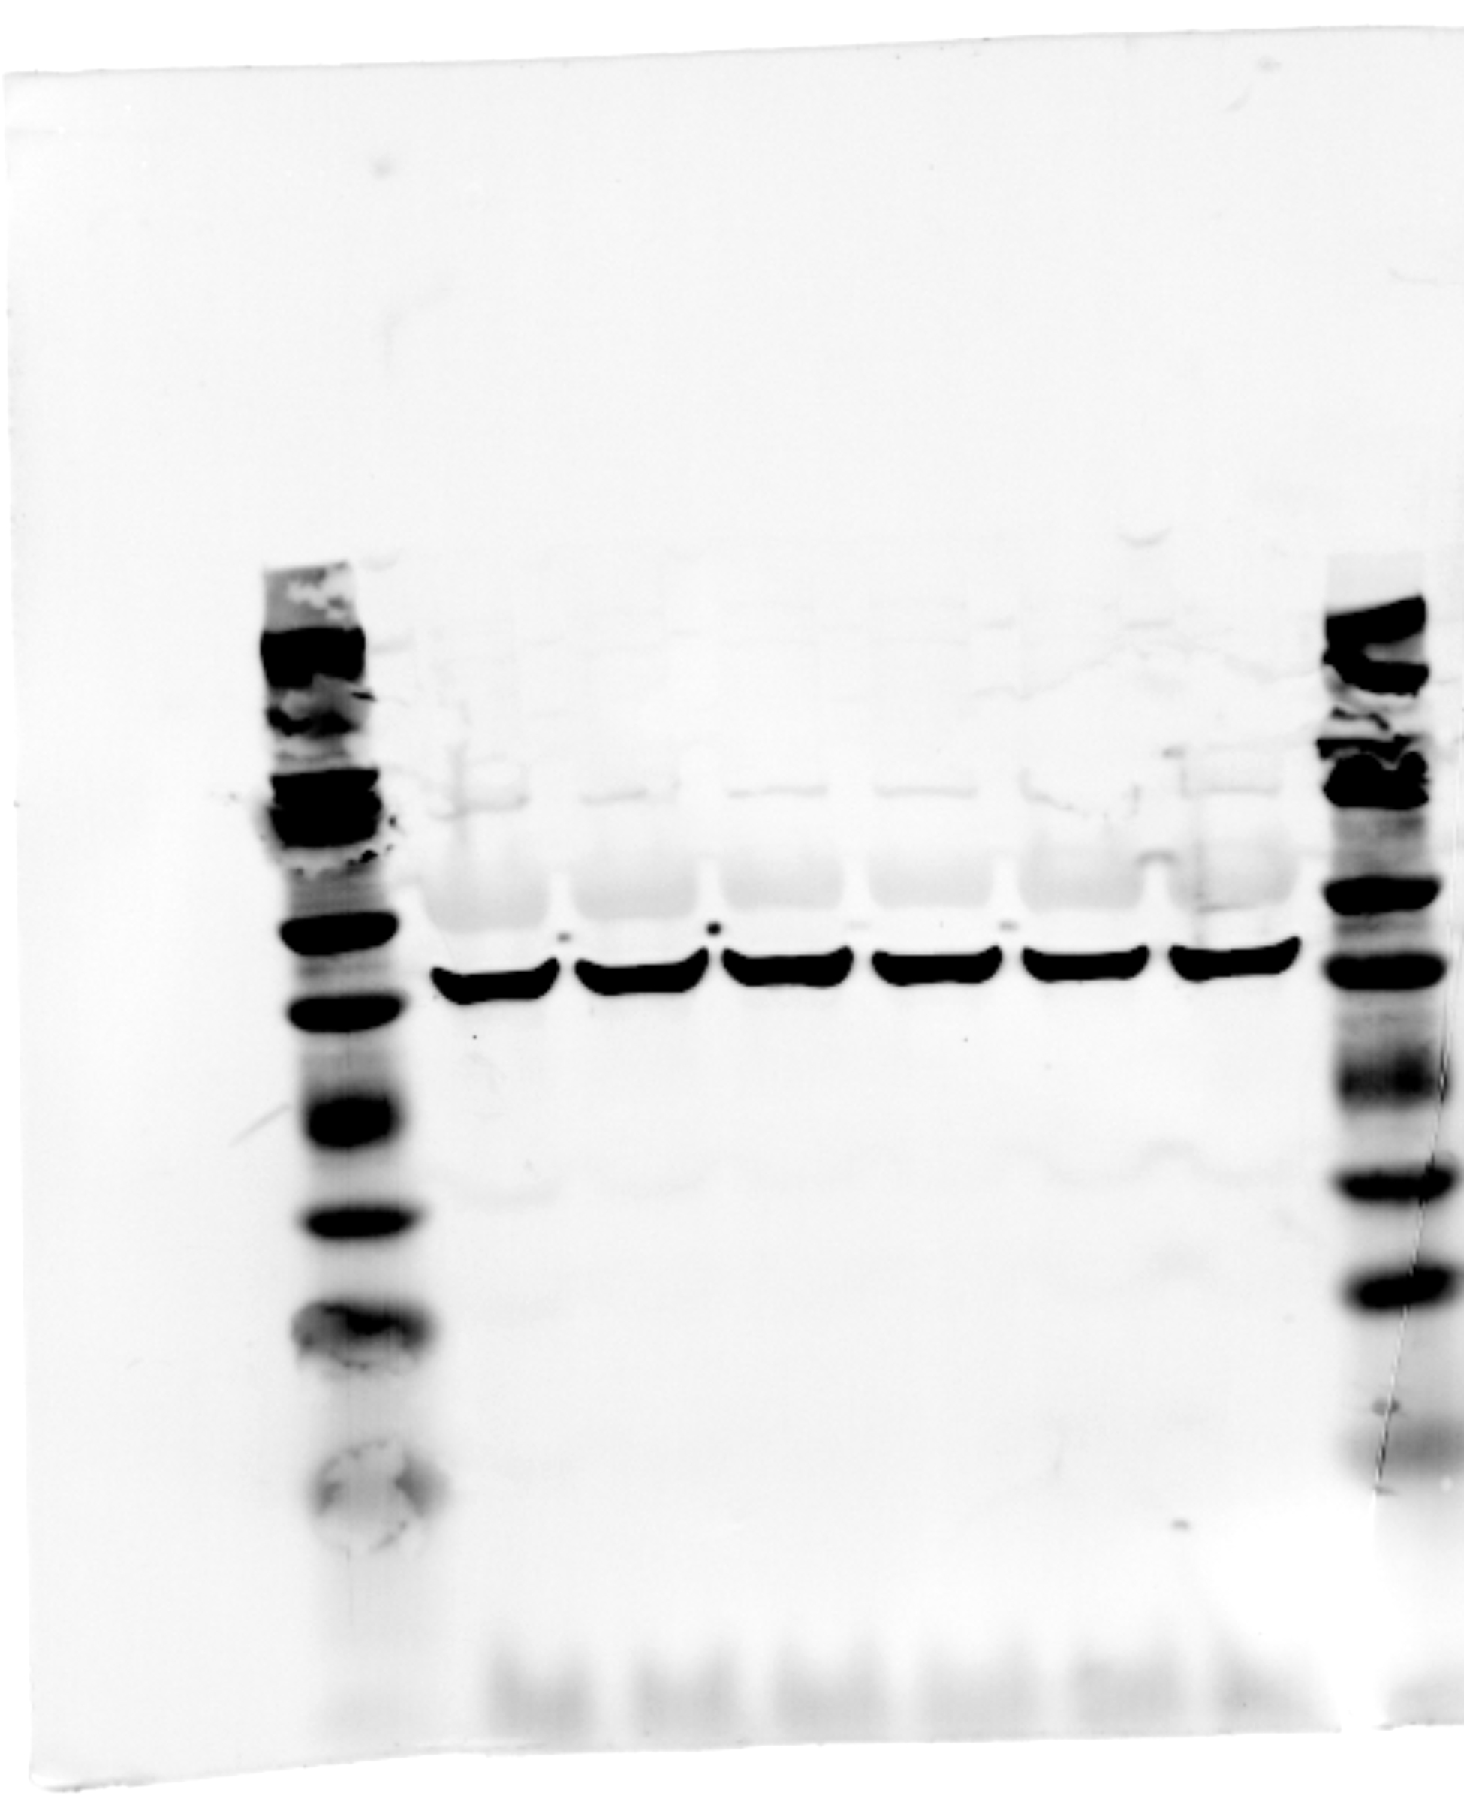
Figure 6B: β-Actin
Loading control for TEX264
Mouse anti-beta-Actin (C4)
Santa Cruz #sc-47778

Slide 3
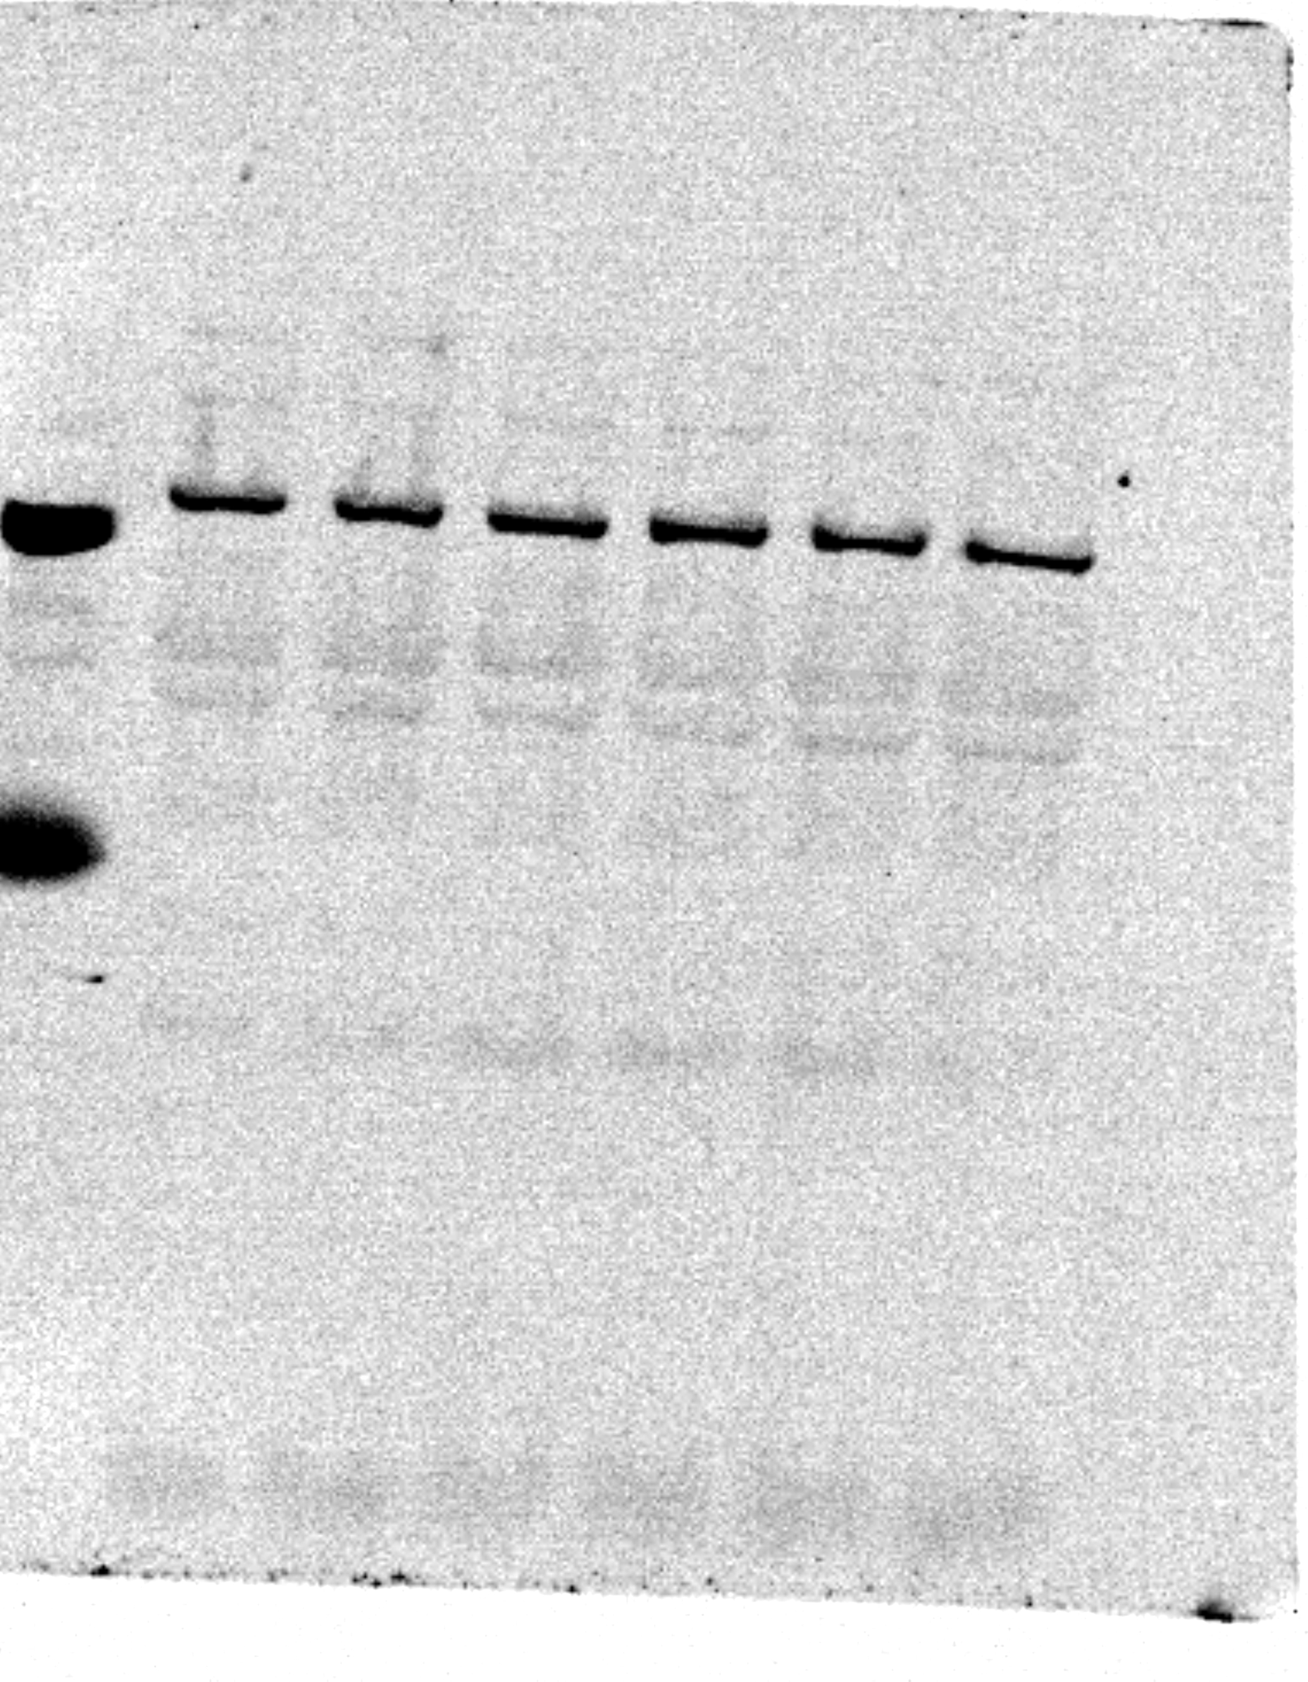
Figure 6B: CCPG1
Rabbit anti-CCPG1 (E3C5G)
Cell Signaling #80158

Slide 4
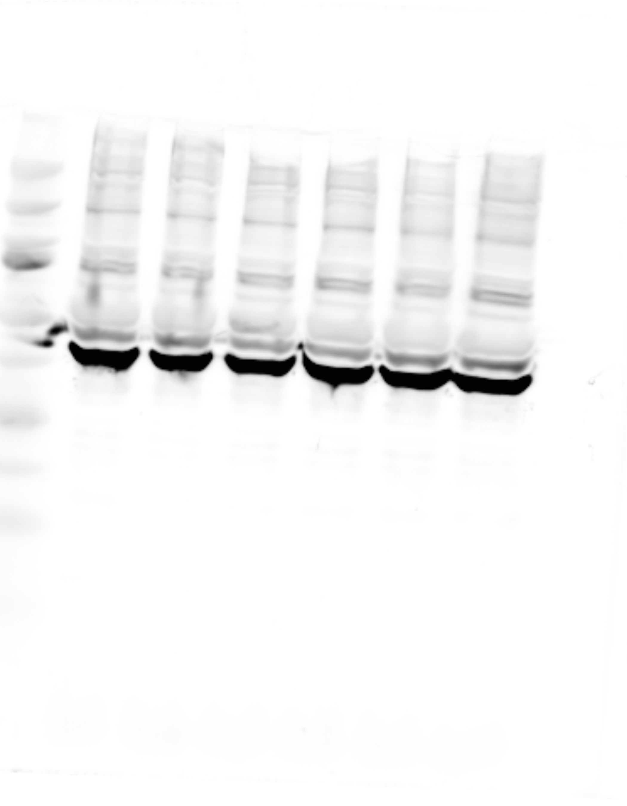
Figure 6B: β-Actin (not in final figure)
Loading control for CCPG1
Mouse anti-beta-Actin (C4)
Santa Cruz #sc-47778

Slide 5
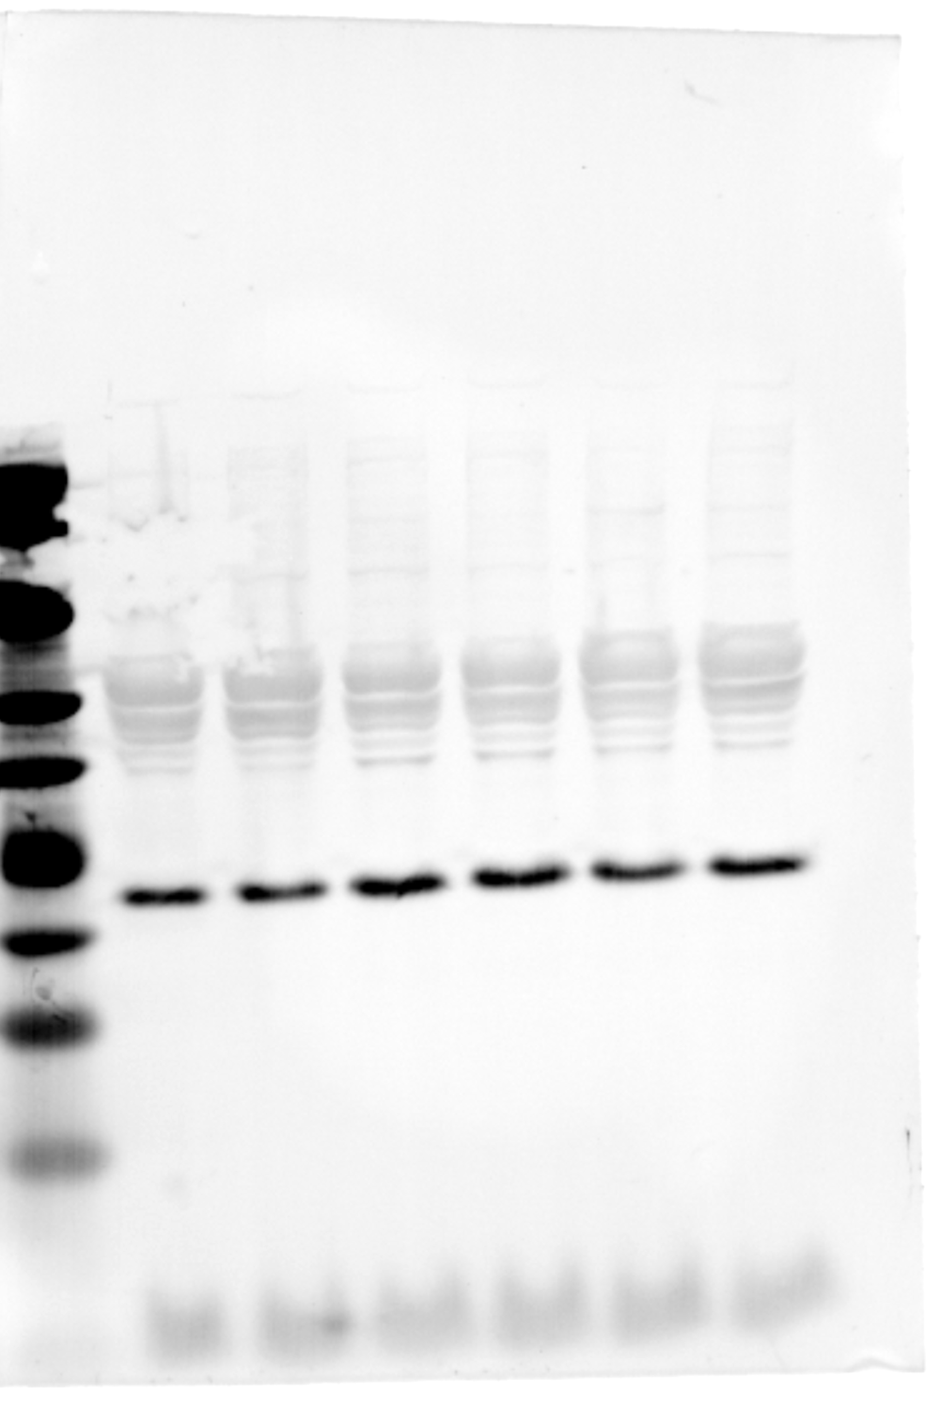
Figure 6B: RTN3 (short isoform)
Mouse anti-RTN3/HAP
Abcam #ab68328

Slide 6
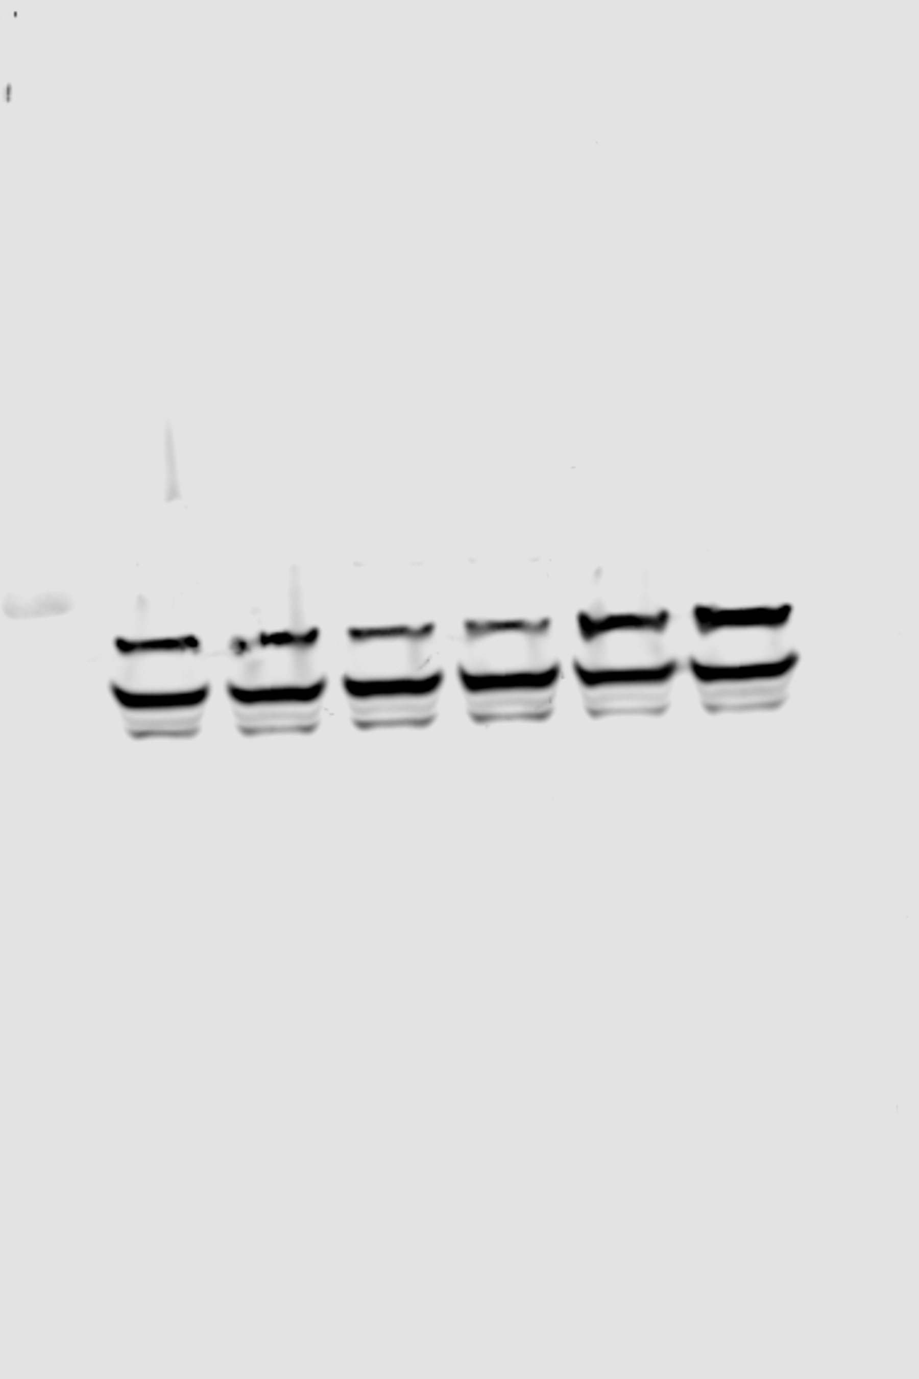
Figure 6B: SEC62
Rabbit anti-SEC62
Sigma #HPA014059

Slide 7
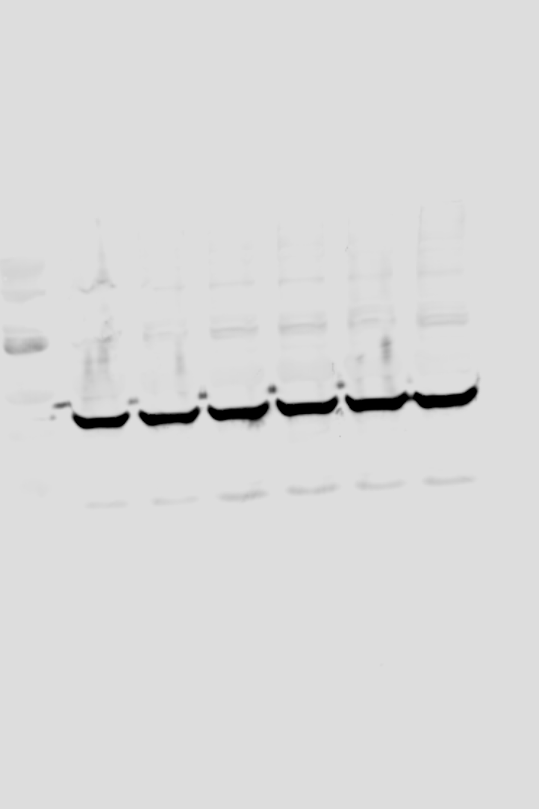
Figure 6B: β-Actin (not in final figure)
Loading control for RTN3 and SEC62
Mouse anti-beta-Actin (C4)
Santa Cruz #sc-47778

