Slide 1
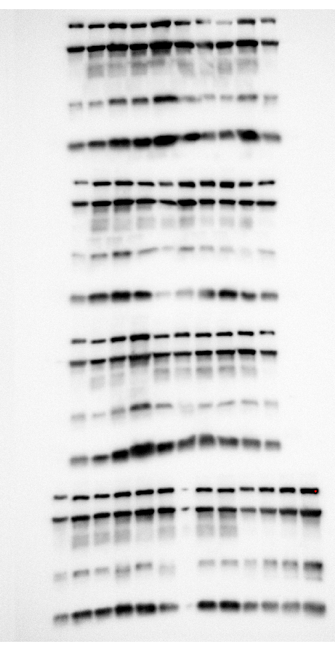
Uncropped WB
Label for Gel 1-3
Std
Control
TAZ MKO
Std
HFD
FO
HFD
FO
GEL1
GEL2
complex 5
complex 3
complex 4
complex 2
complex 1
GEL3
GEL4
Label for Gel 4
Std
HFD
FO
HFD
FO
Std curve
Control
TAZ MKO
Notes:
##-AccessibilityAssistant: Skip layout check-##

