Slide 1
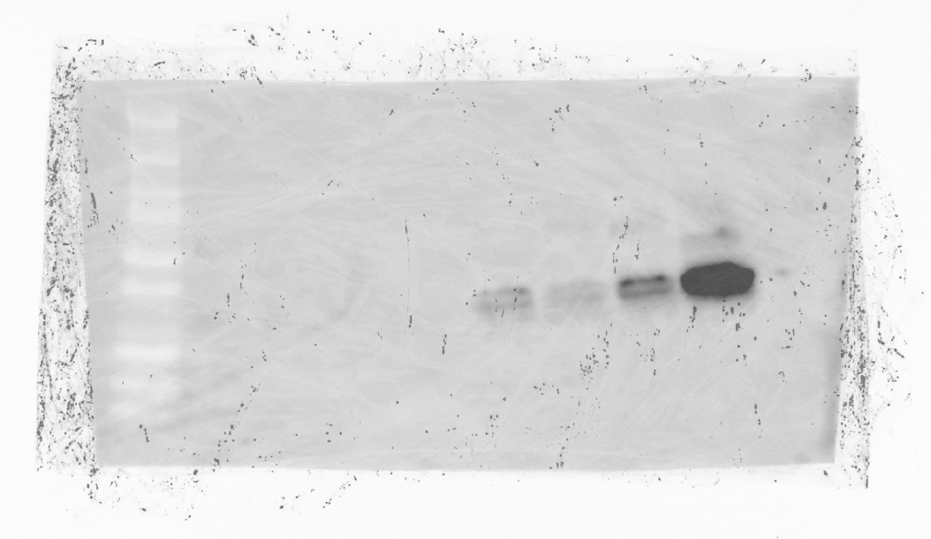
Full unedited gel for Supplemental Figure 6D

