Slide 1
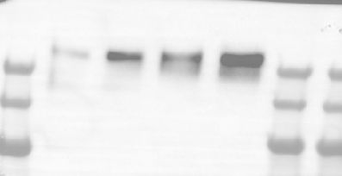
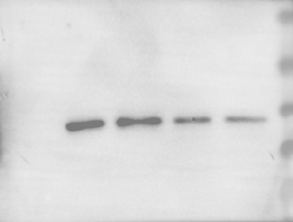
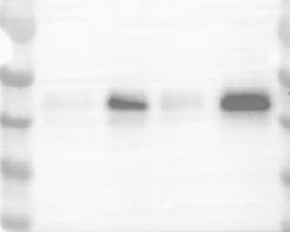
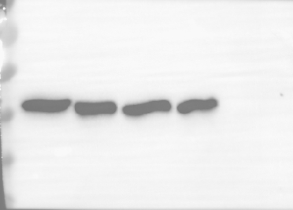
Blots from Figure 4F
Collagen 1
ETS1
PAI-1
β-actin
TGFβ1
- + - +
TGFβ1
- + - +
dsiNC
dsiETS1
dsiNC
dsiETS1

Slide 2
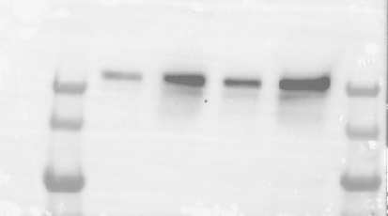
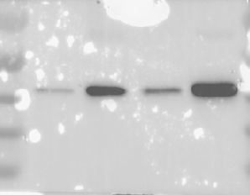
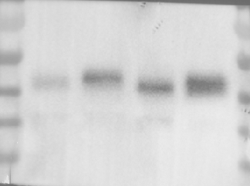
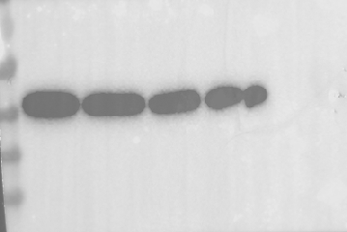
Blots from Figure 5D
Collagen 1
⍺SMA
PAI-1
β-actin
MASH
- + - +
MASH
- + - +
dsiNC
dsiETS1
dsiNC
dsiETS1

Slide 3
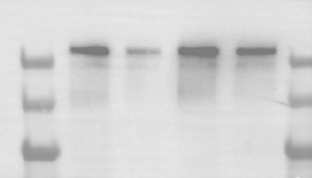
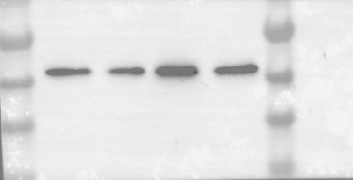
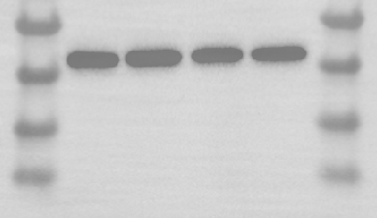
Blots from Figure 6D
Collagen 1
β-actin
⍺SMA
Reg
Reg
Reg
Reg
MASH
MASH
MASH
MASH
dsiNC
dsiETS1
dsiNC
dsiETS1

Slide 4
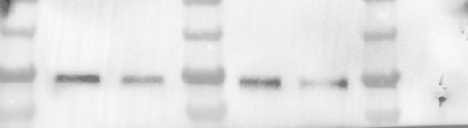
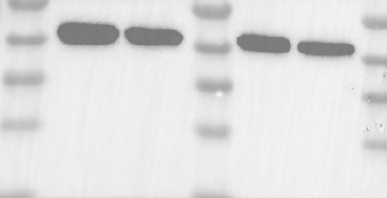
Blots from Figure 7E
β-actin
CRTC2
dsiNC
dsiETS1
dsiNC
dsiETS1
dsiNC
dsiETS1
dsiNC
dsiETS1
set1
set2
set1
set2

Slide 5
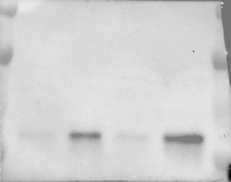
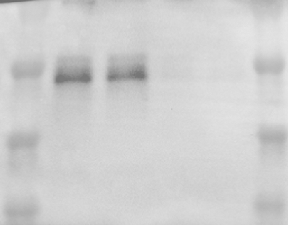
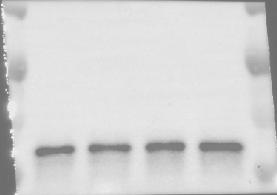
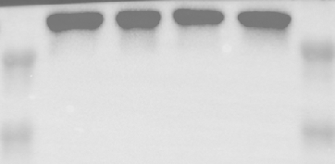
Blots from Figure S5A
ETS1
Phospho-SMAD2
β-actin
SMAD2
TGFβ1
- + - +
TGFβ1
- + - +
dsiNC
dsiETS1
dsiNC
dsiETS1

