Slide 1
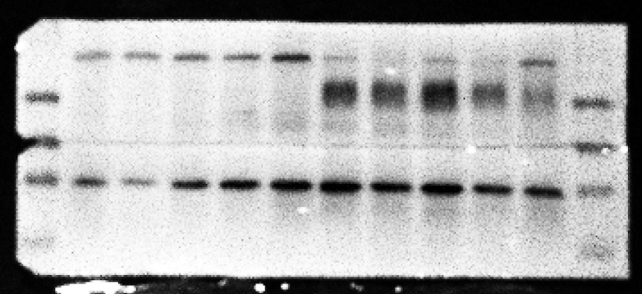
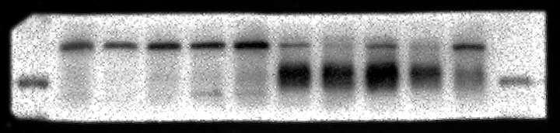
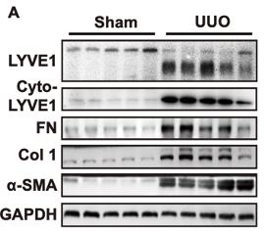
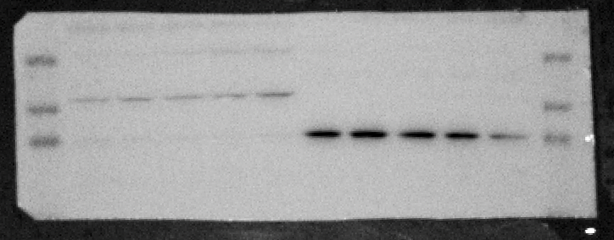
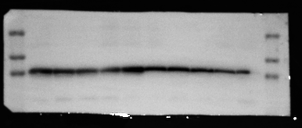
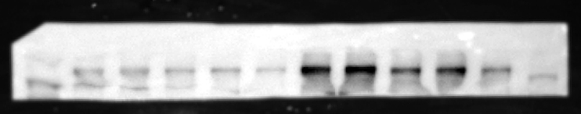
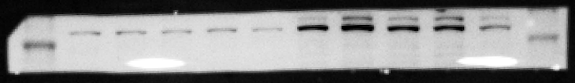
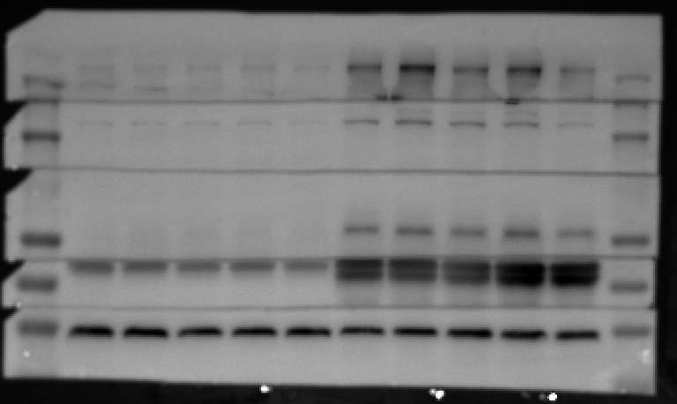

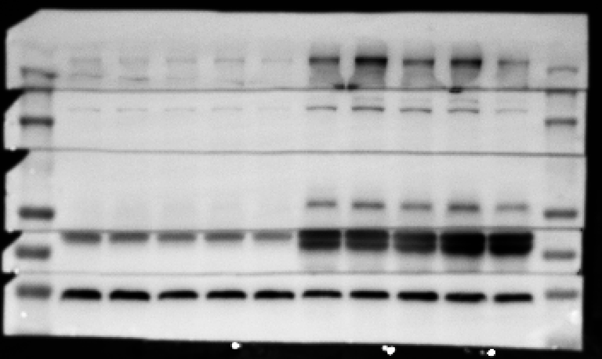
Full unedited gel for Figure 1A
75
Ecto-LYVE1
50
40
GAPDH
40
35
40
35
GAPDH
250
150
100
FN
Collagen I
40
α-SMA
35
GAPDH

Slide 2
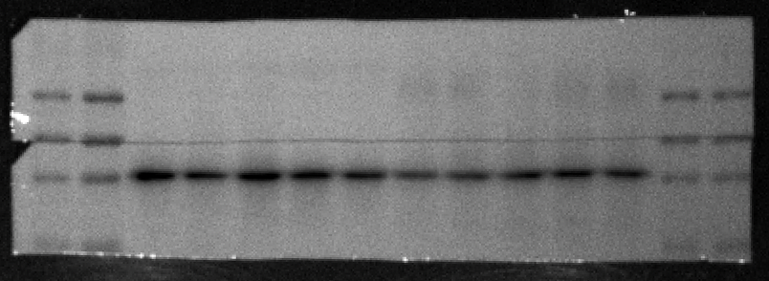
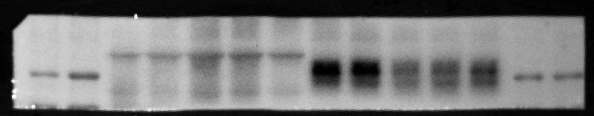
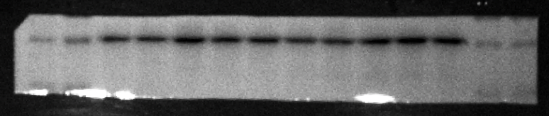
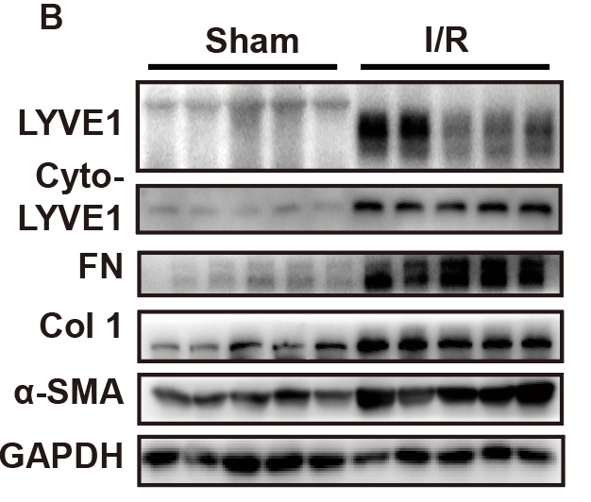
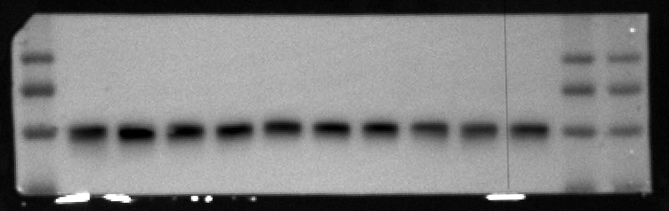
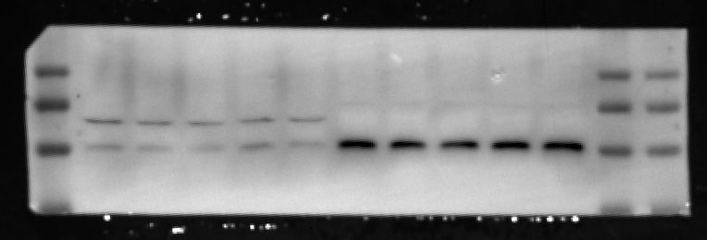
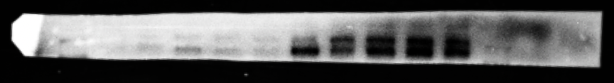
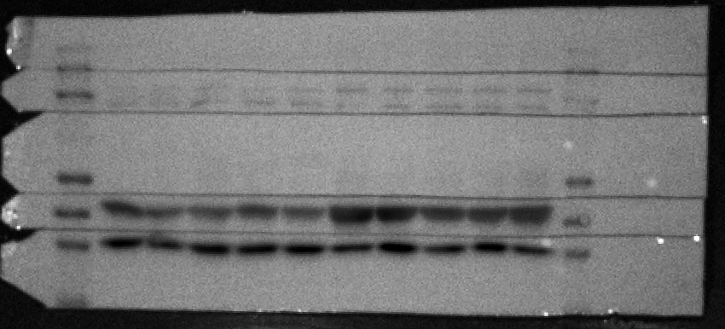
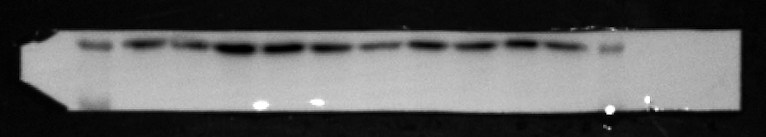
Full unedited gel for Figure 1B
Ecto-LYVE1
75
50
40
Ecto-LYVE1
40
GAPDH
35
40
40
35
35
GAPDH
250
150
FN
100
Collagen I
40
α-SMA
35
GAPDH

Slide 3
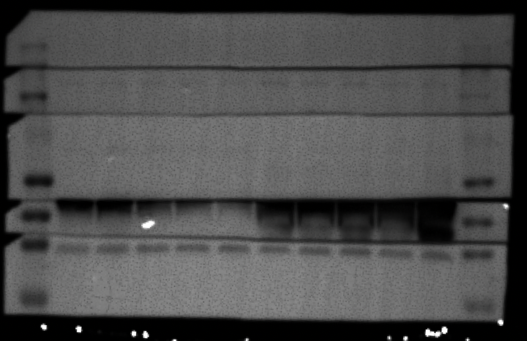
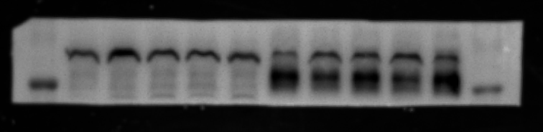
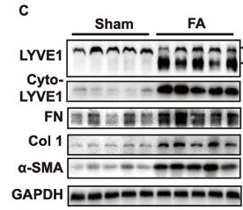
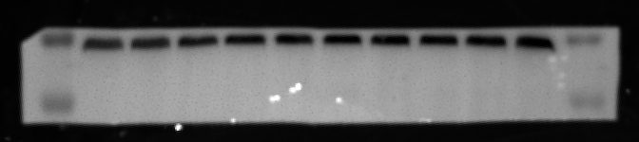
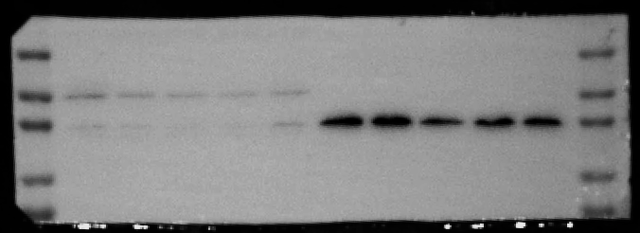
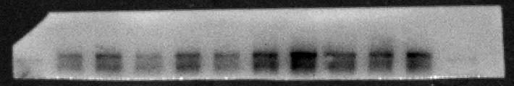
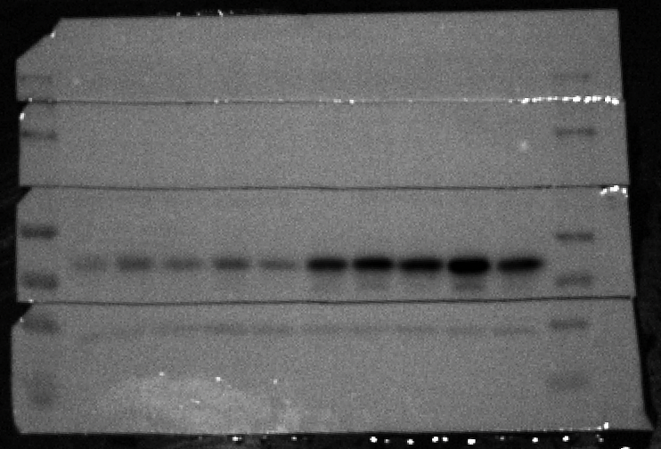
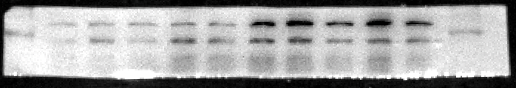
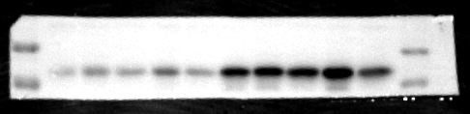
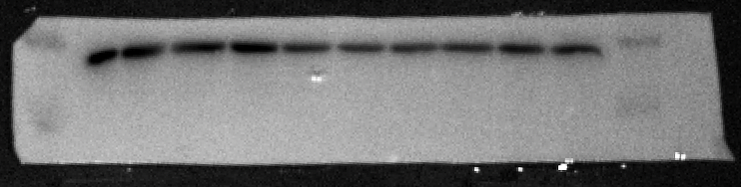
Full unedited gel for Figure 1C
75
50
Ecto-LYVE1
35
25
GAPDH
50
40
35
250
FN
150
Collagen I
100
α-SMA
50
40
GAPDH
35

Slide 4
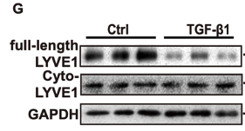
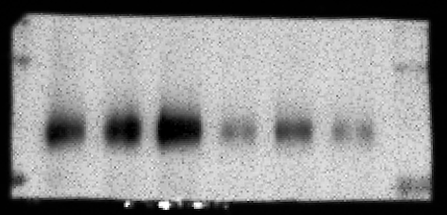
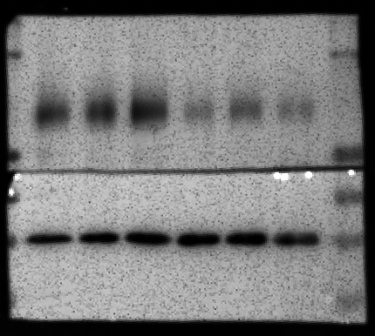
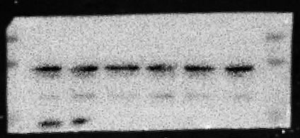
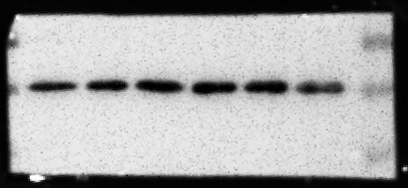
Full unedited gel for Figure 1G
100
75
50
Ecto-LYVE1
40
35
25
GAPDH
40
35
25

Slide 5

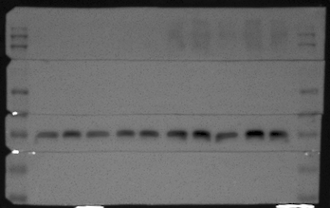
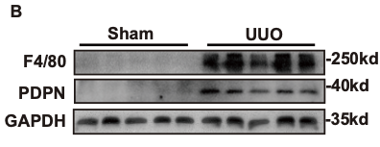

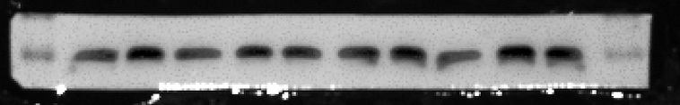

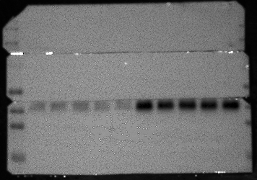
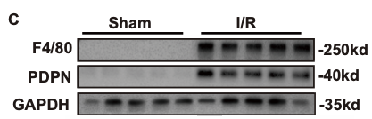
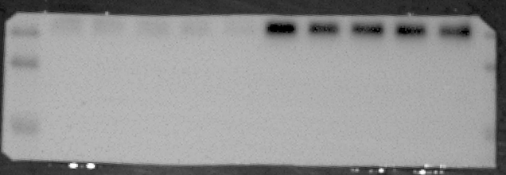
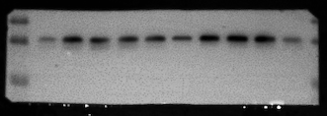
Full unedited gel for Figure 2B
F4/80
GAPDH
PDPN
F4/80
GAPDH
PDPN

Slide 6

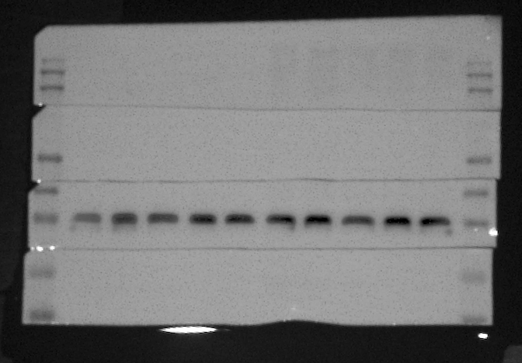
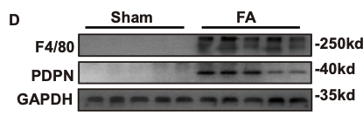


Full unedited gel for Figure 2D
F4/80
GAPDH
PDPN

Slide 7
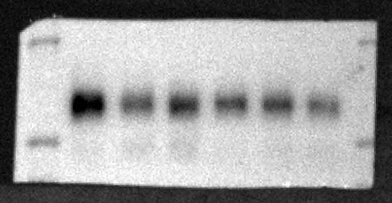
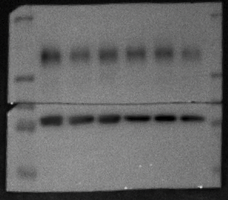
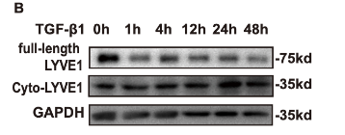

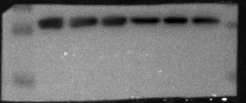
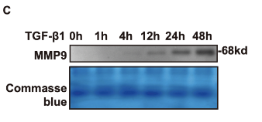
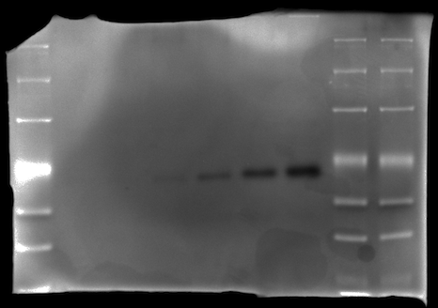
Full unedited gel for Figure 3B
Ecto-LYVE1
GAPDH
Full unedited gel for Figure 3C

Slide 8
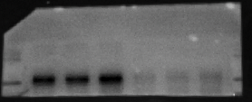
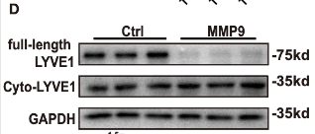



Full unedited gel for Figure 3D
D
Ecto-LYVE1
GAPDH

Slide 9







Full unedited gel for Figure 3H
Full unedited gel for Figure 3I
Ecto-LYVE1
GAPDH

Slide 10











Full unedited gel for Figure 3L
MMP9
GAPDH
Full unedited gel for Figure 3M
MMP9
GAPDH
LYVE1
GAPDH

Slide 11







Full unedited gel for Figure 4A
Full unedited gel for Figure 4B
Ecto-LYVE1
GAPDH

Slide 12







Full unedited gel for Figure 4E
Ecto-LYVE1
GAPDH
MMP9
GAPDH

Slide 13







Full unedited gel for Figure 4F
Ecto-LYVE1
GAPDH
MMP9
GAPDH

Slide 14








Full unedited gel for Figure 5G
F4/80
GAPDH
F4/80
GAPDH

Slide 15




Full unedited gel for Figure 6A
FN
Collagen I
α-SMA
GAPDH

Slide 16






Full unedited gel for Figure 6B
FN
Collagen I
α-SMA
GAPDH

Slide 17








Additional blot for UUO+SB-3CT/UUO+GM6001
150
150
100
100
70
70
50
50
UUO+
SB-3CT
40
40
Ctrl
UUO
SB-3CT
35
35
25
GAPDH
25
LYVE1
70
50
Cyto-LYVE1
40
35
Cyto-LYVE1
25
MMP9
Same gel
70
50
GAPDH
40
35
GAPDH
25
MMP9
GAPDH

Slide 18





UUO+
SB-3CT
Ctrl
UUO
SB-3CT
250
FN
FN
150
100
Col1
Collagen I
70
α-SMA
50
40
α-SMA
GAPDH
GAPDH
35

Slide 19







LYVE1
UUO+
GM6001
70
50
Ctrl
UUO
GM6001
40
LYVE1
35
GAPDH
Cyto-LYVE1
70
70
50
50
40
40
MMP9
35
35
Cyto-LYVE1
GAPDH
GAPDH
MMP9
GAPDH

Slide 20





UUO+
GM6001
Ctrl
UUO
GM6001
250
150
FN
FN
100
Col1
Collagen I
α-SMA
70
50
α-SMA
GAPDH
40
GAPDH
35

Slide 21







UUO+
SB-3CT
Ctrl
UUO
SB-3CT
F4/80
GAPDH
UUO+
GM6001
Ctrl
UUO
GM6001
F4/80
GAPDH

