Slide 1
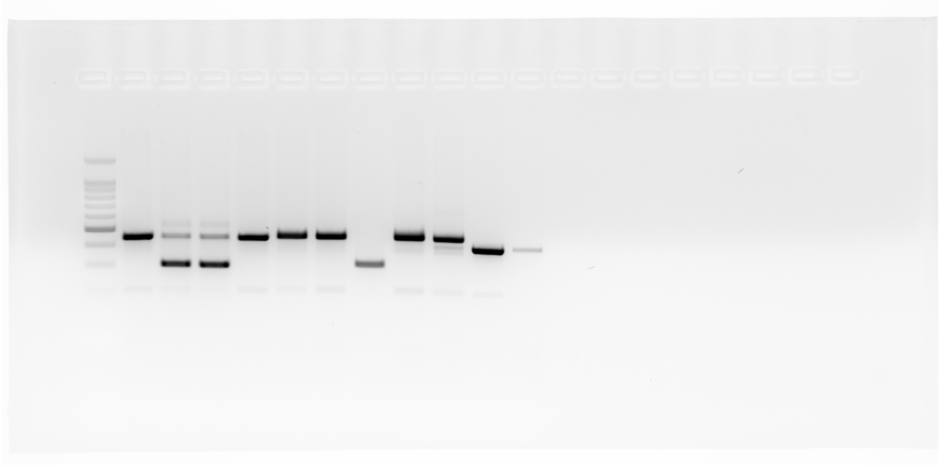
Full Unedited Gel for Supplemental Figure 1
Lanes shown in SupFig.1 indicated with a red asterisk (*)
flox/flox Cond. Ctrl
flox/+ Cond. Ctrl
+/+ WT Ctrl
+/+ WT Ctrl
Water Blank
100 bp Ladder
CRE-
CRE+
CRE+
CRE-
CRE-
CRE-
Null Ctrl
*
*
*
*

