Slide 1
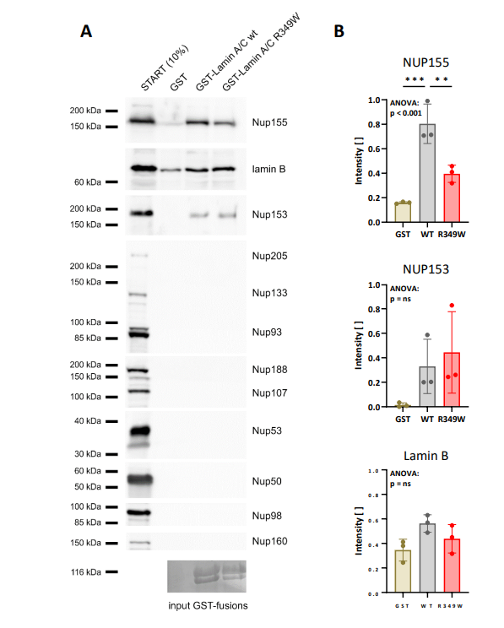

Slide 2
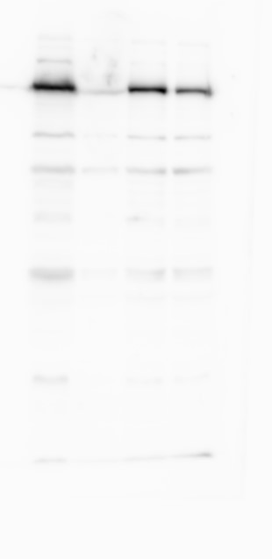
START (10%)
GST
GST-Lamin A/C wt
GST-Lamin A/C R349W
Nup155 band used for figure 4A

Slide 3
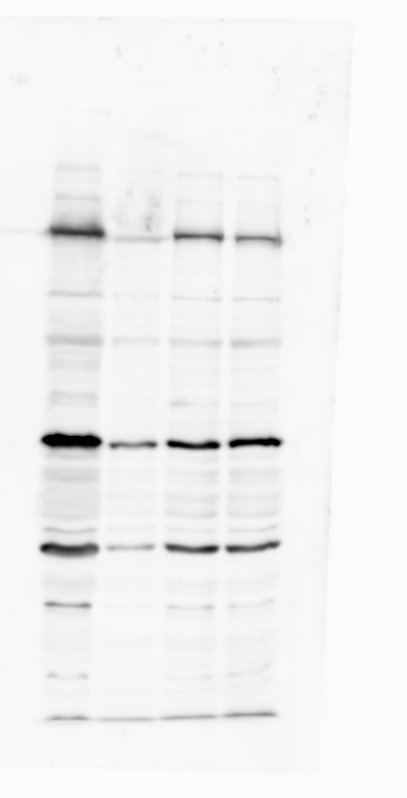
START (10%)
GST
GST-Lamin A/C wt
GST-Lamin A/C R349W
Lamin B band used for figure 4A

Slide 4
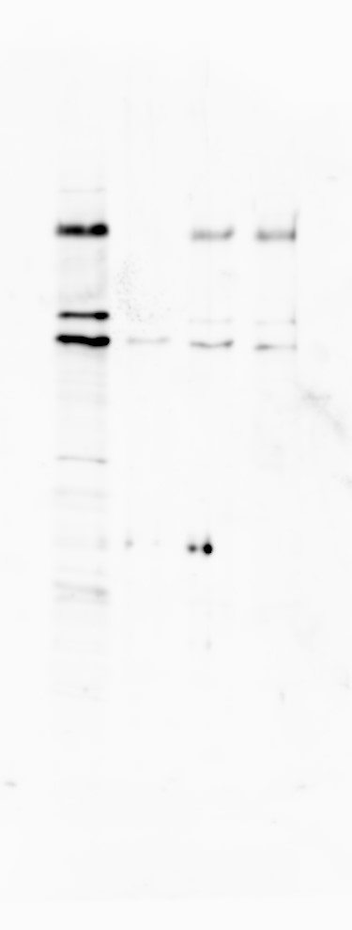
START (10%)
GST
GST-Lamin A/C wt
GST-Lamin A/C R349W
Nup153 band used for figure 4A

Slide 5
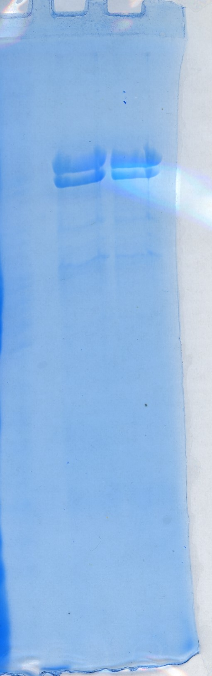
GST-Lamin A/C wt
GST-Lamin A/C R349W
input GST-fusions used for figure 4A

Slide 6
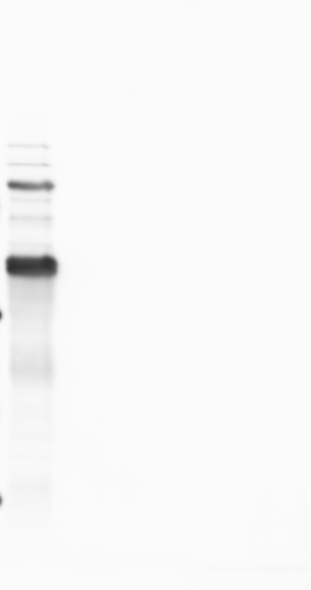
START (10%)
GST
GST-Lamin A/C wt
GST-Lamin A/C R349W
Nup160 band used for figure 4A
Nup98 band used for figure 4A
Nup50 band used for figure 4A

Slide 7
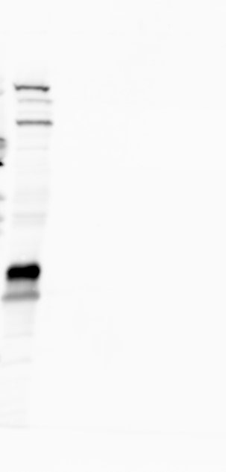
START (10%)
GST
GST-Lamin A/C wt
GST-Lamin A/C R349W
Nup188 band used for figure 4A
Nup107 band used for figure 4A
Nup53 band used for figure 4A

Slide 8
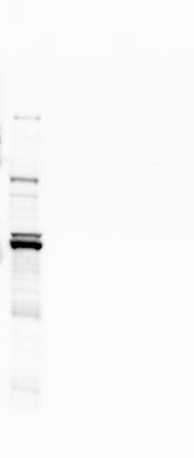
START (10%)
GST
GST-Lamin A/C wt
GST-Lamin A/C R349W
Nup205 band used for figure 4A
Nup133 band used for figure 4A
Nup93 band used for figure 4A

