Slide 1
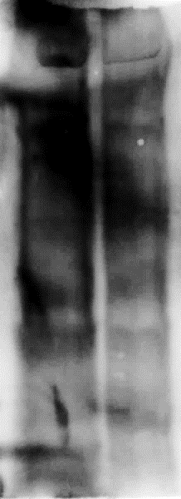
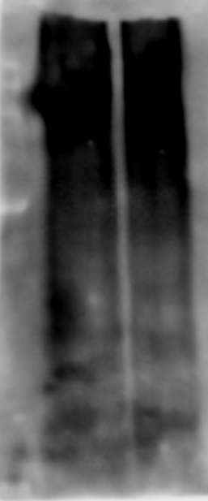
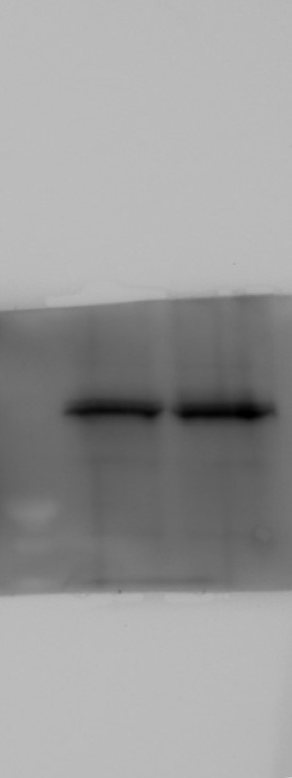
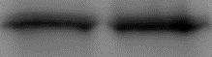
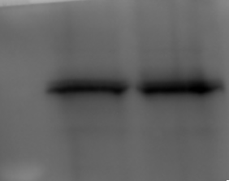
Original image with molecular weight marker
Full unedited gel
235
Figure 4
180
135
100
75
63
48
A
35
25
HECTD3
KO
WT
63
WB:
Myd88
48
35
235
235
235
180
180
180
135
PolyUb Enrich – TUBE-agarose
135
135
100
WB: Ubiquitin
100
100
75
75
75
63
63
63
48
48
48
35
10% input
35
35
WB: MyD88
35
25
25
17

Slide 2
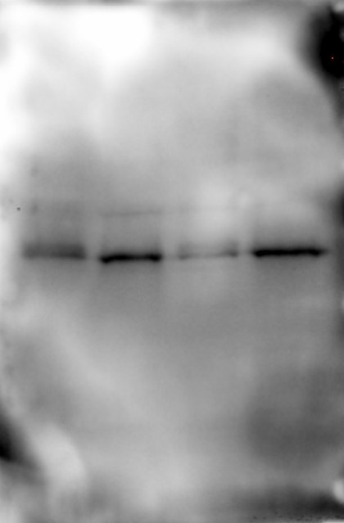

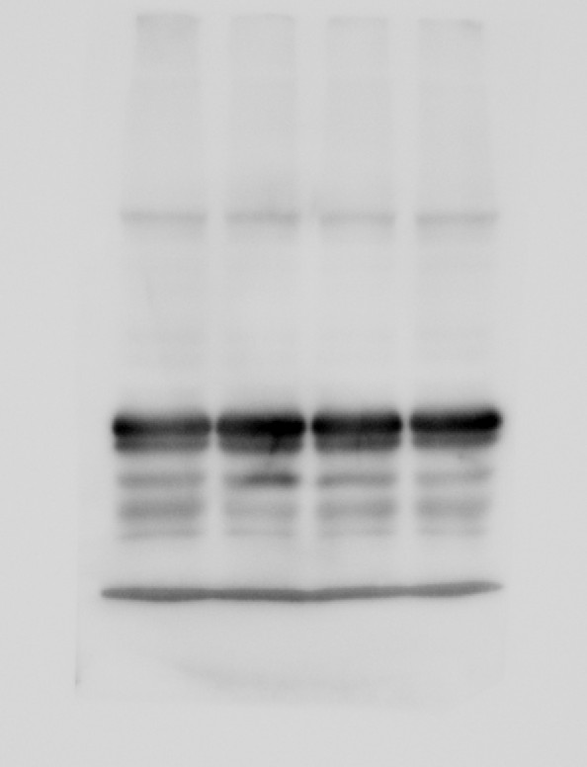
Original image with molecular weight marker
Full unedited gel
Figure 4
235
180
135
100
B
75
63
48
35
HECTD3KO
WT
25
untreated
untreated
17
LPS
LPS
MyD88
35
10
GAPDH
35
235
180
135
100
75
63
48
35
25
20
17
10

Slide 3
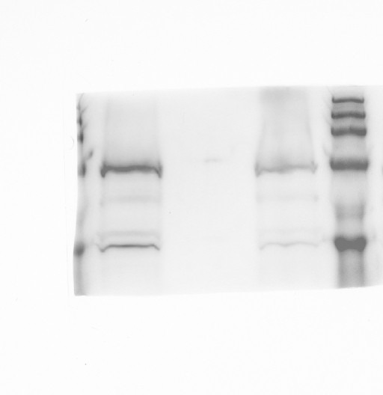
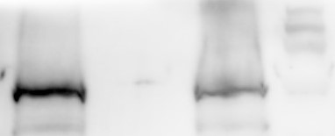
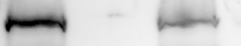
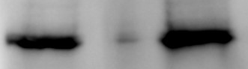
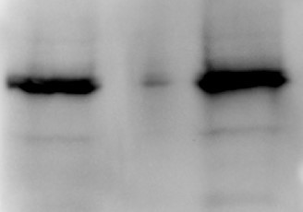
Original image with molecular weight marker
Full unedited gel
235
180
Figure 4
135
100
C
75
10% Input
IP: MyD88
63
IP: IgG
WB: HECTD3
100
WB: MyD88
35
48
35
25

Slide 4
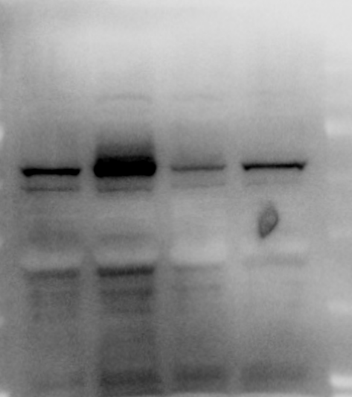
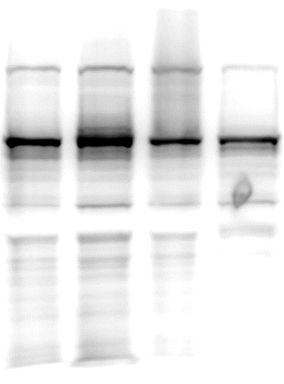
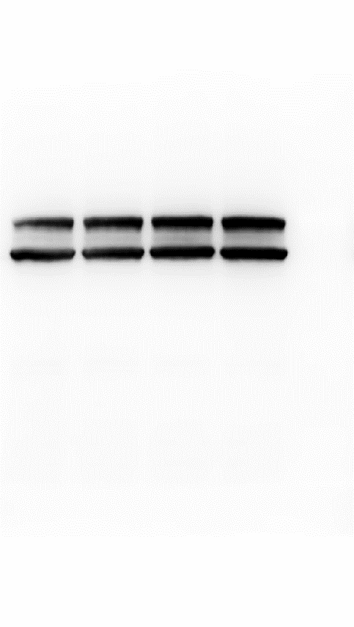
Original image with molecular weight marker
235
Full unedited gel
180
135
Figure 4
100
75
D
HECTD3KO
WT
63
48
untreated
untreated
LPS
LPS
35
p-NF-kB
(p-p65)
75
25
63
NF-kB (p65)
75
63
Lamin A/C
75
63
235
180
135
100
75
63
48
35
235
180
25
135
100
75
63
48
35

Slide 5
Original image with molecular weight marker
Full unedited gel
Figure 5
235
180
A
135
+
+
100
HIS-Ub
+
+
Flag-MyD88
75
Ni-NTA PD
WT
KO
75
63
WB: Flag
63
48
48
35
10% Input
25
WB: Flag
35
235
180
135
100
75
63
48
35
25

Slide 6
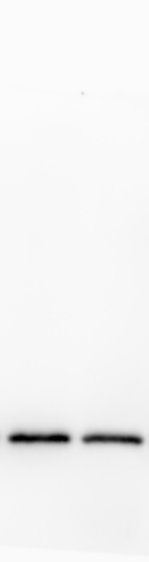
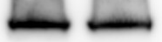
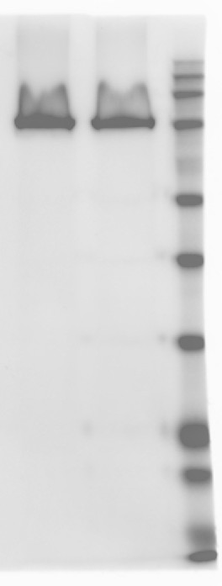
Original image with molecular weight marker
235
Full unedited gel
180
Figure 5
135
100
B
75
HIS-Ub
+
+
63
Flag-MyD88
+
+
48
Xpress-HECTD3
-
+
Ni-NTA PD
KO
KO
75
35
WB: Flag
63
25
48
10% Input
WB: Flag
35
WB: Xpress
100
235
180
235
135
180
100
135
75
100
63
75
63
48
48
35
35
25
25
20
17
11

Slide 7
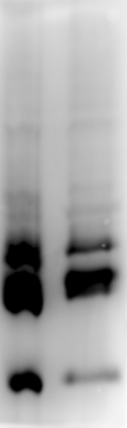
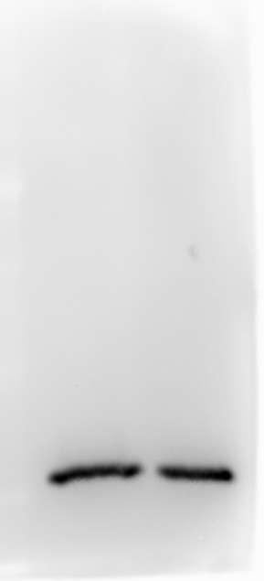
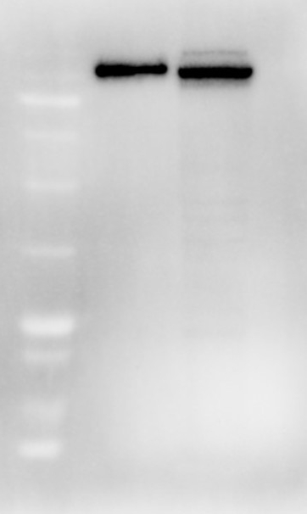
Full unedited gel
Original image with molecular weight marker
Figure 5
C
+
+
235
HIS-Ub
180
Flag-MyD88
+
+
135
Xpress-HETCD3WT
+
-
100
Xpress-HECTD3C823A
-
+
Ni-NTA PD
KO
KO
75
75
WB: Flag
63
63
48
48
10%Input
35
WB: Flag
35
WB: Xpress
100
235
235
180
180
135
135
100
75
100
63
48
75
35
63
25
48
20
17
11
35
25

Slide 8
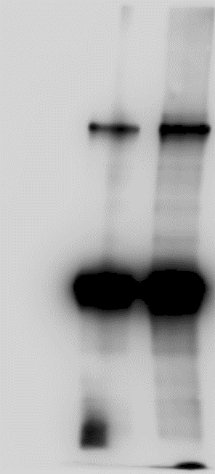
Original image with molecular weight marker
235
Full unedited gel
180
135
Figure 5
100
75
63
D
48
Flag-MyD88
+
+
+
35
GST-HECTD3WT
-
+
-
GST-HECTD3C823A
-
-
+
HA-Ub
+
+
+
In vitro Ubiquitination
63
WB: Flag
48
WB: Hectd3
35
100
235
180
135
100
75
63
48
35
25

Slide 9
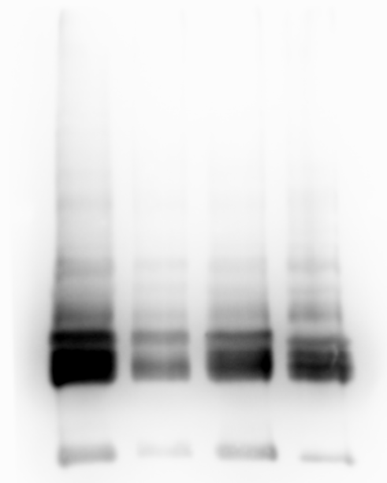
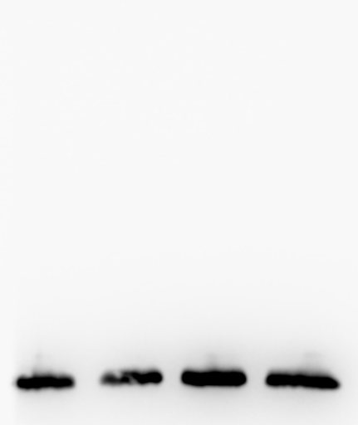

Original image with molecular weight marker
Full unedited gel
235
180
135
Figure 5
100
75
63
E
48
HIS-Ub
+
+
+
+
35
Xpress HECTD3 WT
+
+
+
+
Flag-MyD88 WT
+
-
-
-
Flag-MyD88 K103R
-
+
-
-
Flag-MyD88 K119R
-
-
+
-
Flag-MyD88 K127R
-
-
-
+
Ni-NTA PD
75
WB: Flag
63
48
235
180
Input
135
WB: Flag
35
100
WB: Xpress
100
75
63
48
35
235
180
135
100
75
63
48
35

Slide 10
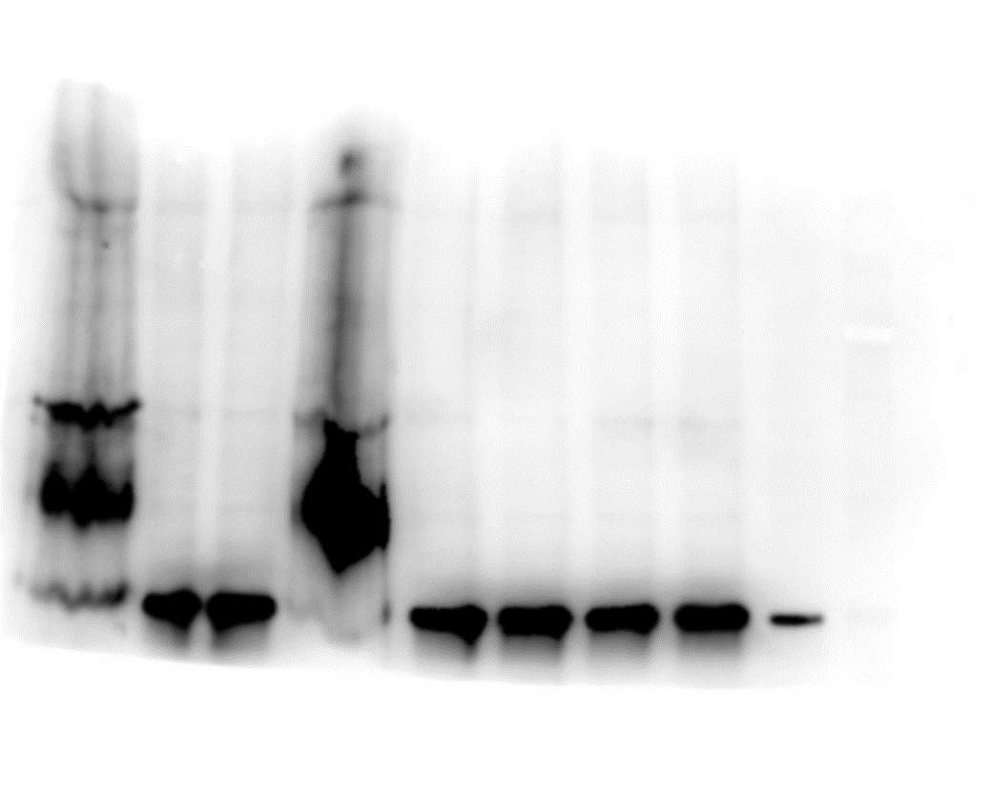
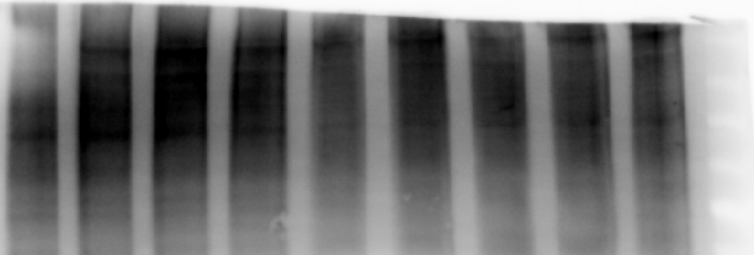
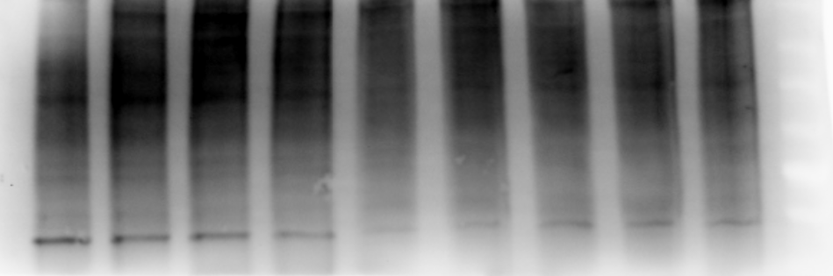
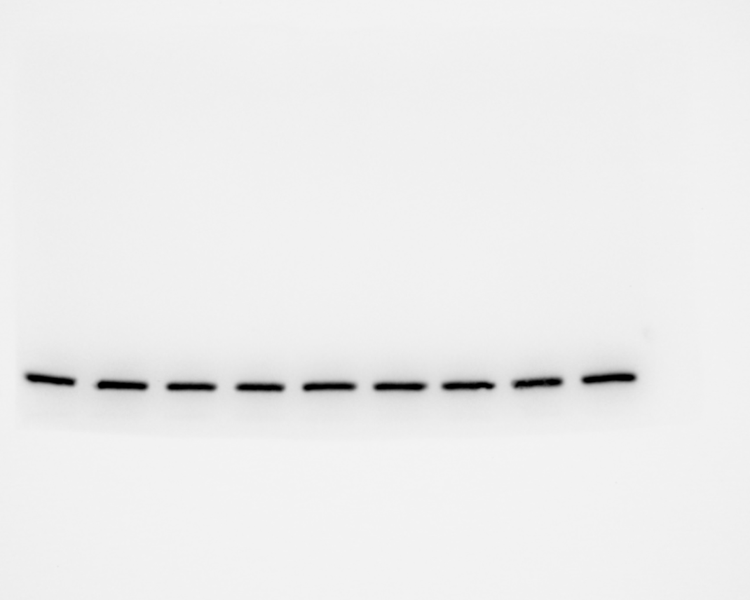
Original image with molecular weight marker
Full unedited gel
Figure 6
A
235
180
135
His Ub K11
His Ub K27
His Ub K29
His Ub K48
His Ub K63
100
His Ub WT
His Ub K6
His Ub K33
His Ub K0
75
63
48
+
+
+
+
+
+
+
+
+
35
Flag-MyD88 WT
Xpress HECTD3
Ni-NTA PD
+
+
+
+
+
+
+
+
+
180
WB: Flag
135
100
235
75
135
180
63
100
48
75
10% input
245
63
WB: HIS
180
135
100
75
WB: Flag
63
35
235
135
180
100
75
63
48
35

Slide 11
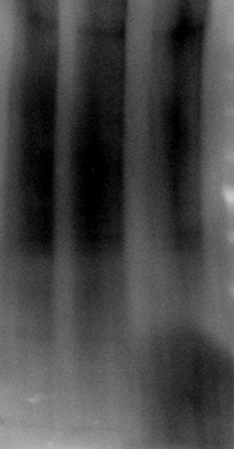
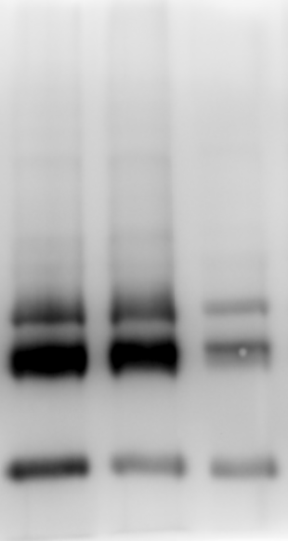
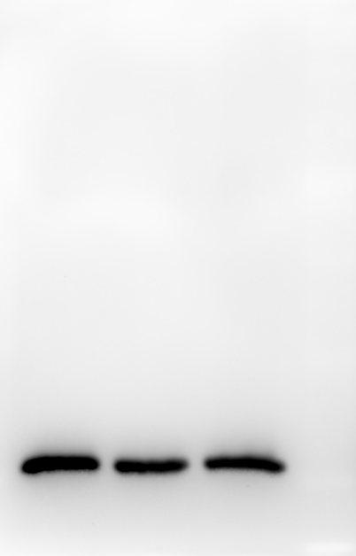

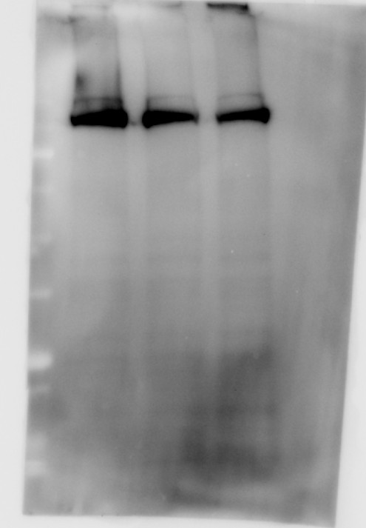
Full unedited gel
Original image with molecular weight marker
Figure 6
B
Flag-MyD88
+
+
+
Flag-MyD88
+
+
+
Xpress-HECTD3
+
+
Xpress-HECTD3
+
+
+
HIS-Ub WT
+
235
HIS-Ub WT
+
-
-
HIS-Ub K27
+
-
-
180
HIS-Ub K27
-
+
-
-
+
-
135
HIS-Ub K27R
-
-
+
HIS-Ub K27R
-
-
+
100
Ni-NTA PD
135
10% input
245
75
100
180
63
WB: Flag
75
WB: HIS
135
48
63
100
35
75
48
63
25
48
WB:
Flag
35
WB: Xpress
235
180
135
100
75
63
48
35
135
180
100
75
63
48
35

Slide 12
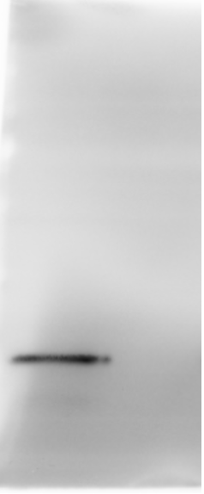
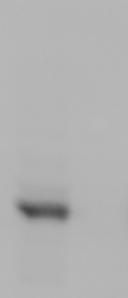
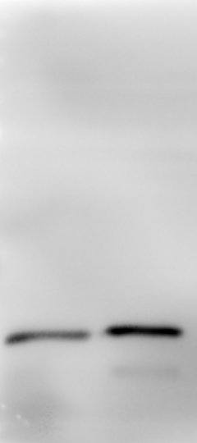

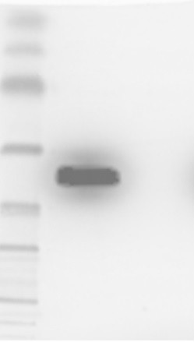
Original image with molecular weight marker
Full unedited gel
Figure 7
235
180
135
100
75
63
A
48
+
-
35
Xpress-HECTD3
Flag-MyD88
+
+
IP: Xpress
WB: Flag
35
235
180
WB: Xpress
100
135
10% input
100
WB: Flag
35
75
63
WB: Xpress
100
48
35
235
180
135
100
75
63
48
35
235
180
135
100
75
63
48
35

Slide 13
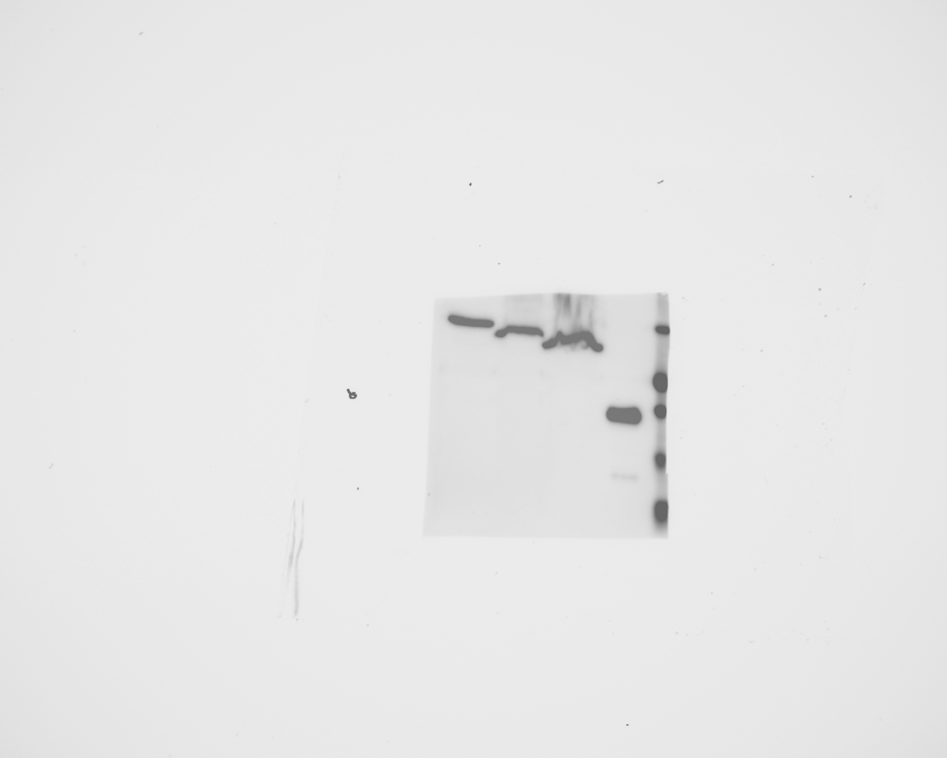
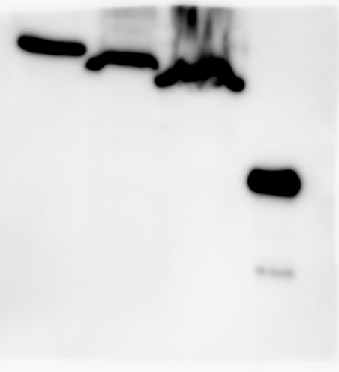
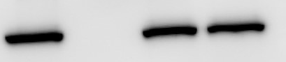
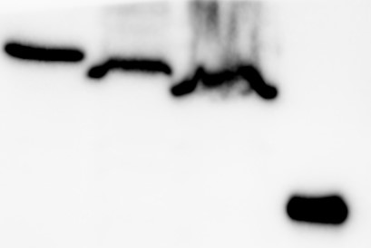
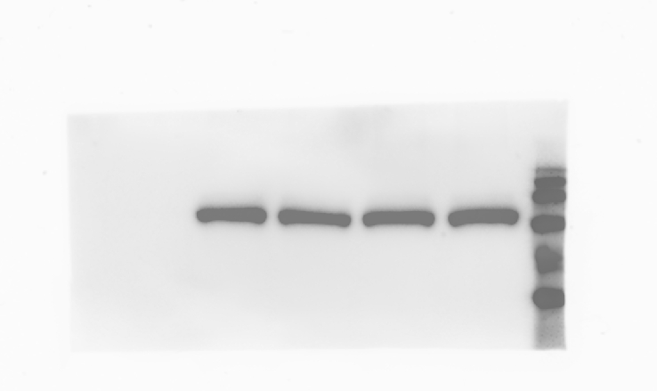
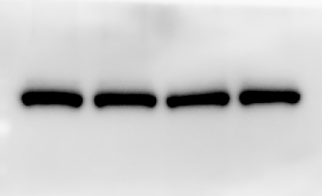
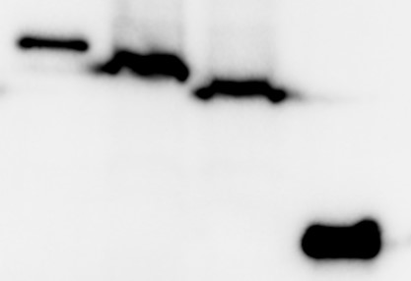
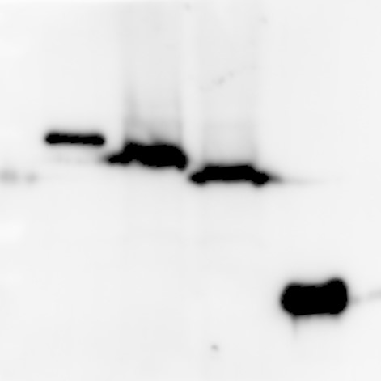
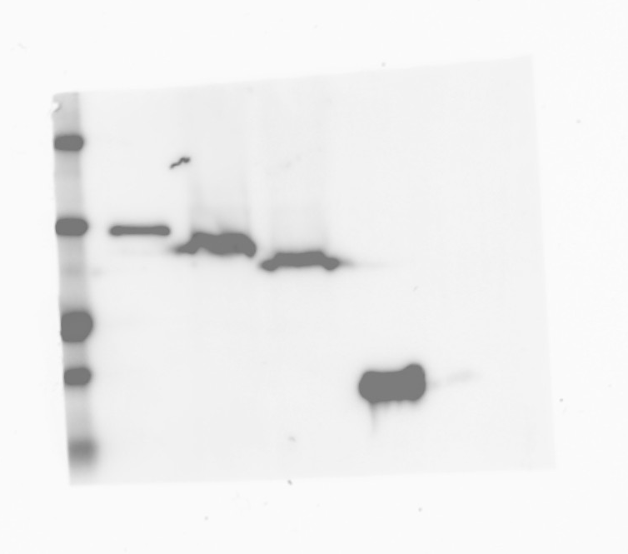
Original image with molecular weight marker
Full unedited gel
Figure 7
235
180
135
100
75
63
48
35
C
Flag-MyD88
+
-
-
-
Flag-MyD88 ΔDD
-
+
-
-
35
-
-
+
-
Flag-MyD88 ΔID
-
25
-
-
Flag-MyD88 ΔTIR
+
20
Xpress-HECTD3
+
+
+
+
130
17
IP: Flag
WB: Xpress
100
10
WB:
Flag
35
25
235
135
10% input
WB:
Xpress
130
180
100
100
75
WB:
Flag
35
63
25
20
35
25
20
17
10

Slide 14
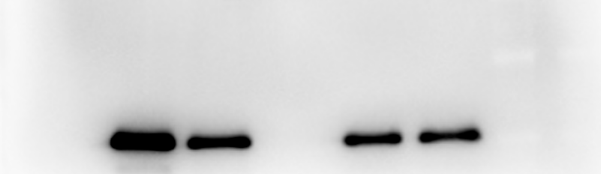
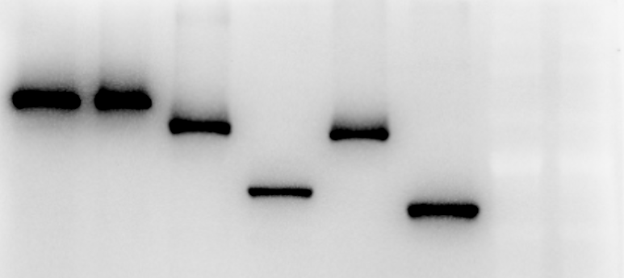
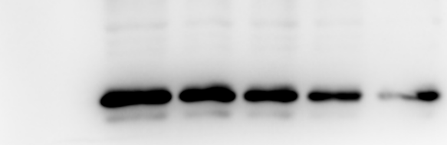
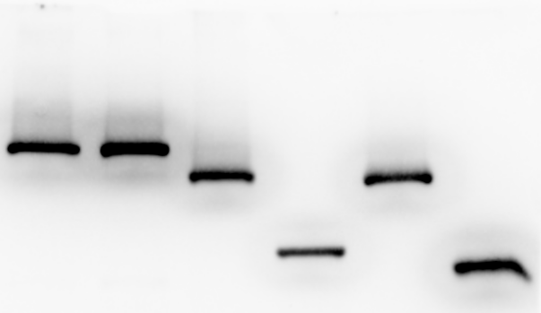
Original image with molecular weight marker
Full unedited gel
Figure 7
D
Xpress-HECTD3
+
-
-
-
-
235
Xpress-HECTD3 ΔN
-
+
-
-
-
180
135
Xpress-HECTD3 ΔDOC
-
-
100
-
-
+
75
-
-
-
+
-
Xpress-HECTD3 ΔLD
+
63
-
-
-
-
Xpress-HECTD3 ΔHECT
35
Flag-MyD88
+
+
+
+
+
25
IP: Xpress
WB: Flag
35
100
235
WB: Xpress
135
180
100
75
75
63
63
10% input
WB: Flag
35
235
180
100
135
WB: Xpress
100
75
75
63
48
63
35
235
180
135
100
75
63
48

Slide 15
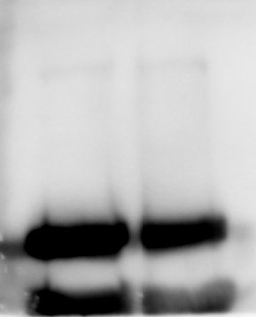




Original image with molecular weight marker
235
180
Full unedited gel
135
100
Figure 8
75
63
48
B
IP: MyD88
35
KO
WT
WB:IRAK4
63
25
48
WB: MyD88
35
10% input
63
235
WB: IRAK4
180
48
135
WB: MyD88
35
100
75
63
48
35
25

Slide 16







Original image with molecular weight marker
Full unedited gel
Figure 8
235
180
135
100
75
C
63
48
KO
WT
LPS
LPS
untreated
untreated
235
63
180
135
p-IRAK4
48
100
IRAK4
48
75
GAPDH
35
63
48
35
25
235
180
135
100
75
63
48
35
25

Slide 17






Original image with molecular weight marker
Full unedited gel
Figure 8
35
E
D
Flag-MyD88
+
+
+
+
+
+
Myc-IRAK4
235
+
+
+
180
TLR4
+
135
CD14
+
+
100
+
+
+
75
MD2
-
-
63
C823A HECTD3
+
+
Xpress-HECTD3
-
-
48
WB: Flag MyD88
35
63
WB: Myc-IRAK4
IP: Myc-IRAK4
48
48
35
Flag-MyD88
10% input
35
Myc-IRAK4
63
48
235
180
135
100
75
63
48

Slide 18

Original image with molecular weight marker
Figure S3
Full unedited gel
A
235
180
135
100
WT
KO
75
HECTD3
100
63
GAPDH
35
48
35
25
20

Slide 19



Full unedited gel
Original image with molecular weight marker
Figure S3
B
Vav
icre WT
Vav
icre KO
235
180
100
135
HECTD3
100
GAPDH
35
75
63
48
35
25
20

Slide 20




Original image with molecular weight marker
Full unedited gel
Figure S3
235
180
C
135
100
75
Cd11c
cre WT
63
Cd11c cre KO
HECTD3
100
GAPDH
35
48
48
35
25
20

Slide 21
Original image with molecular weight marker
Full unedited gel
Figure S6
WT
8
9
10
11
12
13
14
KO splenocytes
170
130
HECTD3
95
72
55
48
GAPDH
35

Slide 22
Original image with molecular weight marker
Full unedited gel
Figure S7
A
A
1
2
3
+
-
+
Flag Myd88
Xpress-HECTD3
-
+
+
235
180
130
100
WB anti-Flag
75
63
48
35
25
B
20
235
180
130
100
75
63
WB anti-Xpress
48
35
25
20

Slide 23





Original image with molecular weight marker
Full unedited gel
Figure S8
235
180
135
100
75
A
63
48
HIS-Ub
+
+
Xpress-HECTD3
+
+
35
Flag-MyD88
+
+
MG132
-
+
Flag-MyD88
35
235
Xpress-HECTD3
180
135
95
100
MCL-1
40
75
63
ꞵ-actin
40
48
WCE
35
63
235
48
180
35
135
100
75
25
63
48
35

Slide 24

Original image with molecular weight marker
Full unedited gel
Figure S7
B
HIS-Ub
+
+
Xpress-HECTD3
+
+
Flag-MyD88
+
+
MG132
-
+
Ni-NTA PD
100
235
75
180
135
WB α Flag
63
100
75
48
63
48
35

