Slide 1
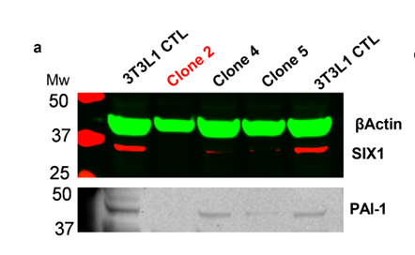
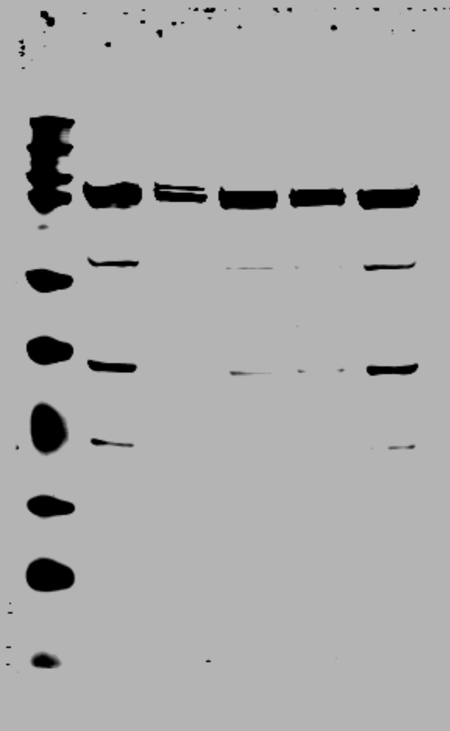
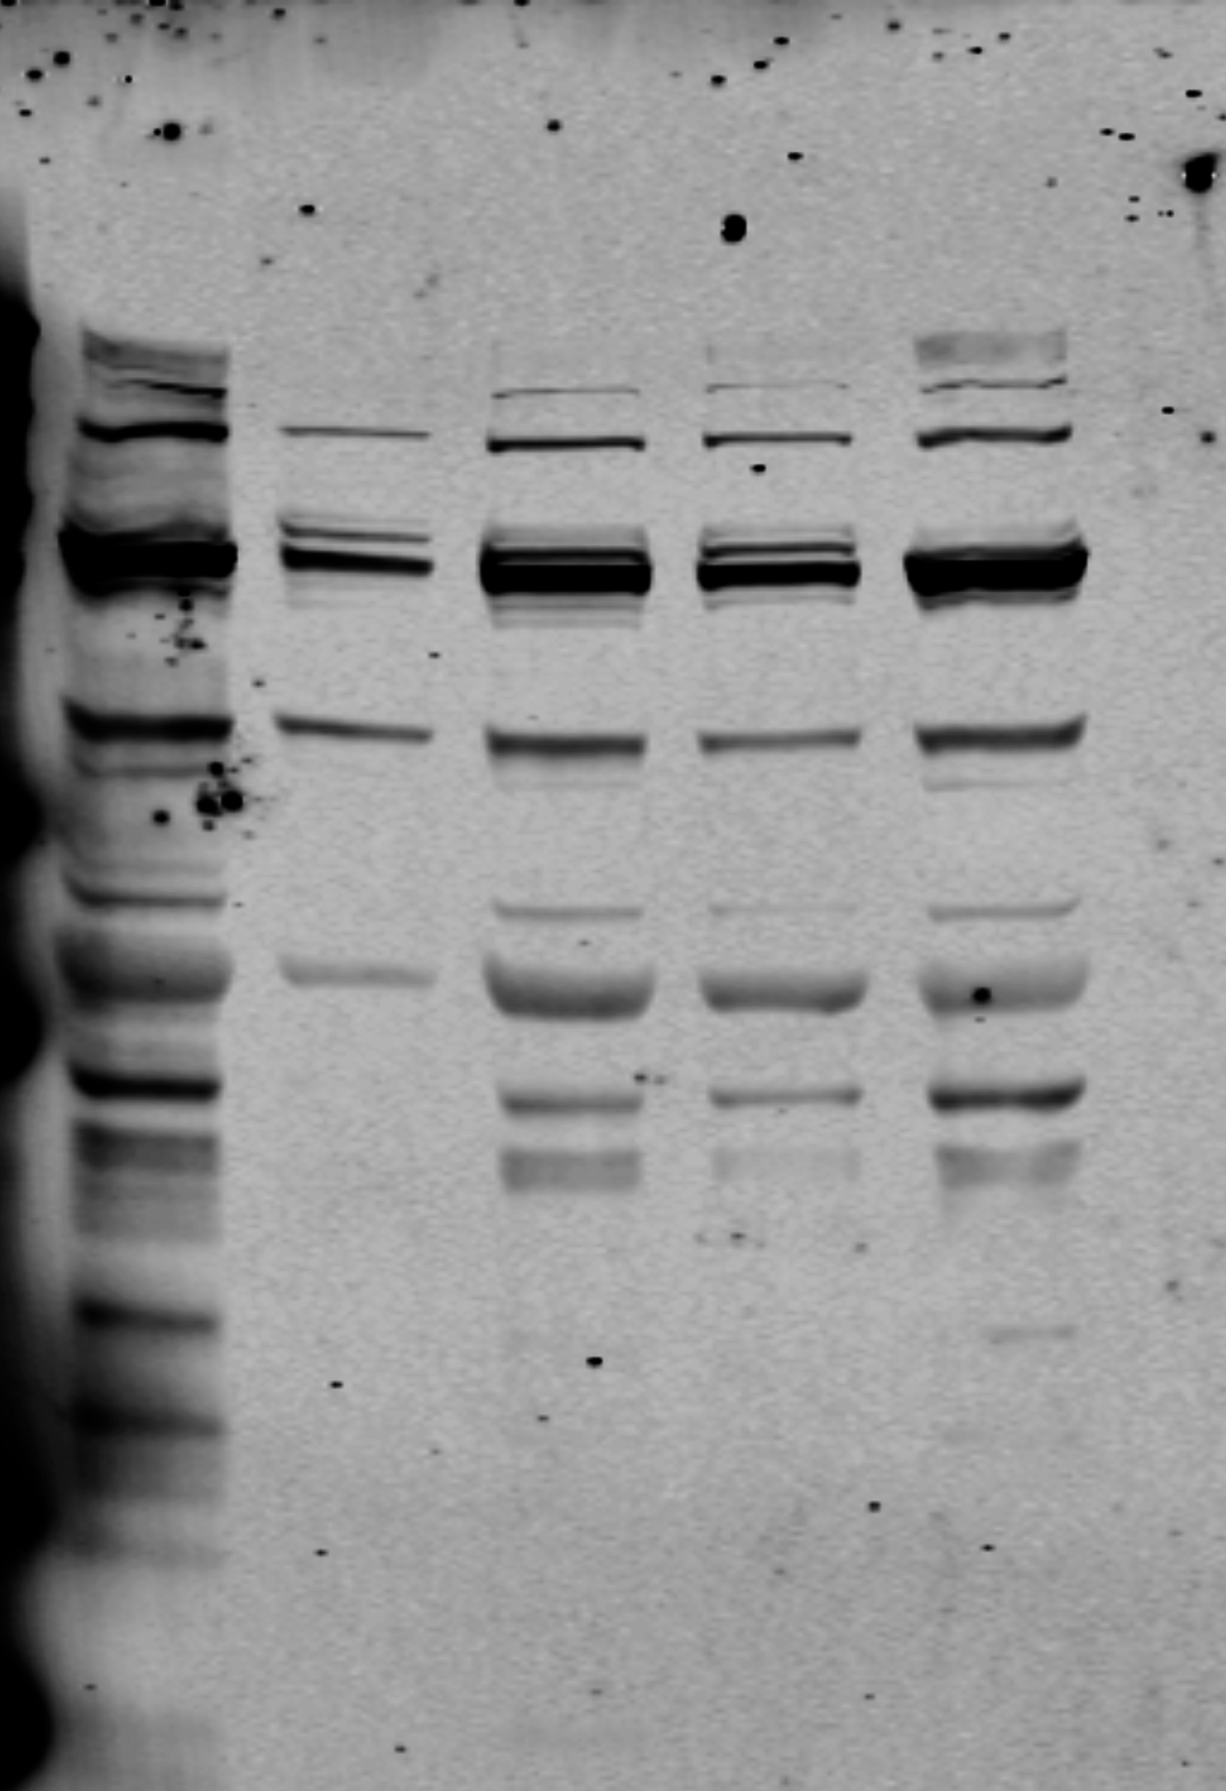
Figure 10 a MANUSCRIPT
Figure 10a FULL BLOTS
Full Gel
Stripped and re-blot with anti-PAI-1
Actin
←Actin
Six1
←Six1
← PAI-1

Slide 2
Figure 10 e MANUSCRIPT
Figure 10e FULL BLOTS
GFP Plasmid
Six1
GAPDH

Slide 3
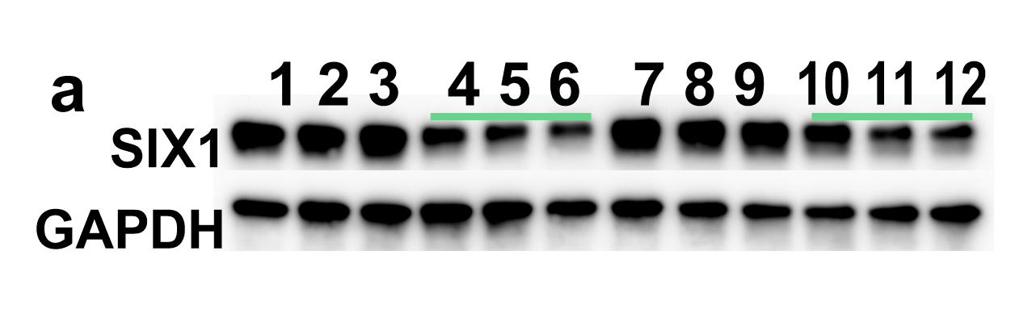
Supplemental Figure 1a FULL BLOTS
Supplemental Figure 1 a MANUSCRIPT
D4 Control siRNA
D6 Control siRNA
D4 Control siRNA
D6 Control siRNA
D4 SIX1 siRNA
D6 SIX1 siRNA
D4 SIX1 siRNA
D6 SIX1 siRNA
SIX1
GAPDH

