Slide 1
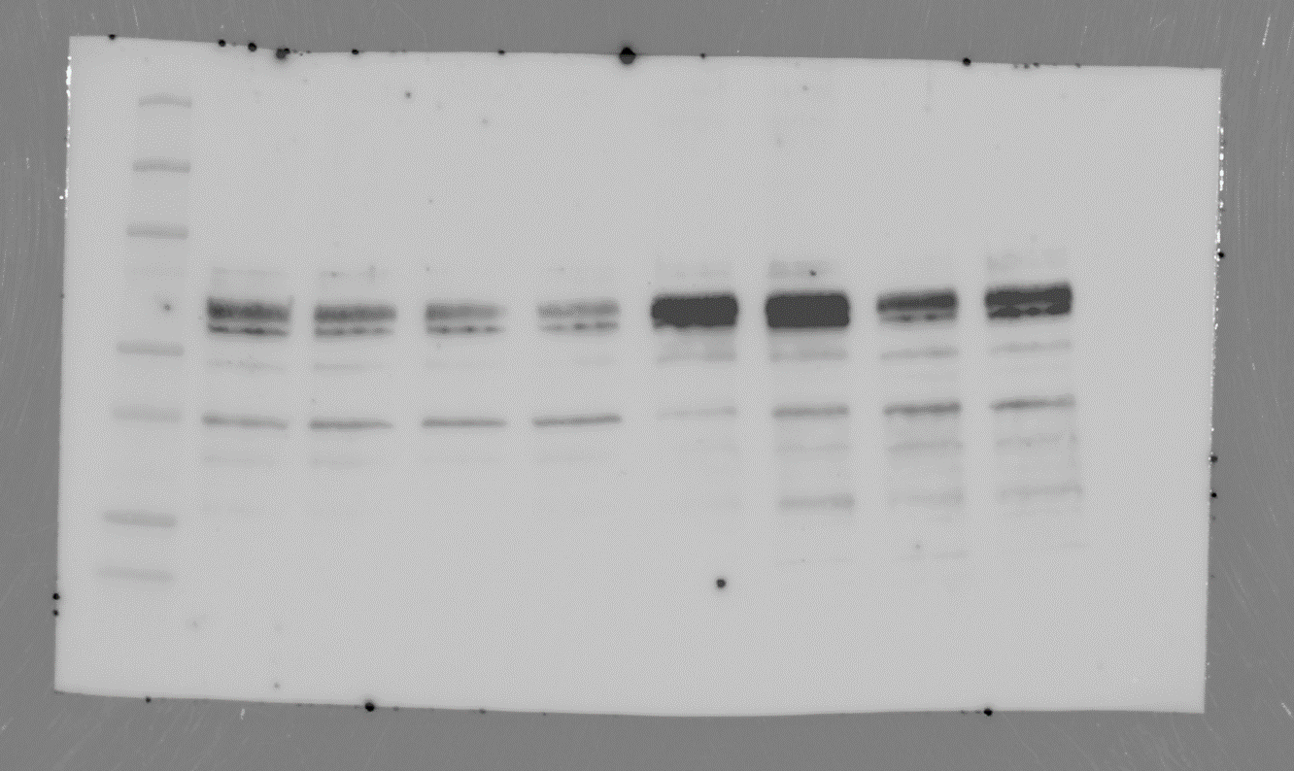
Full unedited gel for Figure 2
4-HNE
(Abcam)

Slide 2
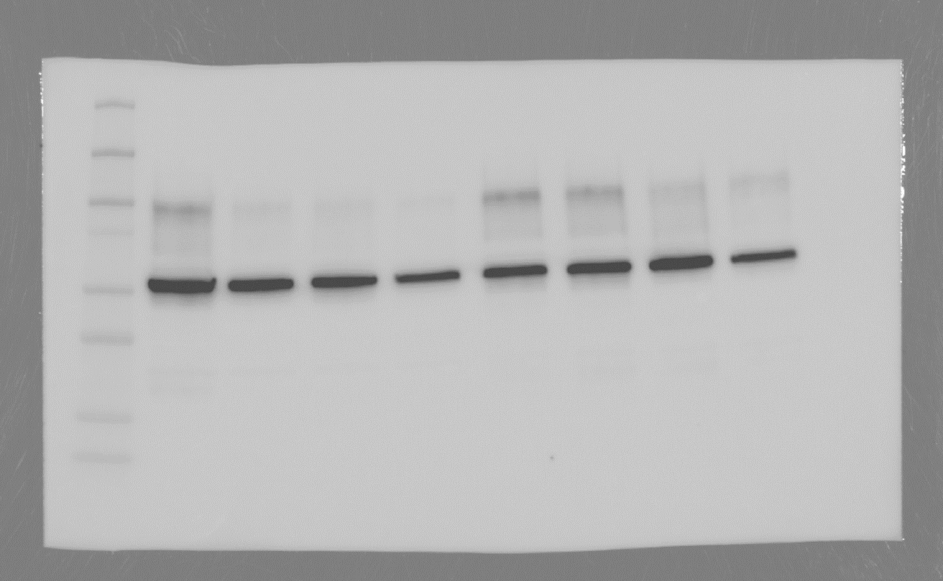
Full unedited gel for Figure 2
β-tubulin
(Sigma-Aldrich)

