Slide 1
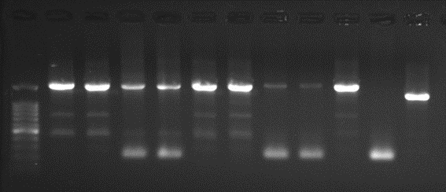
Fig 1B
Fig S1D

