Slide 1
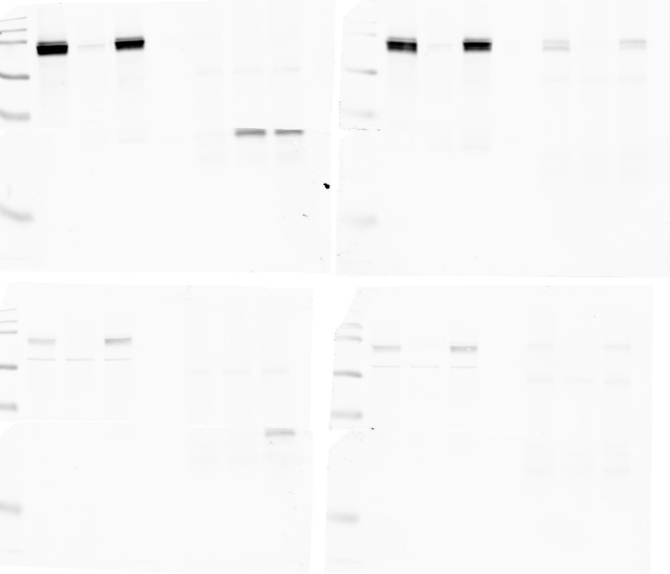
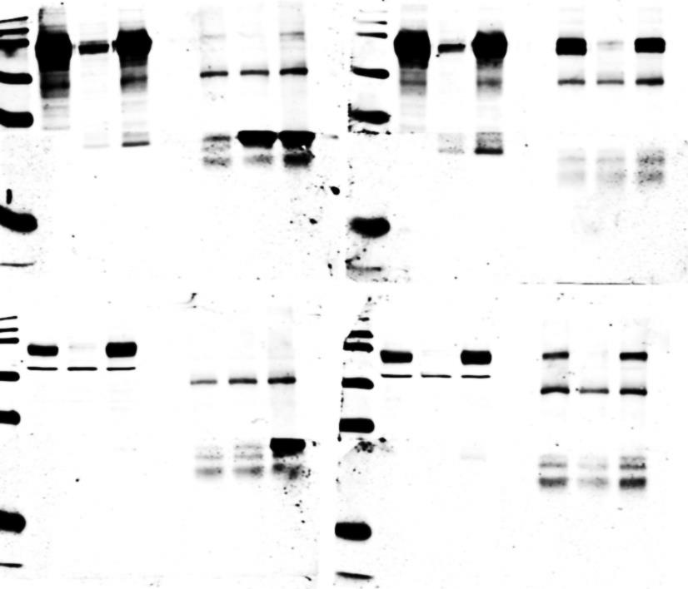
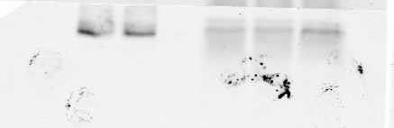
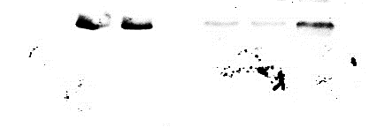
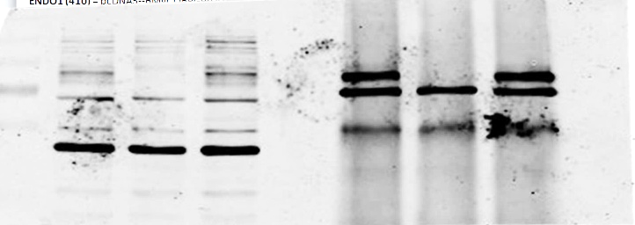
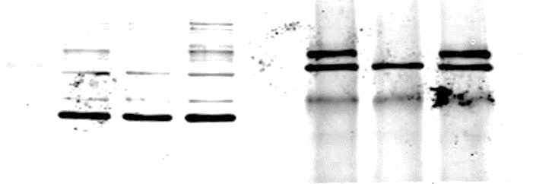
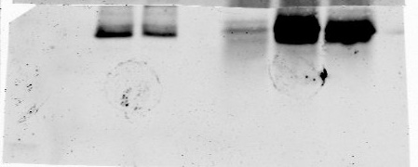
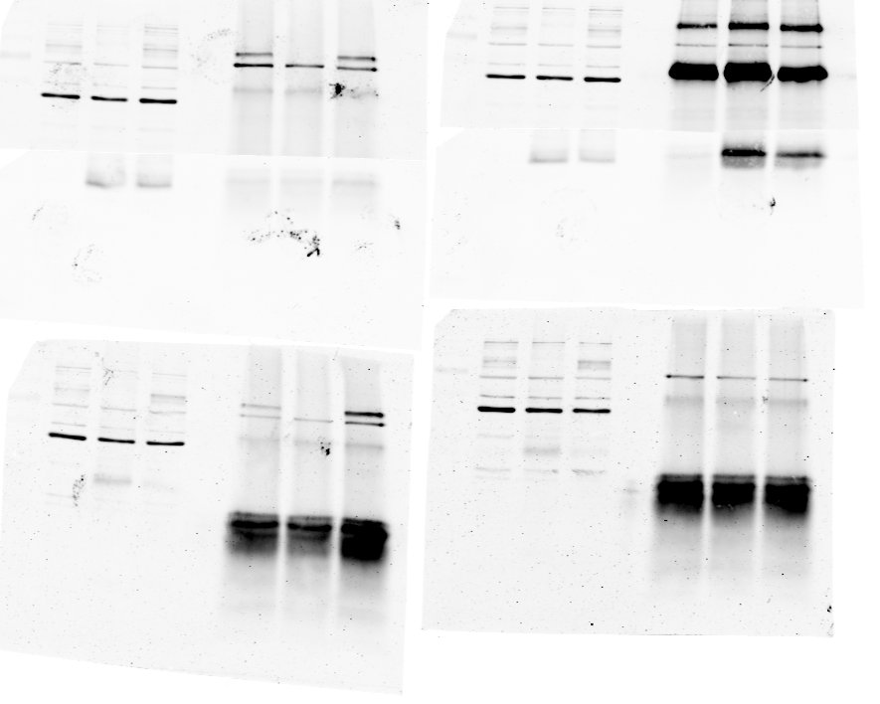
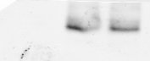
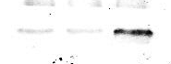
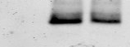
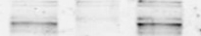
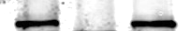
Full unedited gels for Figure 1A
Full unedited gels for Figure 1B
Input
+
-
+
IP: myc
cDNA
CD36 (flag)
-
-
ENDO1 (myc)
+
+
+
+
Input
kDa
-
+
+
IP: flag
+
-
+
-
CD36
100
cDNA
CD36 (flag)
+
+
100
-
-
ENDO1 (myc)
+
+
+
+
myc
CD36
myc
Membrane was cut into 2 parts and blotted against the indicated antibody
Membrane was cut into 2 parts and blotted against the indicated antibody
A
Input
IP: myc
B
-
+
-
+
Input
IP: flag
+
+
cDNA
CD36 (flag)
+
-
+
+
-
+
-
-
cDNA
CD36 (flag)
ENDO1 (myc)
+
+
+
+
-
-
kDa
ENDO1 (myc)
+
+
+
+
Original figure:
100-
Original figure:
kDa
CD36
15-
myc
15-
myc
100-
CD36

Slide 2
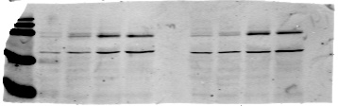
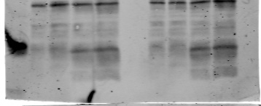
Full unedited gels for Figure 1C
Days of differentiation
Markers
0
4
8
12
kDa
Original figure:
100-
CD36
C
kDa
Endo1
100-
CD36
15-
15-
Endo1
55-
Tubulin
0
4
8
12
55-
Tubulin
Days of differentiation
Membrane was cut into 3 parts and blotted against the indicated antibody

Slide 3
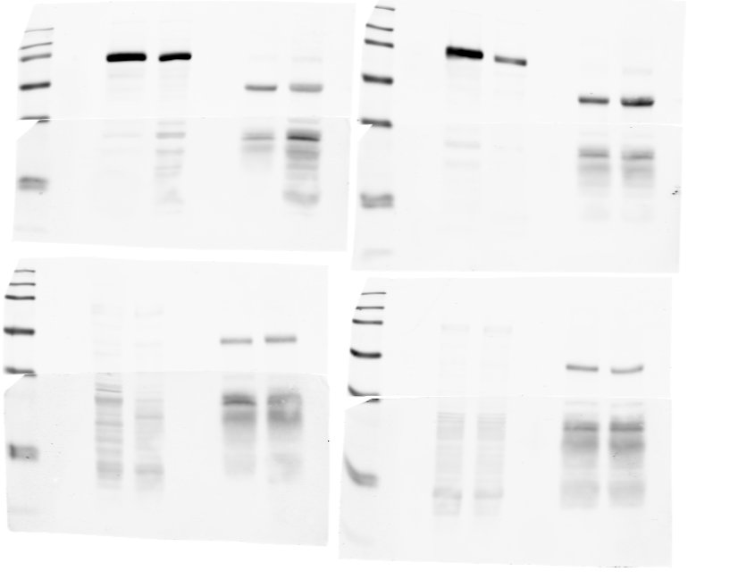
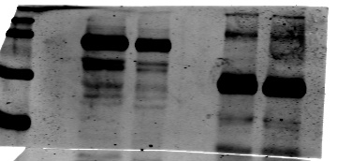
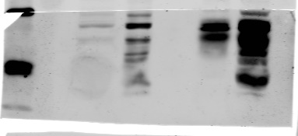
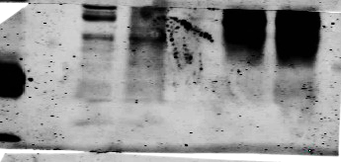
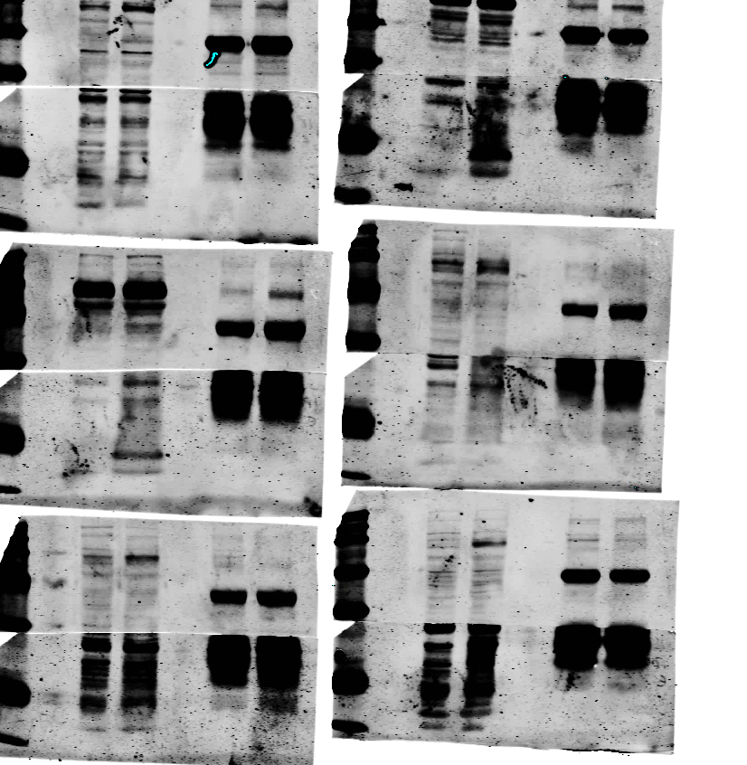
Full unedited gels for Figure 1E
Markers
IP: CD36
Marker
Total lysate
IP: Endo1
kDa
Total lysate
KO
WT
kDa
KO
WT
KO
WT
KO
WT
100
CD36
100
CD36
55
VAT
15
Endo1
15
Endo1
E
kDa
IP: CD36
IP: Endo1
Total lysate
KO
WT
KO
WT
KO
WT
kDa
Original figure:
100-
CD36
VAT
15-
Endo1
Membrane was cut into 2 parts and blotted against the indicated antibody

Slide 4
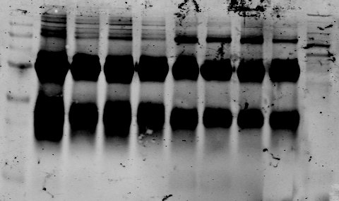
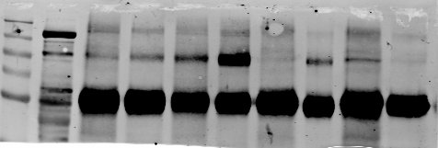
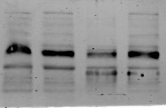
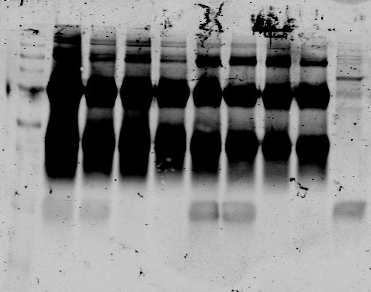
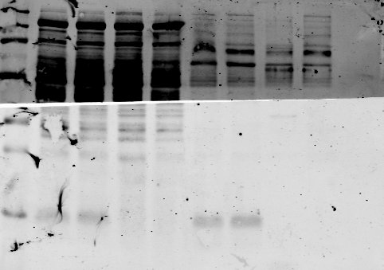
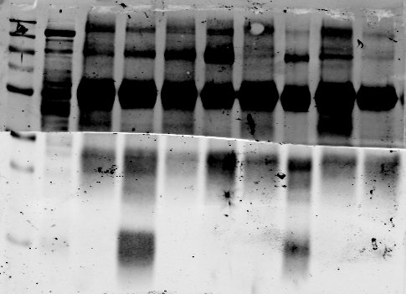
Full unedited gels for Figure 1E
IP CD36
IP Endo1
WT
KO
Total Lysate
WT
KO
WT
KO
100-
CD36
100-
CD36
100-
CD36
IP CD36
Total Lysate
IP Endo1
WT
KO
WT
KO
WT
KO
15-
Endo1
15-
Endo1
15-
Endo1
Original figure:
IP: CD36
IP: Endo1
Total lysate
KO
WT
KO
WT
KO
WT
100-
CD36
GAT
15-
Endo1

Slide 5
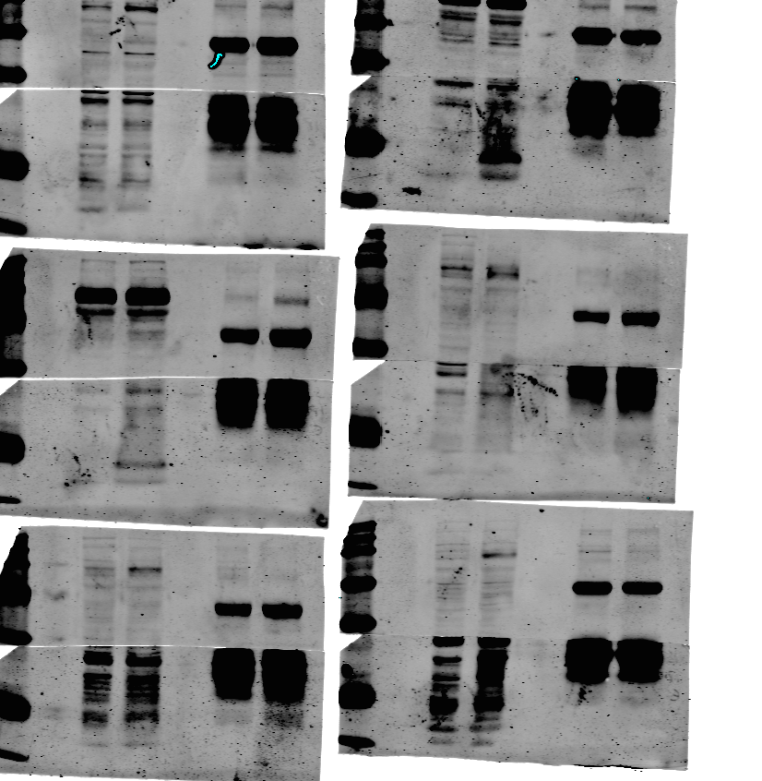
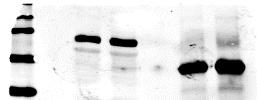
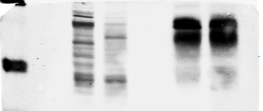
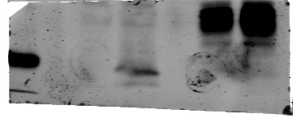
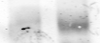
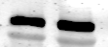
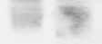
Full unedited gels for Figure 1E
Markers
Total lysate
Marker
Total lysate
IP: Endo1
kDa
KO
WT
IP: CD36
kDa
KO
WT
KO
WT
KO
WT
100-
CD36
CD36
SAT
15-
Endo1
15-
Endo1
10-
10-
Total lysate
kDa
KO
WT
15-
Endo1
10-
IP: CD36
IP: Endo1
Total lysate
100-
KO
WT
KO
WT
KO
WT
Original figure:
SAT
CD36
15-
Endo1
Membrane was cut into 2 parts and blotted against the indicated antibody

Slide 6
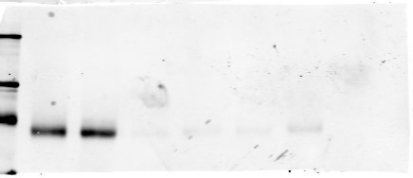
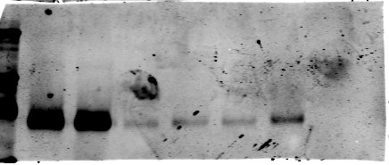


Full unedited gel for Figure 2A
Total
lysate
Washed
fraction
Total
lysate
Washed
fraction
Cell surface
Cell surface
WT
KO
WT
KO
WT
KO
WT
KO
WT
KO
WT
KO
kDa
100-
100
CD36
Mature adipocytes
Total lysate
Cell surface
Original figure:
kDa
WT
KO
WT
KO
100-
CD36

Slide 7
Full unedited gels for Figure 2B
VAT
GAT
SAT
BAT
WT
KO
WT
KO
WT
KO
WT
KO
kDa
100
CD36
55
ß actin
kDa
100-
CD36
Original figure:
55-
Actin
Membrane was cut into 2 parts and blotted against the indicated antibody

Slide 8
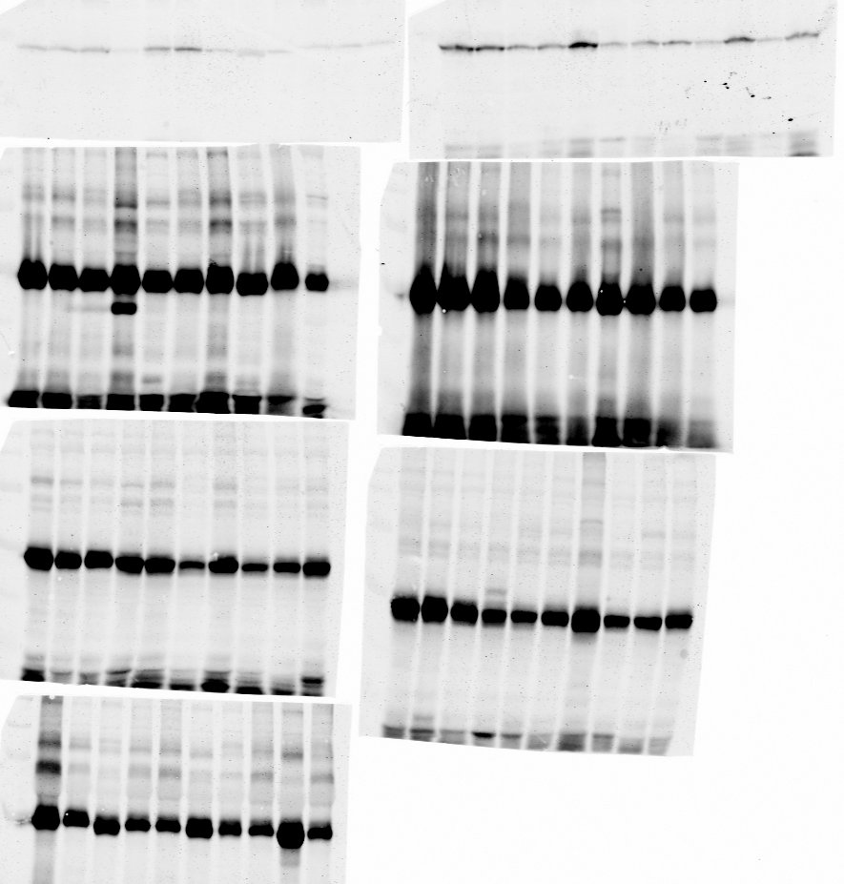
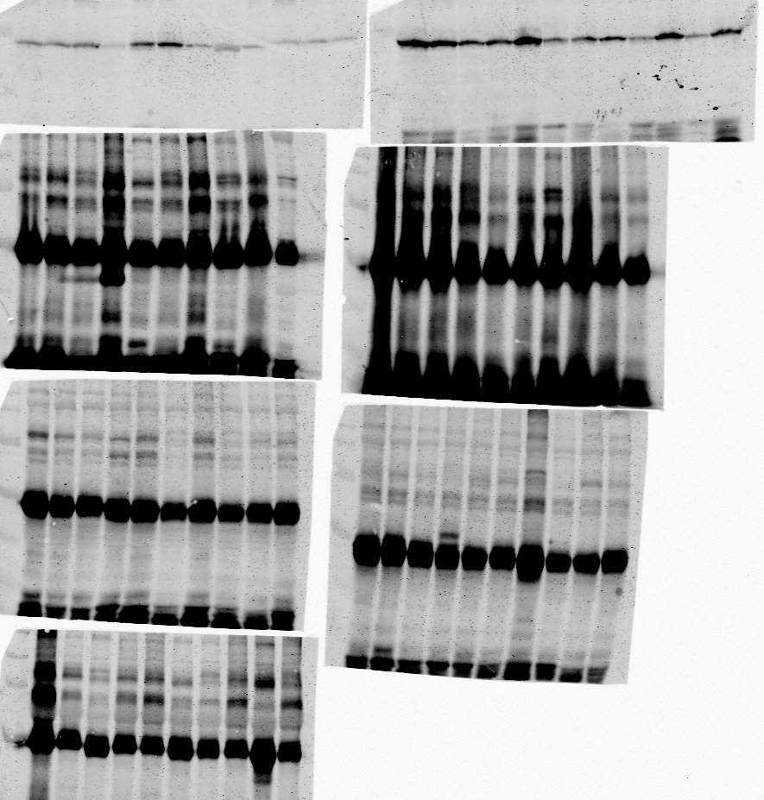
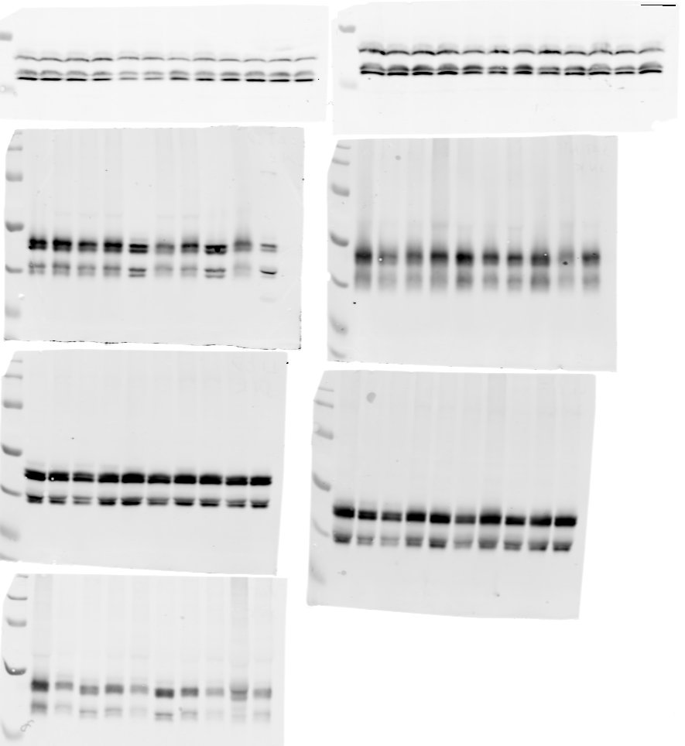

Full unedited gels for Figure 4C
Hypothalamus CD
Hypothalamus HFD
WT
KO
WT
KO
kDa
kDa
55
pJNK1
55
pJNK1
55
JNK1
55
JNK1
kDa
kDa
Original figure:
55-
Original figure:
55-
P-JNK
55-
P-JNK
55-
JNK
JNK

Slide 9
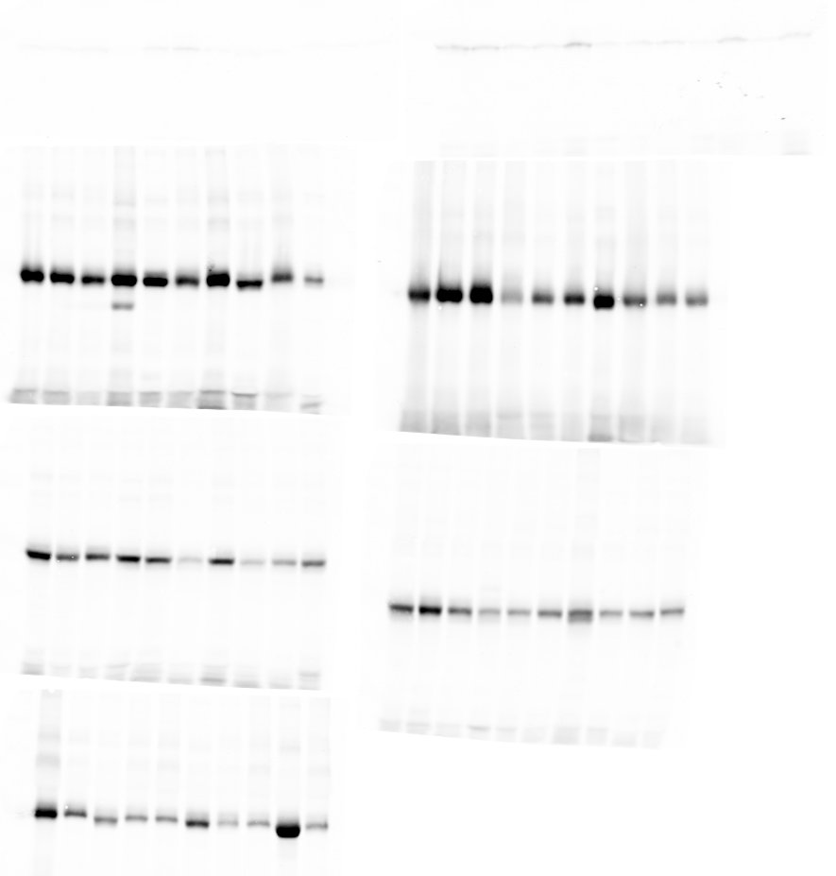
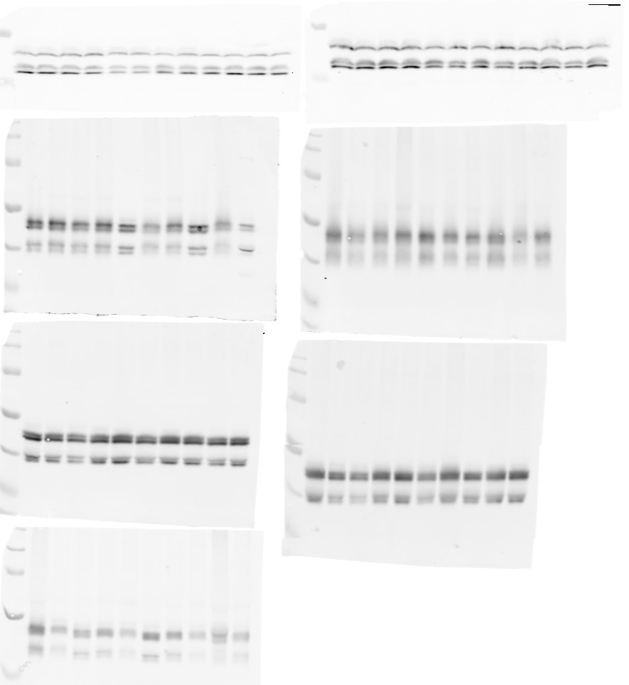
Full unedited gels for Figure 4C
Liver CD
Liver HFD
WT
KO
WT
KO
kDa
kDa
55-
55-
pJNK1
pJNK1
55-
55-
JNK1
JNK1
kDa
kDa
55-
Original figure:
55-
P-JNK
Original figure:
55-
P-JNK
55-
JNK
JNK

Slide 10
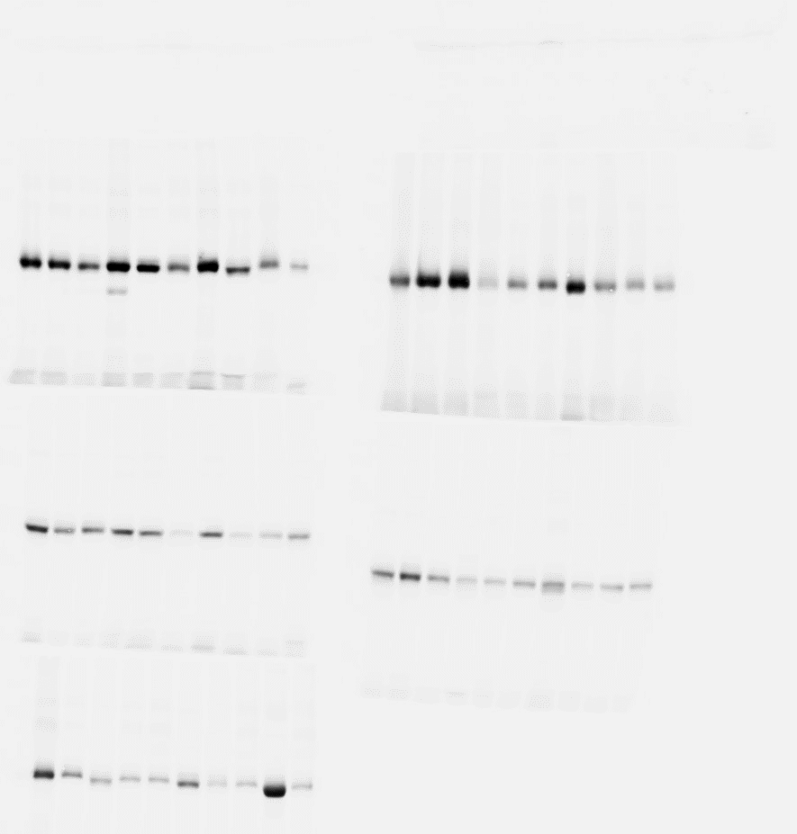
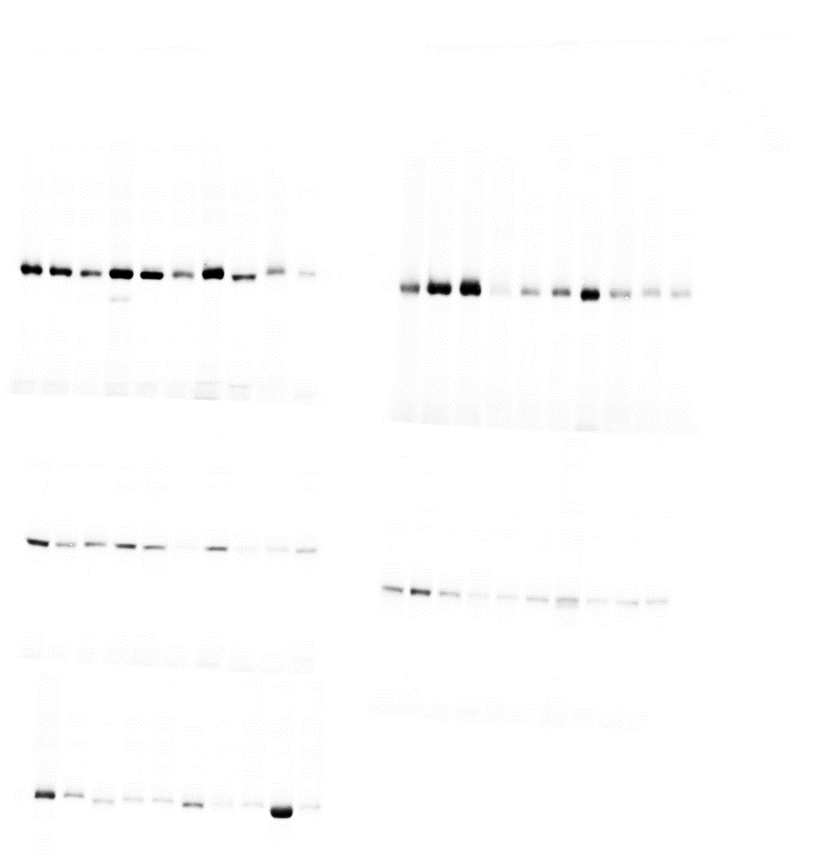
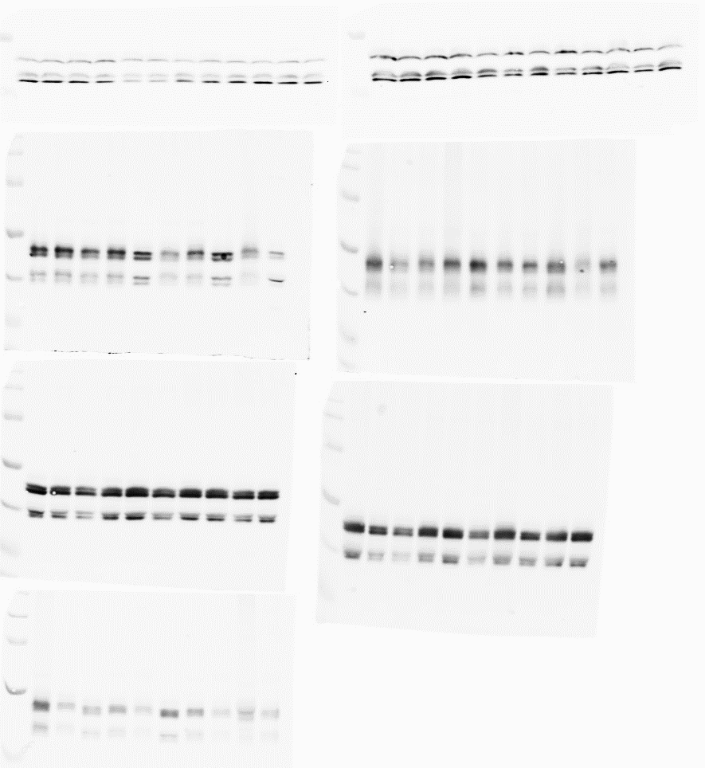
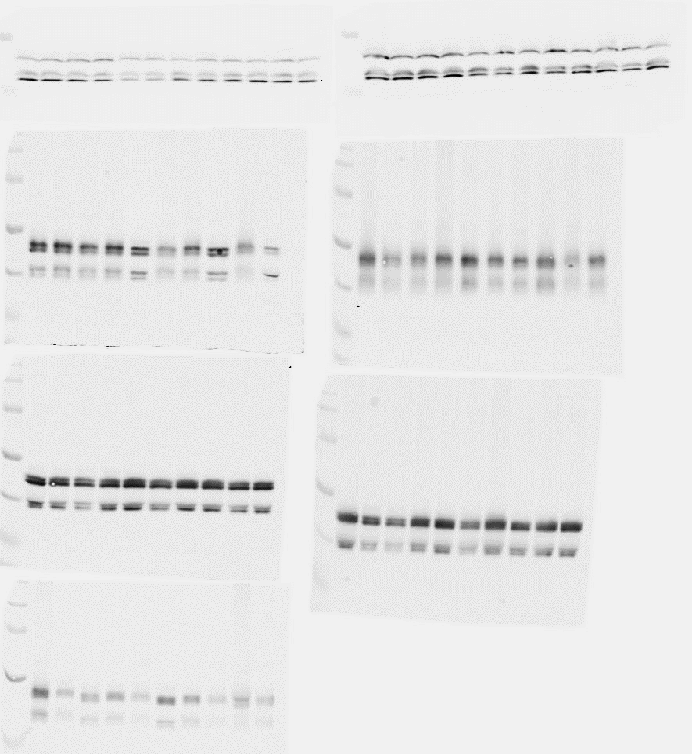
Full unedited gels for Figure 4C
SAT CD
SAT HFD
kDa
WT
KO
kDa
WT
KO
55-
55-
pJNK1
pJNK1
55-
JNK1
55-
JNK1
Original figure:
kDa
Original figure:
kDa
55-
P-JNK
55-
P-JNK
55-
JNK
55-
JNK

Slide 11
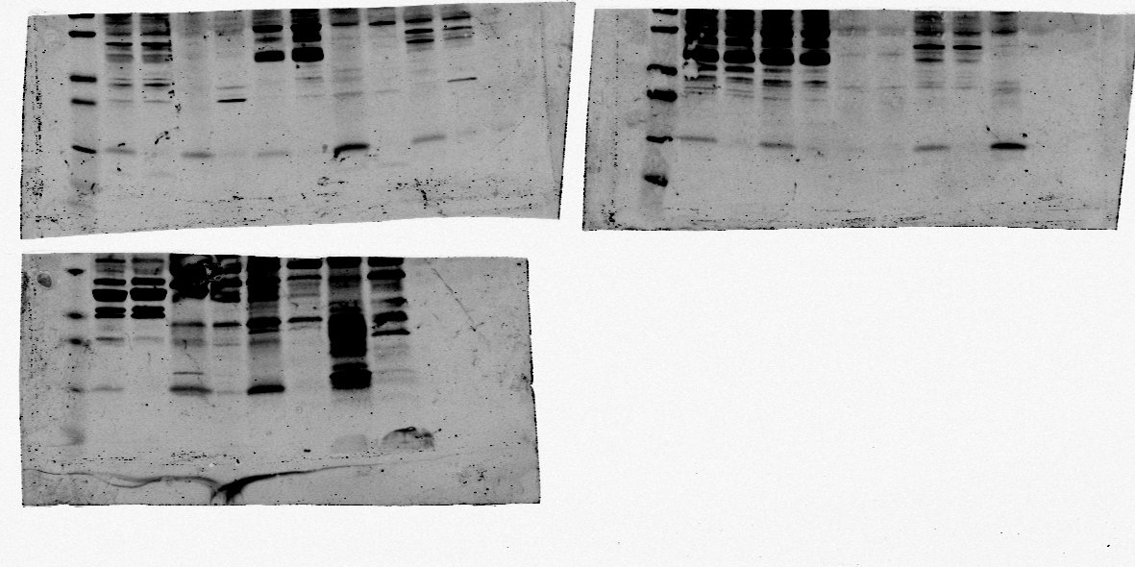
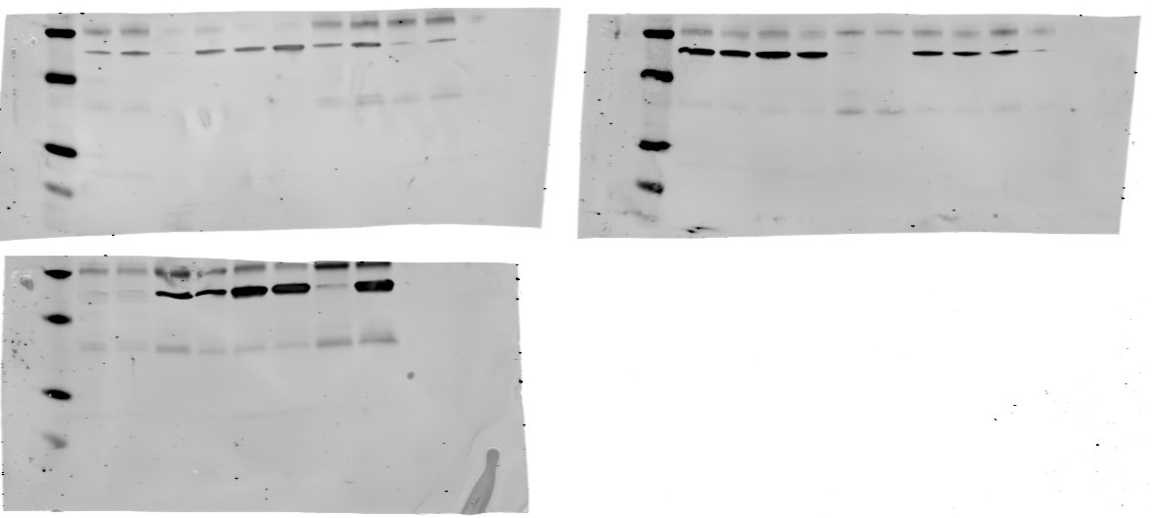
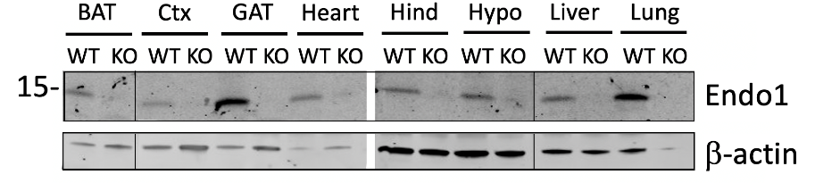
Full unedited gels for Supplemental FIGURE 1C
BAT
Ctx
GAT
Heart
Hind
Hypo
Liver
Lung
markers
WT KO
WT KO
WT KO
WT KO
markers
WT KO
WT KO
WT KO
WT KO
kDa
kDa
15
Endo1
15
Endo1
55
β-actin
55
β-actin
Original figure:

Slide 12
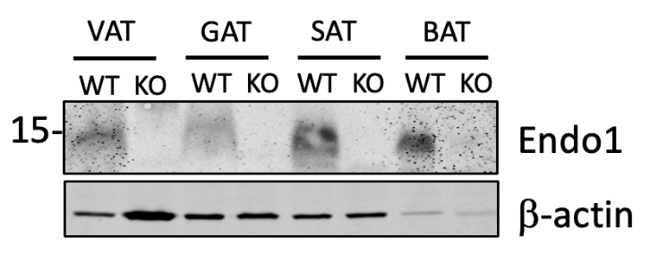
Full unedited gels for Supplemental FIGURE 1C
VAT
GAT
SAT
BAT
kDa
WT KO
WT KO
WT KO
WT KO
15
Endo1
55
β-actin
Original figure:
Membrane was cut into 2 parts and blotted against the indicated antibody

Slide 13
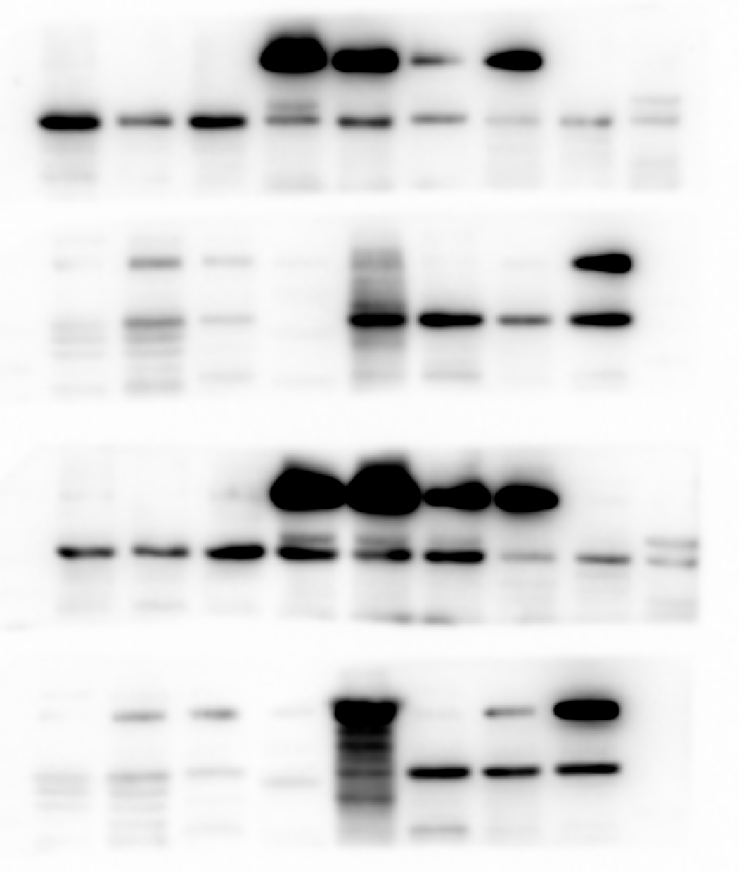
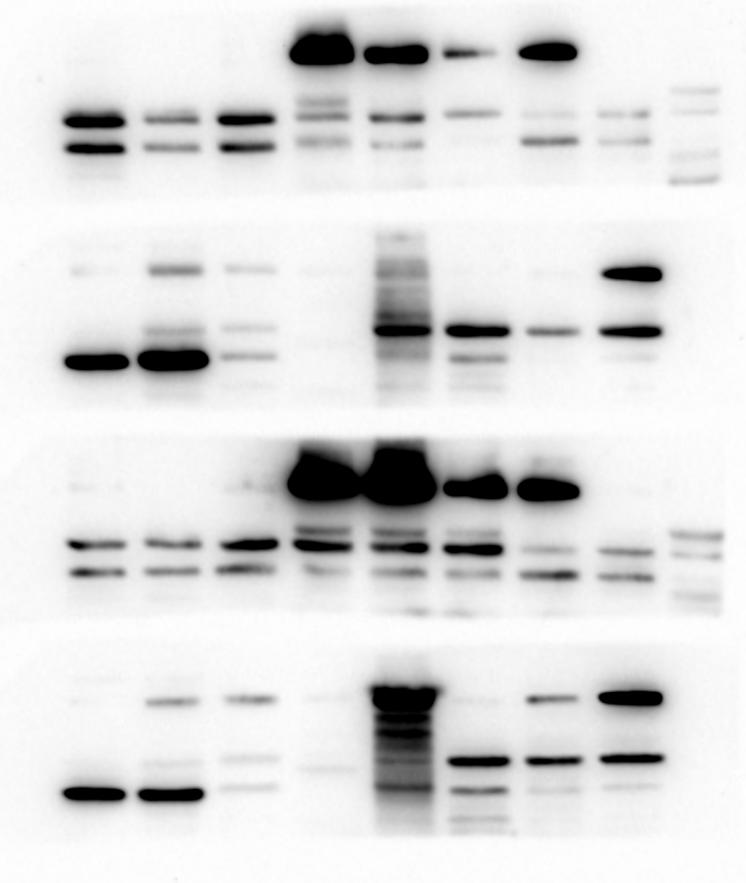
Full unedited gels for Supplemental FIGURE 1D
kDa
Hypo
Hind
Ctx
SAT
GAT
VAT
BAT
Liver
Pan
kDa
Gas
Sol
Kidn
Lung
100-
CD36
100-
CD36
15-
Endo1
15-
Endo1
β-actin
35-
β-actin
35-
35-
GADPH
35-
GADPH
Original figure:
kDa
Hypo
Hind
Ctx
SAT
GAT
VAT
BAT
Liver
Pan
Gas
Sol
Kidn
Lung
100-
CD36
15-
Endo1
35-
β-actin
Membranes were cut into 2 parts and blotted against the indicated antibody.
β-actin and GAPDH images were obtained after re-blotting the membranes
35-
GADPH

Slide 14
Supplemental FIGURE 5
WT
KO
kDa
0
4
8
12
0
4
8
12
Leptin
15
55
Tubulin
kDa
WT
KO
15
Leptin
Original figure:
55
Tubulin
0
4
8
12
0
4
8
12
Days of differentiation
Membrane was cut into 2 parts and blotted against the indicated antibody

Slide 15



Full unedited gels for Supplemental FIGURE 6
B
KO
Total Lysate
IP CD36
kDa
WT
A
KO
WT
KO
WT
100
← CD36
100-
← CD36
LIVER
IP Endo1
15
← Endo1
15-
← Endo1
Total Lysate
15
← Endo1
Original figure:
Original figure:
WT
KO
A
B
100-
← CD36
KO
WT
100-
LIVER
15-
← Endo1
IP Endo1
← CD36
15-
← Endo1
IP CD36
LIVER
15-
← Endo1
Total Lysate
15-
← Endo1
Total Lysate
Membrane was cut into 2 parts and
blotted against the indicated antibody

Slide 16


Full unedited gels for Supplemental FIGURE 7
HFD
WT
KO
kDa
100
P-STAT3
100
STAT3
kDa
P-STAT3
90
Original figure:
STAT3
90
Membrane was cut into 2 parts and blotted against the indicated antibody

Slide 17


Full unedited gels for Supplemental FIGURE 9D
50 nM
insulin
WT
Endo1 KO
kDa
0
15’
30’
0
15’
30’
P-AKT1
35-
35-
AKT1
50 nM
insulin
WT
Endo1 KO
Original figure:
kDa
0
15’
30’
0
15’
30’
35-
P-AKT1
35-
AKT1

Slide 18

Full unedited gels for Supplemental FIGURE 9E
WT KO
WT KO
WT KO
WT KO
kDa
P-AKT1
35-
AKT1
35-
Original figure:
kDa
WT KO
WT KO
WT KO
WT KO
35-
P-AKT1
35-
AKT1
Membrane was re-blotted for total AKT1

