Slide 1
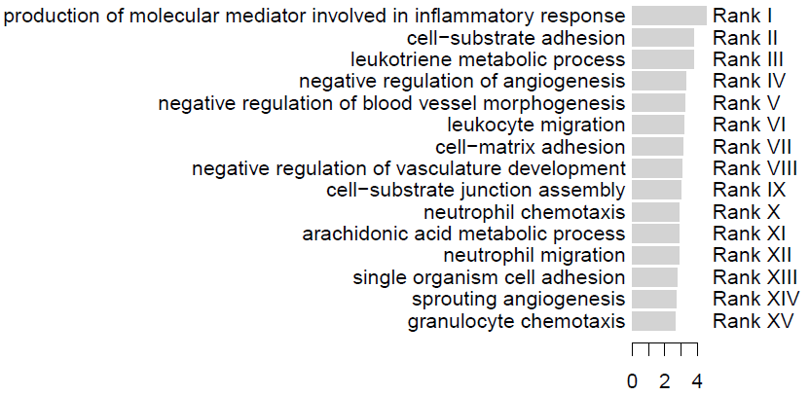
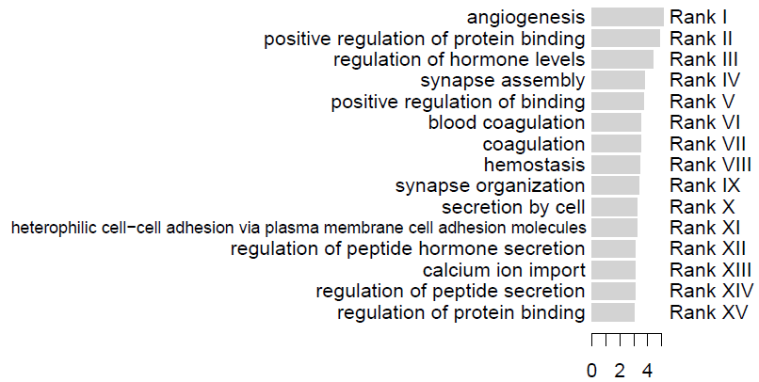
A
Upregulated SCPs in MFS mice
-log₁₀(p)
B
Upregulated SCPs in MFS patients
-log₁₀(p)
Supplementary Figure 1

Slide 2
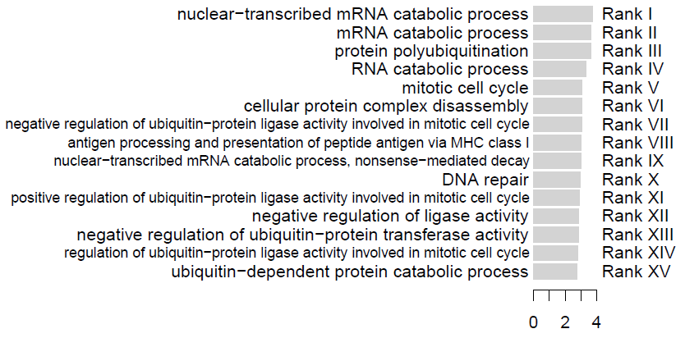
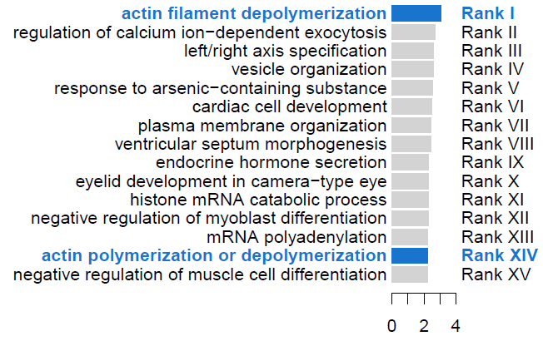
A
Downregulated SCPs after baclofen treatment
in CMap database – baclofen (experiment # 2036)
-log₁₀(p)
B
Downregulated SCPs after baclofen treatment
in CMap database – baclofen (all experiments combined)
-log₁₀(p)
Supplementary Figure 2

Slide 3
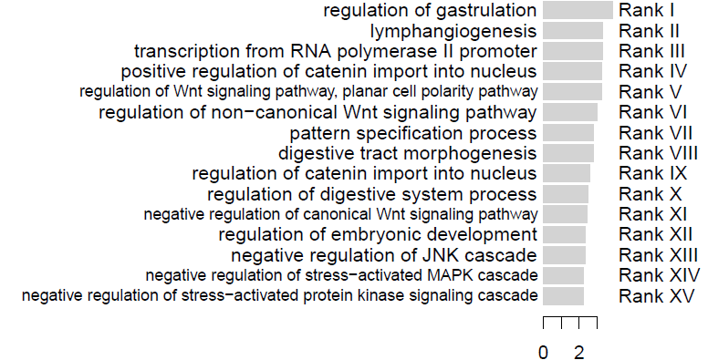
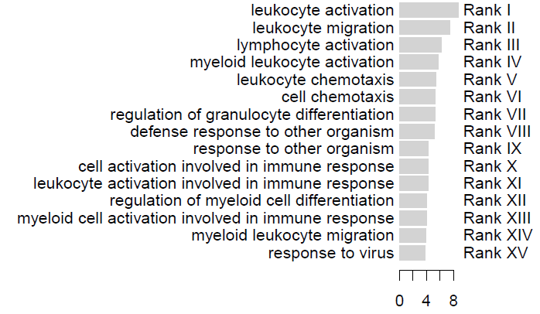
A
Downregulated SCPs in WT mice +/- BAC
B
-log₁₀(p)
Downregulated SCPs in MFS mice +/- BAC
-log₁₀(p)
Supplementary Figure 3

Slide 4
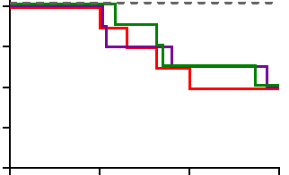
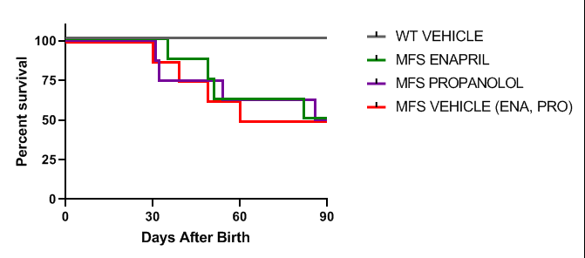
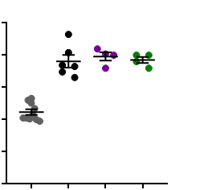
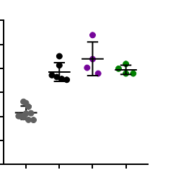
A
100
WT VEH
75
ns
MFS ENA
MFS PRO
50
MFS VEH
Percent Survival
25
0
0
30
60
90
Days After Birth
B
0.25
0.30
0.20
0.25
0.15
0.20
AoR Diameter (cm)
AsA Diameter (cm)
0.10
0.15
0.10
0.05
0.05
0.00
0.00
WT
MFS
MFS
MFS
WT
MFS
MFS
MFS
VEH
VEH
PRO
ENA
VEH
VEH
PRO
ENA
Supplementary Fig. 4

Slide 5
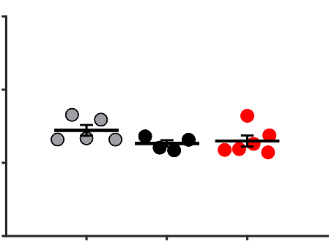
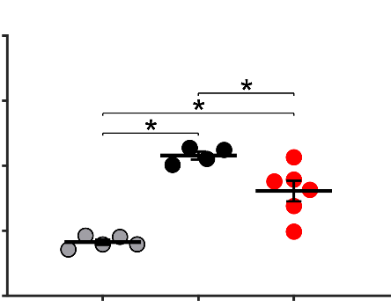
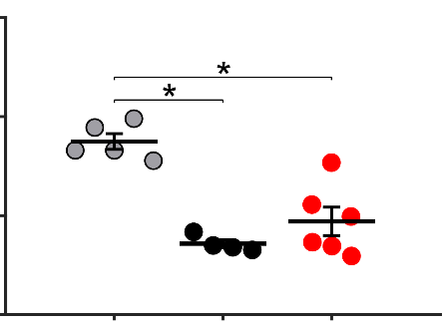
A
B
C
600
8
150
400
6
100
Circumferential Stress (kPa)
Circumferential Stiffness (MPa)
4
Stored Elastic Energy (kPa)
200
2
50
0
WT
MFS
MFS
0
WT
MFS
MFS
0
WT
MFS
MFS
VEH
VEH
BAC
VEH
VEH
BAC
VEH
VEH
BAC
Supplementary Fig. 5

